Slide 1
Touchless Matching Discovery
Insights Pro

Slide 2
Touchless Match Discovery
Touchless Matching Summary
Summary of the goals:
  This dashboard provides a comprehensive analysis of the Accounts Payable matching performance.
  It details how many invoices were associated, were matched in a single pass or fully Touchless matched.
  It provides the user with a comprehensive overview on all of the exceptions that would stop touchless matching, which gives valuable insight into how to make your matching process more touchless.
  It can track the evolution of these exceptions per supplier, organization or invoice origin.
  Unlike essential dashboards, this professional tool also allows you to look at touchless coding, discovering which coding methods are used, and how manual coding processes can be switched to a more touchless alternative
  The dashboards allow you to look at the exception rate in more detail, as well as look for PO’s and Goods receipts that were created after an invoice have come in.
  Pricing deviation is one of the most prevalent issues, and our new visualisations will allow you to track and analyse them.
  A matching simulation dashboard was added to see what solving specific exceptions would mean for your touchless rate.
A user of this dashboard can come away with a clear strategy for which elements of the matching process to improve, to enhance each outcome. The dashboard also provides visibility into whether the most important outcomes are improving as a result of the implemented improvement actions. Additionally, users can analyze each outcome in depth, examining the relationships between different metrics.

Slide 3
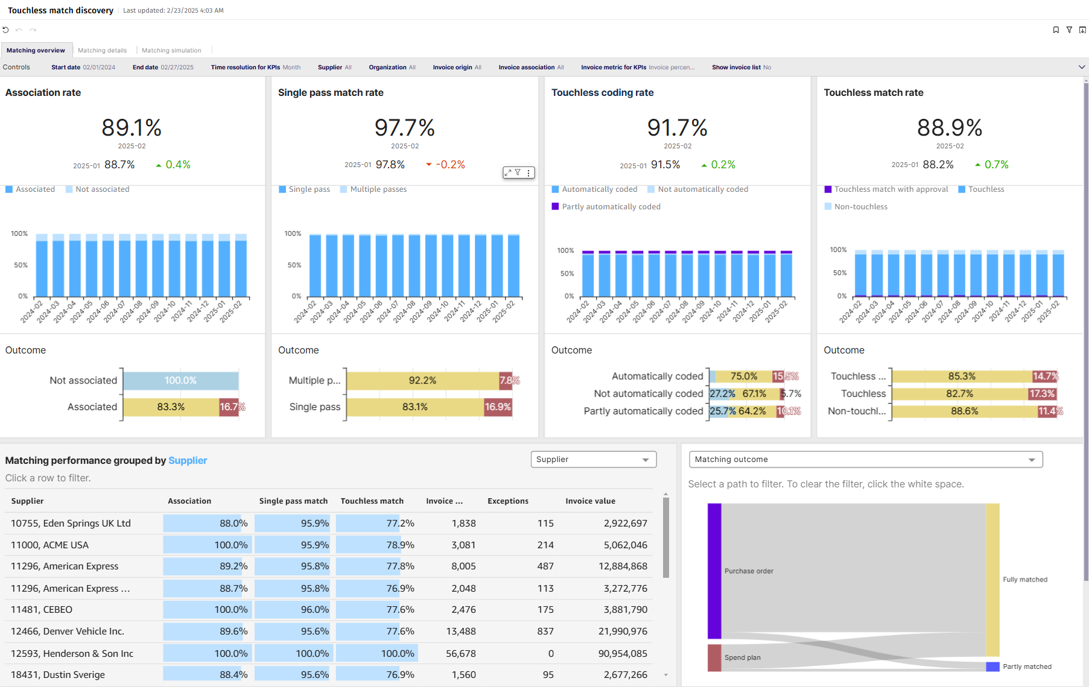
Matching Overview

Slide 4
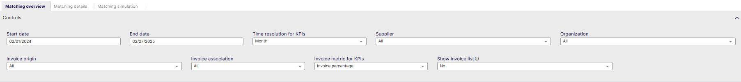
Matching Overview - Controls
Start date: Select the beginning of the time interval. The selected date is included.
End date: Select the end of the time interval. The selected date is included
Time resolution for KPIs: Select how to group data over time. Options include per month, per quarter, or per year.
Supplier: Filter data by suppliers.
Organization: Filter data by your company organizations.
Invoice Origin: Filter data by invoice origin
Invoice Association: Filter data based on whether the invoices are PO, Spend Plan or Non-PO invoices
Invoice metric for KPI’s: Filter invoice data on percentage or count
Show Invoice List: Select whether to show a table containing all the invoices

Slide 5
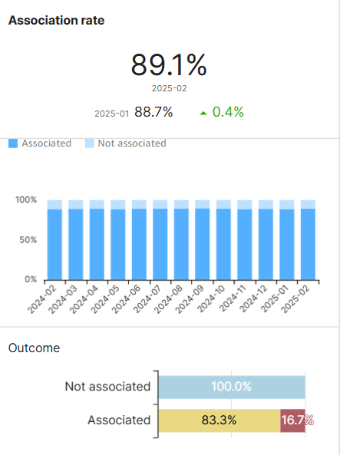
Matching Overview - Association
Association Rate
Shows the percentage of invoices associated with purchase orders or spend plans
  If line level matching is used, please note that an invoice is considered associated as soon as 1 line could be associated with a PO or Spend Plan
You can see the association rate for the selected time period, as well as the previous period, and what the delta was between them
On the bottom the Association rate is displayed over time
The outcome chart on the bottom shows the difference between not associated invoices and Invoices associated with PO (yellow) or Spend plan (red)

Slide 6
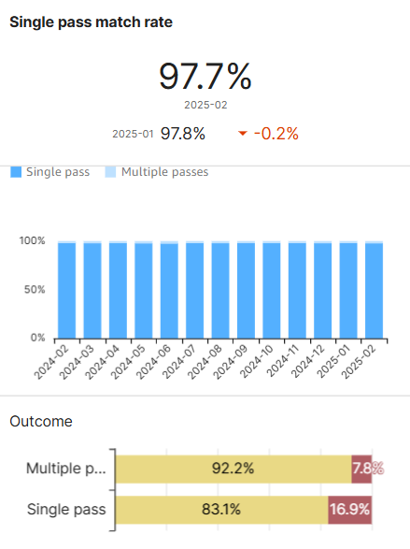
Matching Overview – Single Pass
Single pass match rate
Shows the percentage of matched invoices that were matched the first time right, without having the matching flow to be restarted for them.
You can see the single pass match rate for the selected time period, as well as the previous period, and what the delta was between them
On the bottom the single pass match rate is displayed over time depending on the selected period
The outcome chart on the bottom shows the difference between multiple or single pass, while Invoices are associated with PO (yellow) or Spend plan (red)

Slide 7
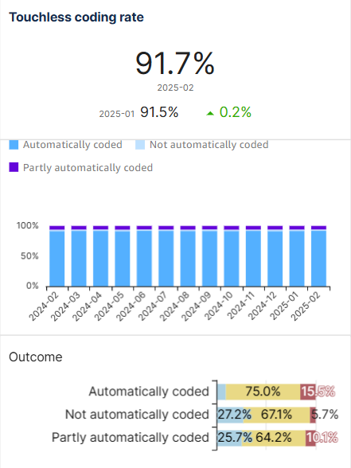
Matching Overview – Touchless Coding
Touchless coding rate
This visualisation shows the amount of invoices that were touchless coded in the selected time period
It also provides the previous period metric and delta.
Below the touchless coding rate percentage you can see the different ways of coding over time. You will see a color coded difference between invoices that were coded differently
The outcome bars show the association with PO/SP or whether the invoices were non-PO compared to how they were coded

Slide 8
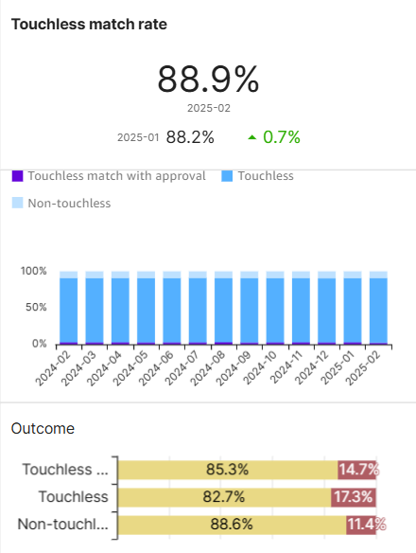
Matching Overview – Touchless Match
Touchless match rate
The Touchless Match Rate is the percentage of invoices matched automatically in a single pass, with no exceptions and with all coding rows generated automatically
This visualisation shows the amount of invoices that were touchless matched in the selected time period
It also provides the previous period metric and delta.
Below the touchless matching rate percentage you can see the different ways of coding over time. You will see a color coded difference between invoices that were coded differently
The outcome bars show the association with PO/SP for the invoices matched, compared to being touchless matched, touchless matched with approval or non touchlessly processed

Slide 9
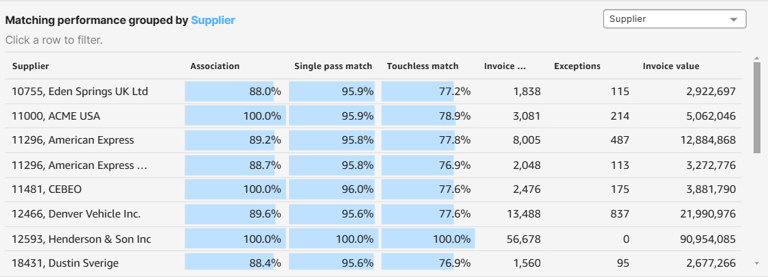
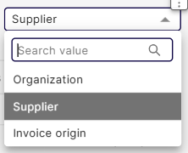
Matching Overview – Performance
Matching performance grouped
Note: This pivot table will be affected by filtering in the above main KPI’s
Select the appropriate grouping via the drop-down in the top right of the table:
  By Organization, Supplier or Invoice Origin
Columns include Association rate, Single Pass match, Touchless match, Invoice count (total number of invoices) and number of matching Exceptions, as well as the invoice value of all invoices in the selected time frame set in the dashboard controls.

Slide 10
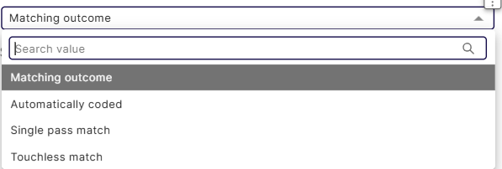
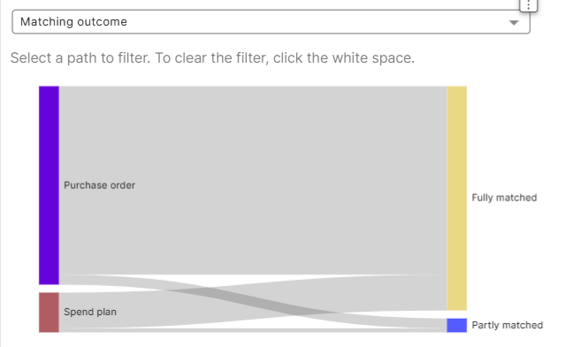
Matching Overview – Outcome
Matching Outcome
Shows the relationship between purchase orders and spend plans and the 5 main matching KPI’s
The dropdown for the Sankey diagram can be individually filtered on matching outcome, automatically coded, single pass match and touchless match
Click a path to activate & filter the entire dashboard, deselect by clicking the Sankey diagram visual somewhere outside the paths.
Use this diagram to see how PO or spend plan invoices lead to different matching outcomes

Slide 11
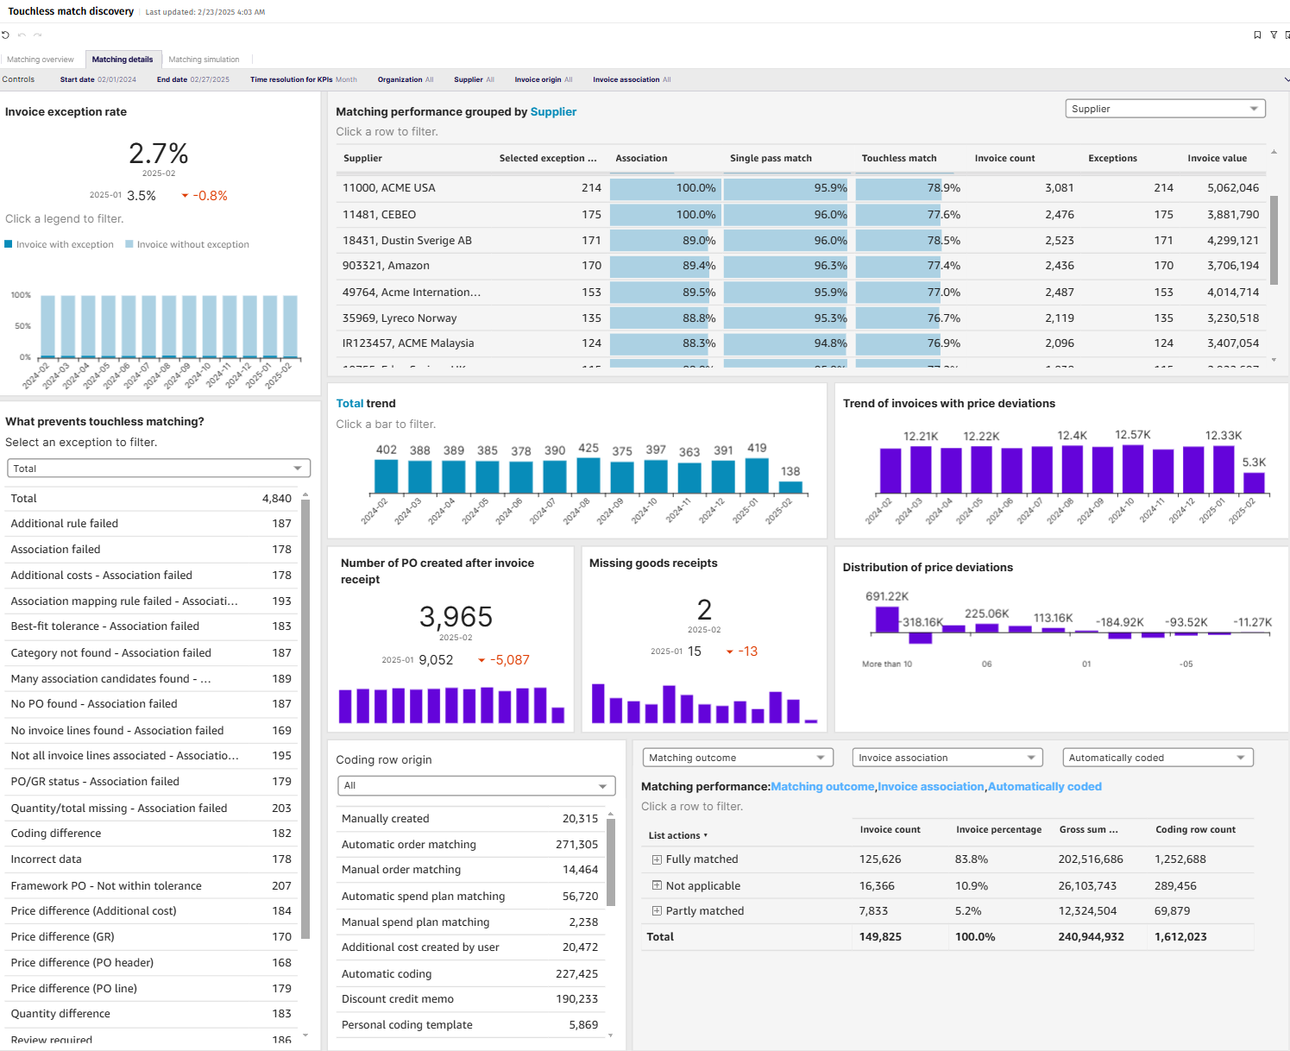
Matching Details

Slide 12
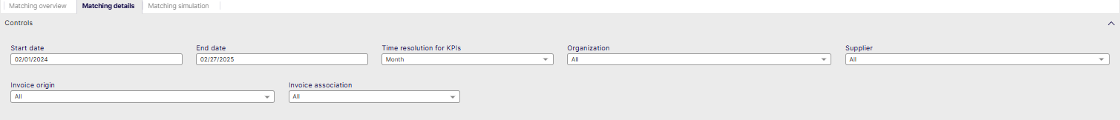
Matching Details - Controls
Start date: Select the beginning of the time interval. The selected date is included.
End date: Select the end of the time interval. The selected date is included
Time resolution for KPIs: Select how to group data over time. Options include per month, per quarter, or per year.
Organization: Filter data by your company organizations.
Supplier: Filter data by suppliers.
Invoice Origin: Filter data by invoice origin
Invoice Association: Filter data based on whether the invoices are PO, Spend Plan or Non-PO invoices

Slide 13
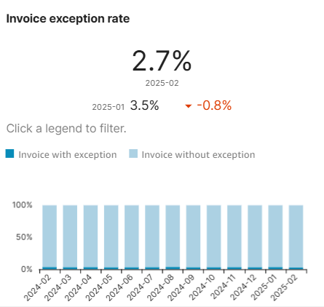
Matching Details – Invoice exception rate
Invoice Exception rate
This visualisation shows how many invoices have exceptions compared to the total amount of invoices
It shows the result as a percentage and how the time period selected compares to the previous time period (default = month)
On the bottom there is a table that shows the changes per time period (default = month)
You can use this to track how exception rates are changing over time

Slide 14
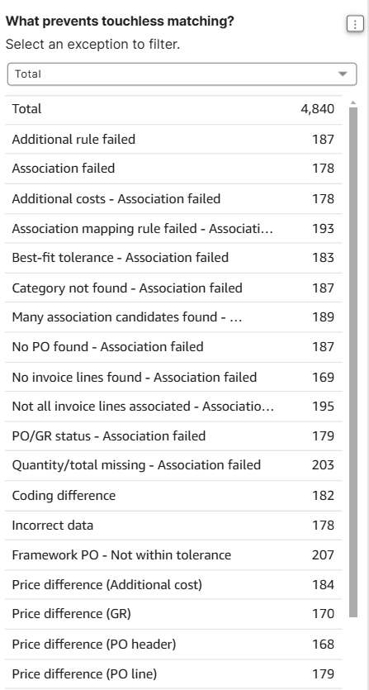
Matching Details – Exception list
What prevents touchless matching?
This list shows the detailed matching exceptions that would stop an invoices from being touchless matched.
It shows the total occurrence of these exceptions in the selected time frame
Selecting a specific exception can be done from the filter, not by clicking in the table itself.
Selecting a specific matching exception will also filter dashboards on the right.

Slide 15
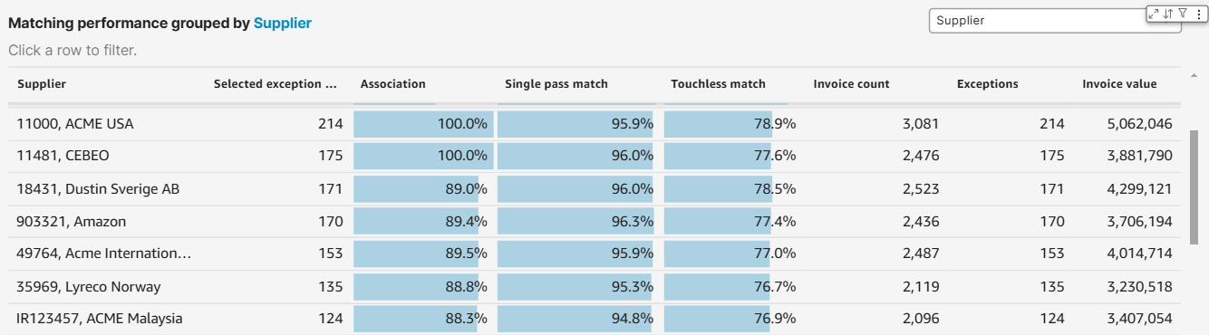
Matching Details – Performance
Matching performance grouped
Shows the exceptions grouped by different criteria, and how they affect main KPI’s
Select the appropriate grouping via the drop-down in the top right of the table:
  By Organization, Supplier or Invoice Origin
Columns include the number of selected exceptions, Association rate, Single Pass match, Touchless match, Invoice count (total number of invoices) and number of matching Exceptions, as well as the invoice value of all invoices in the selected time frame set in the dashboard controls.

Slide 16
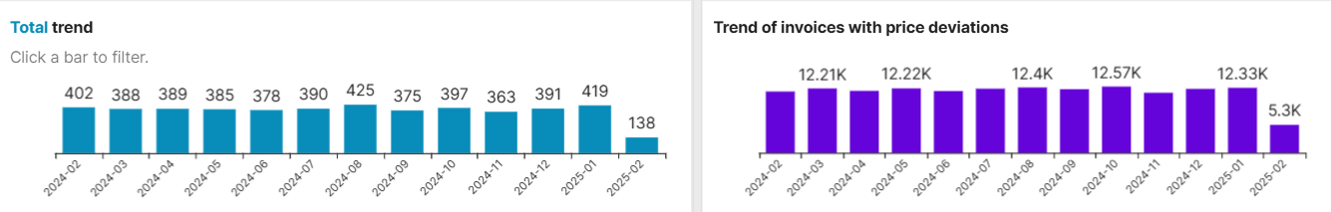
Matching Details – Trends
Total Trend of Exceptions + Trend of invoices with price deviations
Total Trend shows the trend of selected exceptions on the left per selected timeframe in the controls
Trend of invoices with price deviations shows the invoice count of invoices with price deviations over time for the selected time period

Slide 17
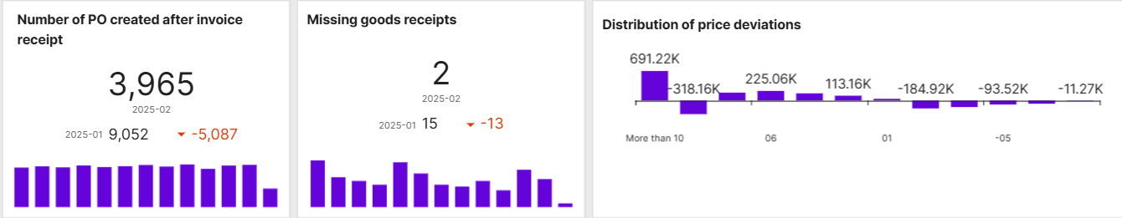
Matching Details – Trends
Number of PO created after invoice receipt shows the number of invoices that had their associated po created after the invoice was already received.
Missing goods receipts shows the number of goods receipts that were missing in the selected time period
Distribution of price deviations shows how many times a price deviation occurred, which is calculated by looking for invoices that are above or below their order value.
It shows the amount of price deviation versus the times it has occurred.

Slide 18
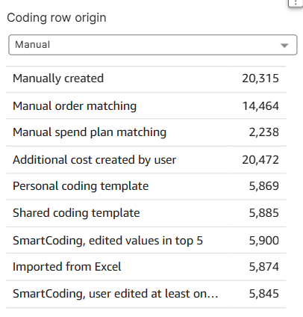
Matching Details – Coding row origin
Coding Row Origin
This visualisation shows you how coding rows are created and how many of them for each creation method used.
Via the drop down you can filter on manual or automatic coding row generation.
It allows you to see how the different coding creation methods compare, and which ones are used the most
It is recommended to prioritize and work towards automated ways of creating coding rows as this saves manual effort, improves efficiency and lowers operating cost

Slide 19
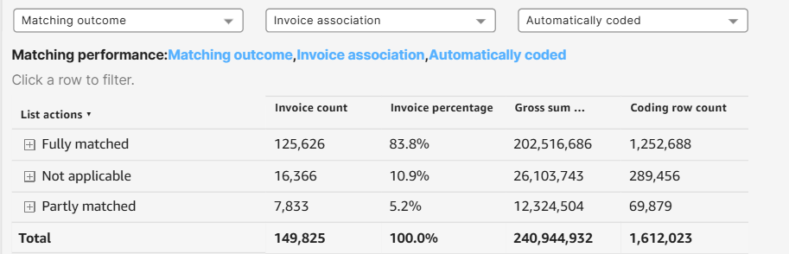
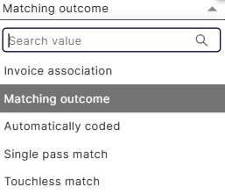
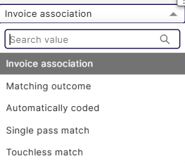
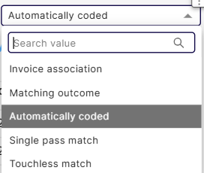
Matching Details – Performance
Matching performance by different dimensions
Like a pivot table, this visualisation allows you to show data in 3 selected dimensions by choosing them via drop downs above.
Click open the top dimension in the list actions to see how other dimensions applied underneath looks like
The columns show data on invoice count invoice percentage, gross sum and coding row count for in the selected dimensions

Slide 20
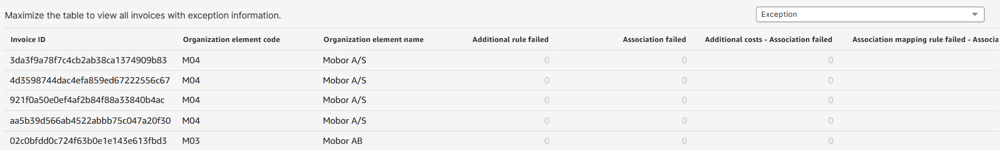
Matching Details - Exception Information
Exception Information table (best used in fullscreen mode)
Each row in this table shows an invoice, and provides a count of the detected exceptions, missing goods receipts and the amount on the invoice related to a PO which was added after the invoice came in.
It is possible that multiple exceptions occur in each invoice.
All tables include the invoice ID, element code and name of the organisation for which this invoice came in

Slide 21
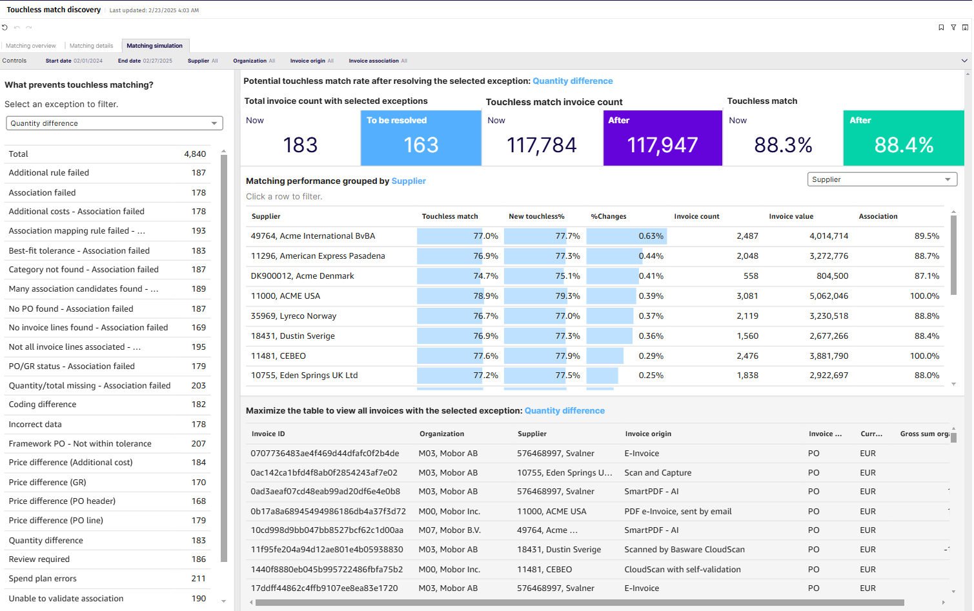
Matching Simulation

Slide 22
Matching Simulation - Controls
Start date: Select the beginning of the time interval. The selected date is included.
End date: Select the end of the time interval. The selected date is included.
Supplier: Filter data by suppliers.
Organization: Filter data by your company organizations.
Invoice Origin: Filter data by invoice origin
Invoice Association: Filter data based on whether the invoices are PO, Spend Plan or Non-PO invoices

Slide 23
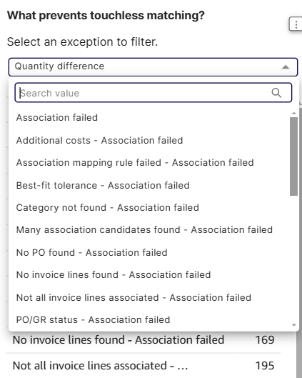
Matching Simulation – Exception list
What prevents touchless matching?
This list shows the detailed matching exceptions that would stop an invoices from being touchless matched.
It shows the total occurrence of these exceptions in the selected time frame
Selecting a specific exception can be done from the filter, not by clicking in the table itself.
Selecting a specific matching exception will also filter dashboards on the right.
Dashboards to the right will show outcomes if the selected exceptions would be fully resolved

Slide 24
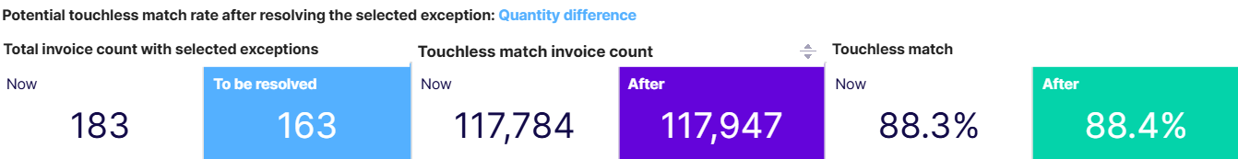
Matching Simulation – Simulation
Simulation of metrics while excluding exceptions
Total invoice count with selected exceptions shows how many invoices there are now that have this exception and how much we believe can be resolved
Touchless match invoice count shows how many invoices are currently touchlessly matched, and how many would be added if the proposed exceptions would be resolved
Touchless match shows the current touchless match rate, and how many it would change if the proposed exceptions would be resolved

Slide 25
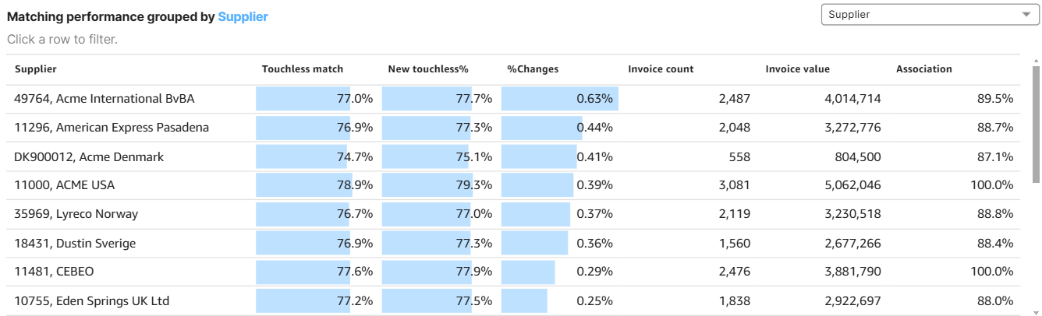
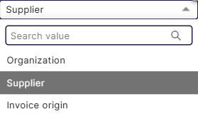
Matching simulation – Simulation
Simulation of metrics while excluding exceptions
While the metrics on the top are more general, this table can show you what the impact would be if the proposed exceptions are resolved, on supplier, organization and Invoice origin Touchless KPI’s specifically.
The impact is shown in the change in touchless rate.

Slide 26
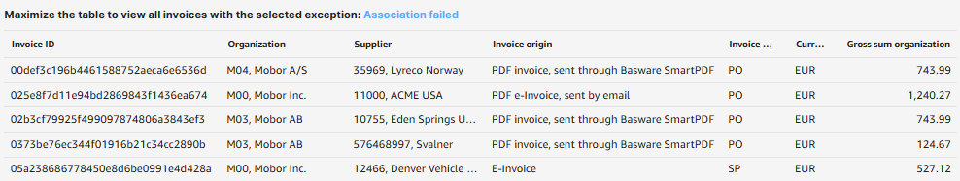

Matching simulation – Simulation
Invoice view with selected exception
This table is best put to fullscreen to see all columns and names correctly
It will show all of the invoices that are linked to the selected specific exception
The table includes Invoice ID, Organization, Supplier, detailed Invoice Origin, which association type, currency and the invoice gross sum.

