Slide 1
Touchless Invoice Processing Discovery (TIP)
Insights Pro

Slide 2
TIP Discovery
Touchless Invoice Process Discovery
Summary of the Reporting:
These dashboards provide a comprehensive overview of key process metrics and various touchless rates.
They provide insights on what is preventing the AP process from becoming touchless with the goal to improve them.
They will help you monitor performance at a glance and allow you to drill down into specific areas as needed.
Features:
TIP Overview: Provide Touchless metrics, Trends and Invoice processing figures, drill down & see what is important to you.
TIP Process Discovery: Dive into Manual Touch Trends, Process flow - How invoices move from process to process
TIP Supplier Discovery: Look at Touchless KPI’s by supplier, look at removed documents and disputed invoices
TIP Team Performance Discovery: Look at Invoice processing and specific touches made per team, see all of the actions done and see which touches were made by specific users.
Process Simulation: Simulate outcomes when touches would be removed or activities automated
Use these dashboards to simulate, plan, execute, report on and track changes to your process.
Find the opportunities to improve by looking at areas which are lagging behind, or manual actions that could be avoided

Slide 3
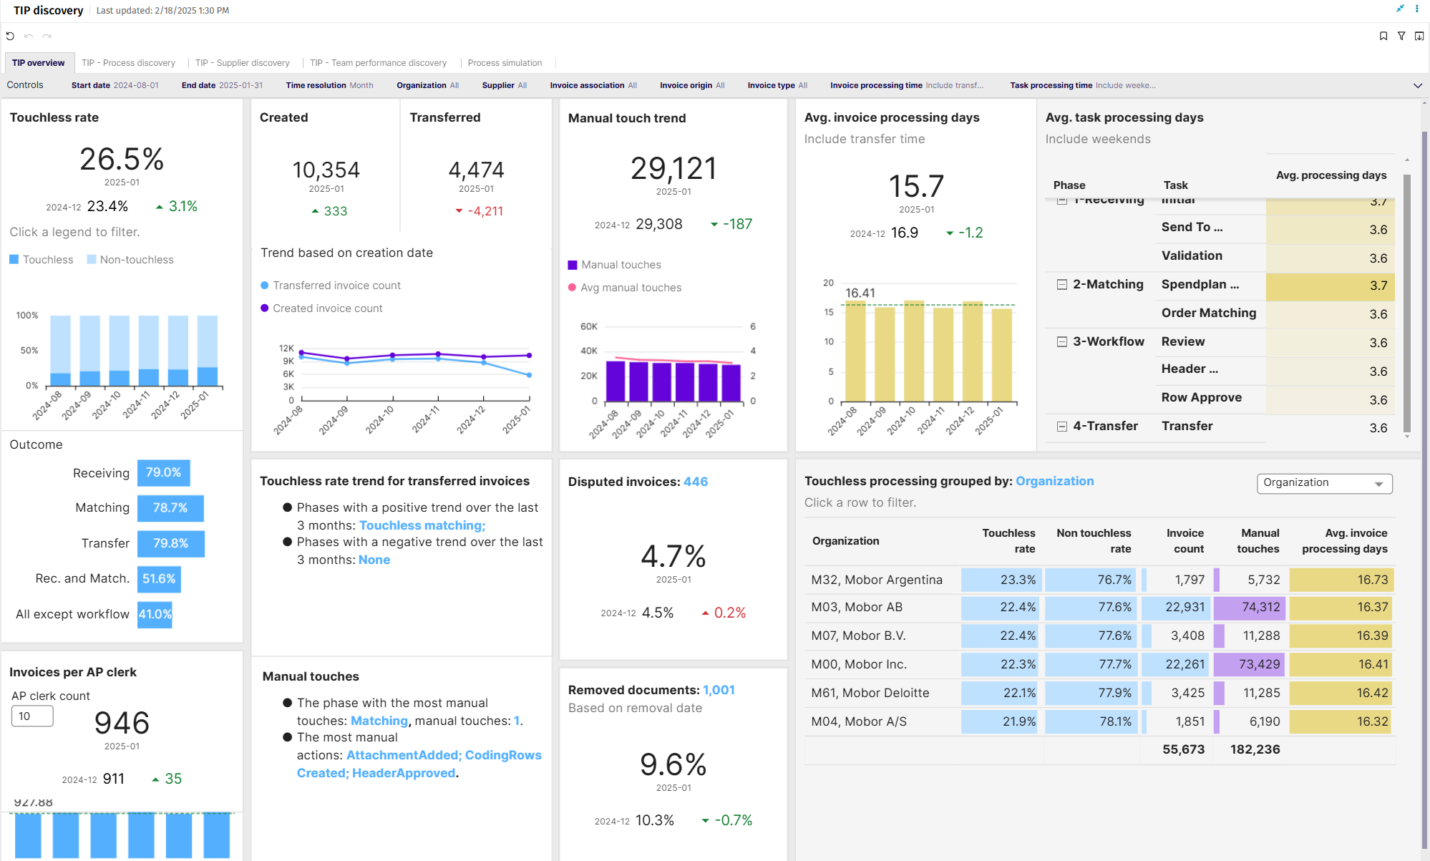
TIP Overview

Slide 4
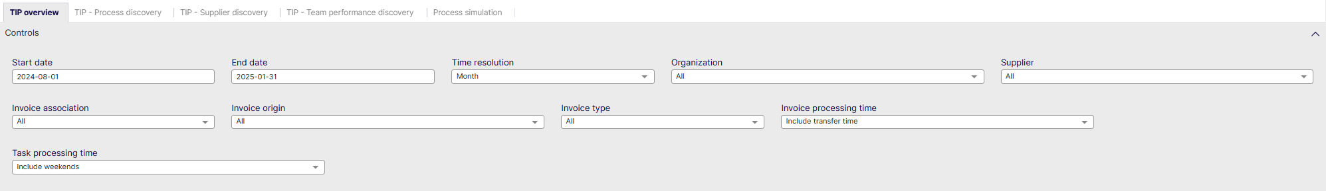
TIP Overview - Controls
Start date: Select the beginning of the time interval. The selected date is included.
End date: Select the end of the time interval. The selected date is included
Time resolution for KPIs: Select how to group data over time. Options include per month, per quarter, or per year.
Organization: Filter data by your company organizations.
Supplier: Filter data by suppliers.
Invoice Association: Filter data based on whether the invoices are PO, Spend Plan or Non-PO invoices
Invoice Origin: Filter data by invoice origin
Invoice Type: Filter data by invoice type.
Invoice Processing Time: Include or Exclude Transfer Time
Task Processing Time: Include or Exclude Weekends

Slide 5
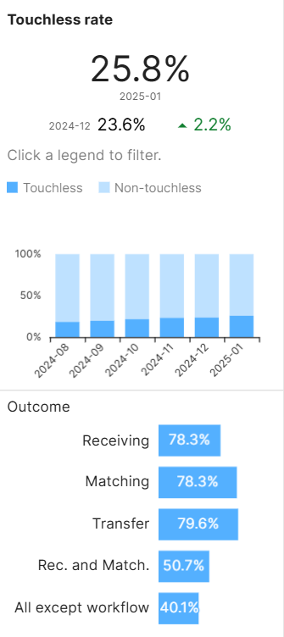
TIP Overview – Touchless Rate
Percentage of associated invoices that are touchless
The Touchless Rate is the percentage of invoices created and processed automatically, with no manual task or actions of all of the invoices transferred
Measured either by invoice count or value.
Document is not created manually
All tasks are executed automatically
No user actions performed
All actions are automatic across Receiving, Matching, Workflow and Transfer
The Touchless Rate is shown over different the different segments
In previous versions, a customer could have had cancel and resend done but all tasks executed automatically, which gave a false positive, meaning the invoice was touched but showed as touchless.
Similarly, in previous versions a manually created invoice may have had all tasks executed automatically which is wrong because someone in AP spent time doing manual work to get the invoice into the system

Slide 6
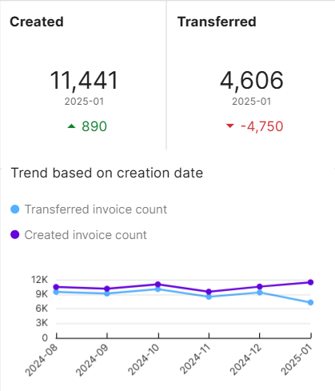
TIP Overview – Created & Transferred Invoices
Created & Transferred Invoices
This dashboard provides an overview and trend of created and transferred invoices
The top shows the respective KPI value for the most recent period
Also shows the difference between current period and previous period
The chart shows the progress of transferred and created invoices over time

Slide 7
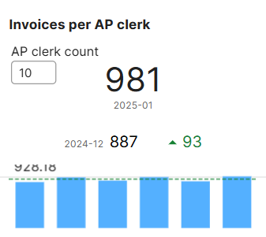
TIP Overview – Invoices per AP clerk
Invoices per AP Clerk
This dashboard provides an overview and trend of manual touches per AP clerk.
The visualization includes:
Number of Invoices processed for the most recent period
Difference between current period and previous period
Trend chart that shows the number of invoices processed per month

Slide 8
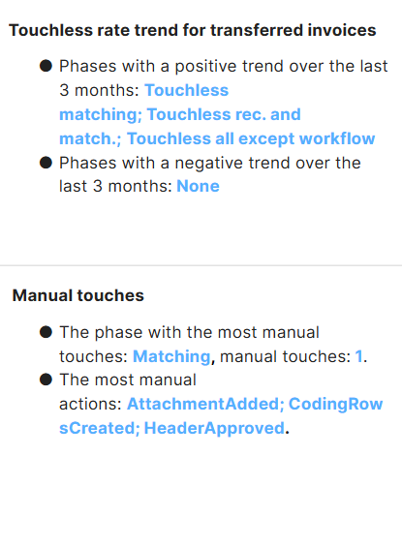
TIP Overview – Touchless Trend Insights
Touchless rate trend for transferred invoices
Compares Touchless receiving, matching, transfer and ‘all except workflow’ rate with previous month and two months before to see if its increasing or decreasing consecutively in two months.
Example: If Dec > Nov > Oct, then it is increasing (positive trend), if Dec < Nov < Oct then it is decreasing (negative trend)
Manual touches
Shows the phase (Receiving, Matching, Workflow or Transfer) that has the most manual touches
This insight also shows the top 3 manual touches

Slide 9
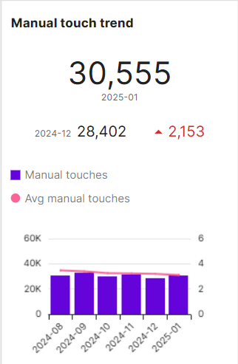
TIP Overview – Manual Touch Trend
Manual Touch Trend
This visualization shows the amount of manual touches for the selected period, as well as the previous period.
It also shows the difference between the current period and the previous period
The bar chart shows the touches per month (blue columns)
The bar chart also shows the average manual touches over time (red line)

Slide 10
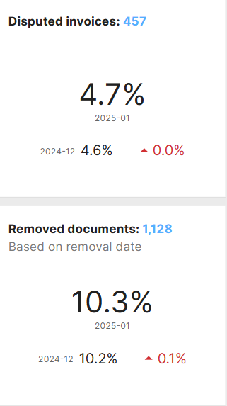
TIP Overview – Disputed & Removed
Disputed Invoices
This visualization shows the amount & percentage of Disputed Invoices for the selected period, as well as the previous period. (percentage out of all invoices in the selected period.)
It also shows the difference between the two
Removed Documents
This visualization shows the amount & percentage of Removed documents for the selected period, as well as the previous period. (percentage out of all documents in the selected period.)
It also shows the difference between the two
This metric is based on the removal date

Slide 11
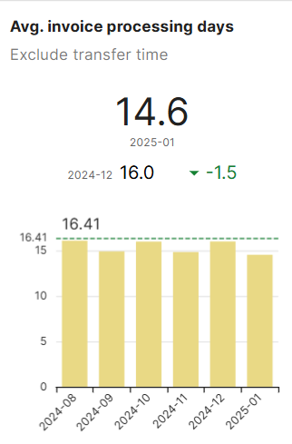
TIP Overview – Avg. Invoice proc. days
Avg. Invoice processing days
The average days an invoice takes to go from creation date to be ready for transfer
This visualization shows an analysis of the average invoice processing days for the selected period, while also showing the previous period.
It also shows the difference between the current period and the previous period
The bar chart shows the average invoice processing days per month (yellow columns)
The bar chart also shows the average over time (green dotted line)

Slide 12
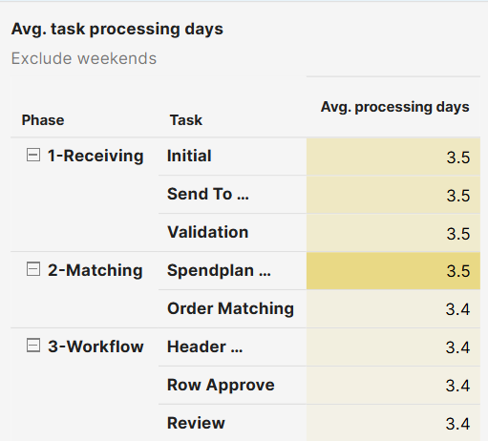
TIP Overview – Avg. Task proc. days
Average task processing days
This visualization shows the average days it takes to complete a specific task
You can see the task in the context of its phase (column 1)
You can see the task name (column 2)
You can see the average days it takes to complete the task (column 3)
In the dashboard controls you can include or exclude weekends

Slide 13
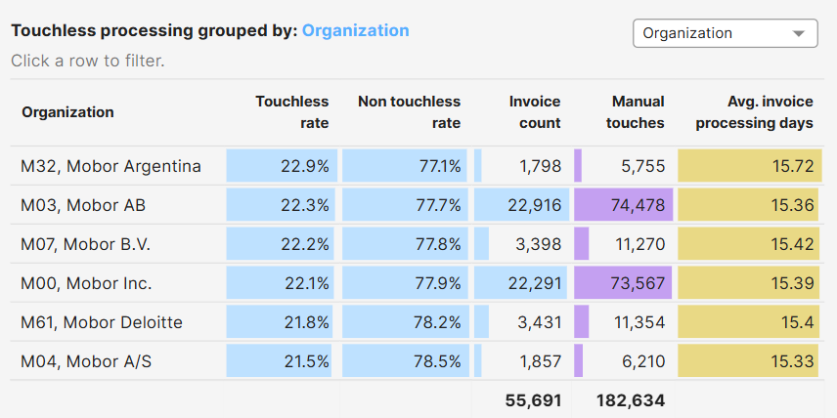
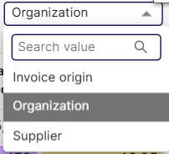
TIP Overview – Touchless processing
Touchless Processing Grouped
This visualization shows touchless processing KPI’s per organization, Supplier or Invoice Origin.
It shows you the Touchless rate, Invoice count, Manual touches and average invoice processing days for the dimension selected

Slide 14
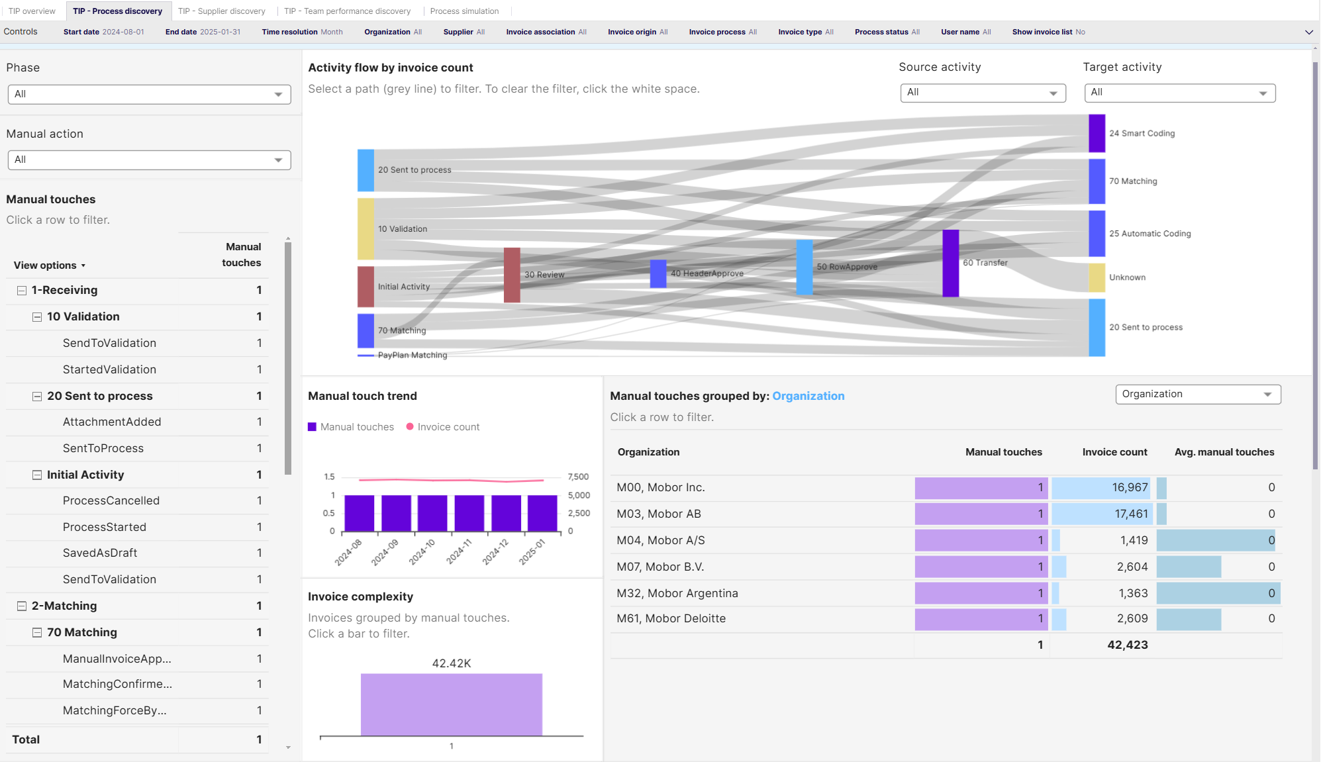
TIP Process Discovery

Slide 15
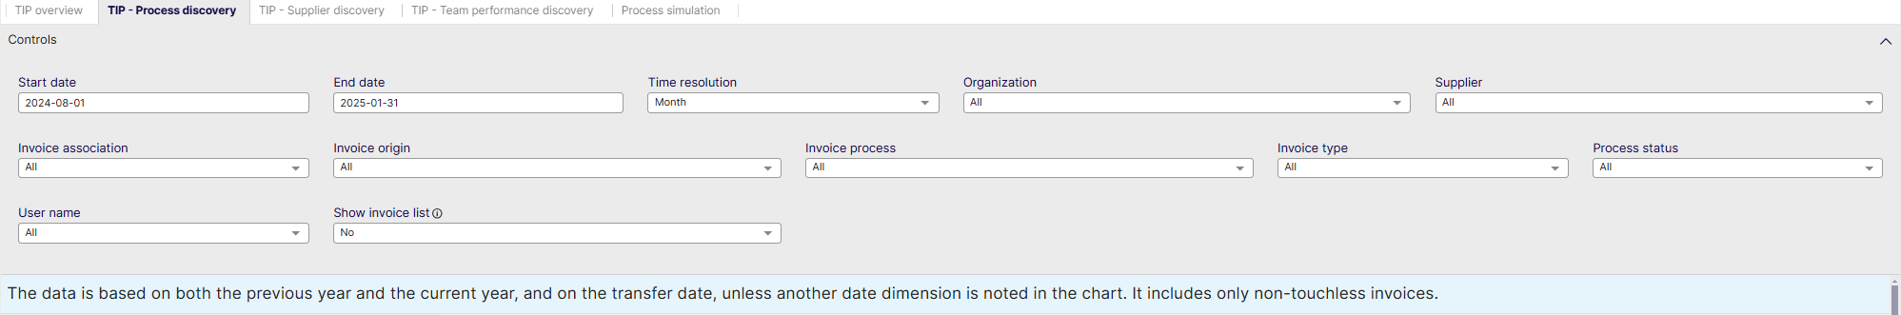
TIP Process Discovery - Controls
Start date: Select the beginning of the time interval. The selected date is included.
End date: Select the end of the time interval. The selected date is included
Time resolution for KPIs: Select how to group data over time. Options include per month, per quarter, or per year.
Organization: Filter data by your company organizations.
Supplier: Filter data by suppliers.
Invoice Association: Filter data based on whether the invoices are PO, Spend Plan or Non-PO invoices
Invoice Origin: Filter data by invoice origin
Invoice Process: Select your specifically configured Invoice process
Invoice Type: Filter data by invoice type.
Process Status: Select whether to include Active or Non-Active Processes
User name: Filter based on a specific user
Show Invoice List: Select whether to show a table containing all the invoices

Slide 16
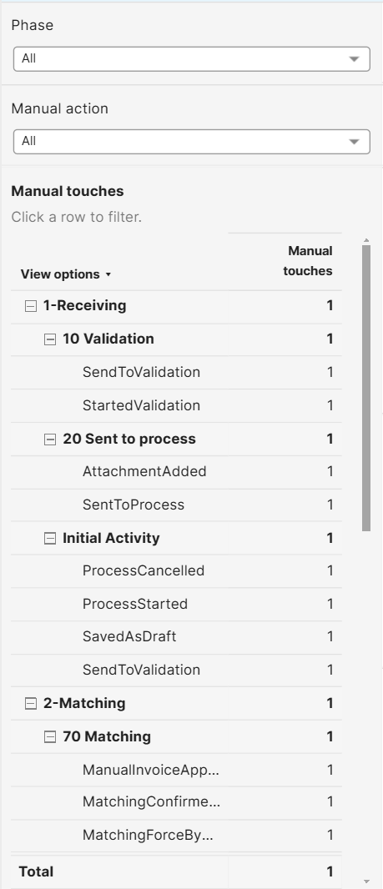
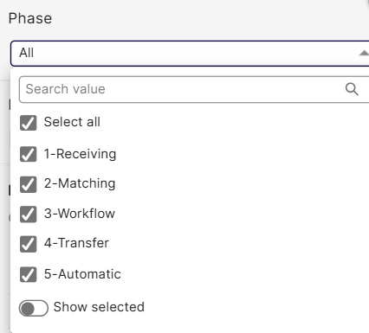
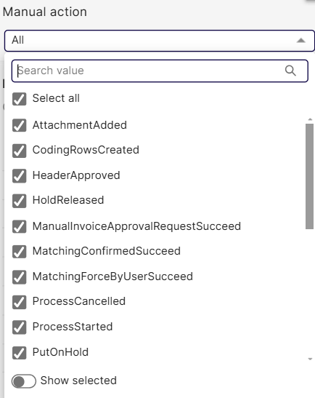
TIP Process Discovery – Manual Touches
Manual Touches
This visualization shows all of the Phases, broken down into activities and further broken down on Task level
In the Phase drop-down, you can opt to see specific phases in the list below
In the Manual action drop-down, you can filter to show only specific manual tasks
For the controls you have set in the TIP Process Discovery dashboard, the table shows the manual touches for each Phase, activity and task

Slide 17
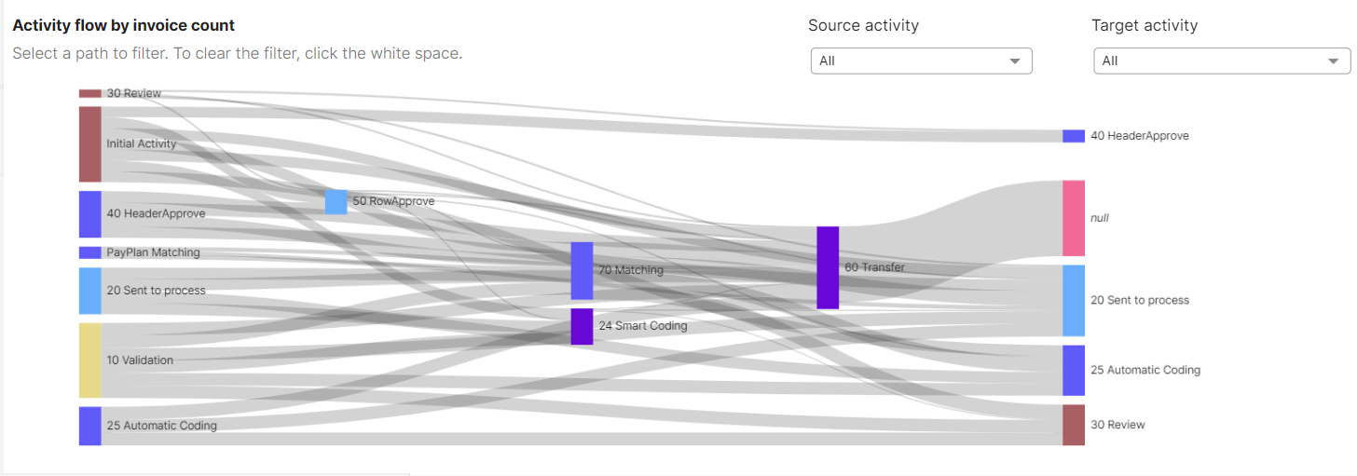
TIP Process Discovery – Activity Flow
Activity flow by Invoice count
Analysis of invoice volume by activity flows which shows source and target activities.
This chart shows how invoices move from activity to activity
Users can use the filters to select one or more specific activities.

Slide 18
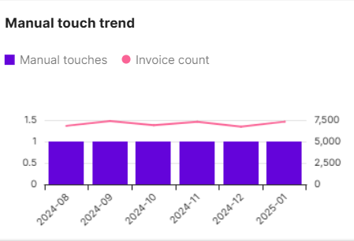
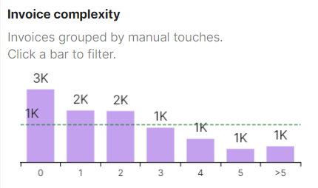
TIP Process Discovery – Manual Touch Trend
Manual Touch Trend
This visualisation shows the trend of manual touches and invoice volume for the selected time period
The red line shows the invoice count
The blue bars show the amount of touches
Invoice Complexity
This visualization shows the amount of touches performed per total amount of invoices for the selected time period
In this example, the amount of invoices that did not require touches was 3000 (3k)
The green dotted line shows the average invoice volume

Slide 19
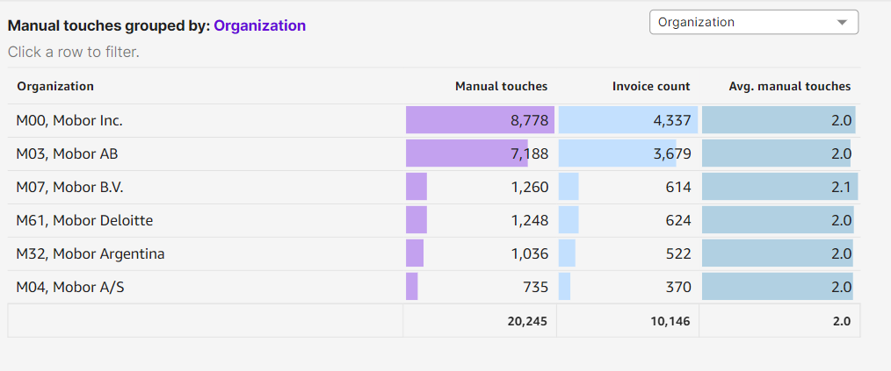
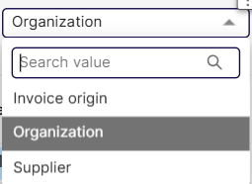
TIP Process Discovery – Touches Grouped
Manual Touches Grouped
This visualisation shows all manual touches, invoice count and average manual touches grouped by Organization (default), Invoice origin or Supplier

Slide 20
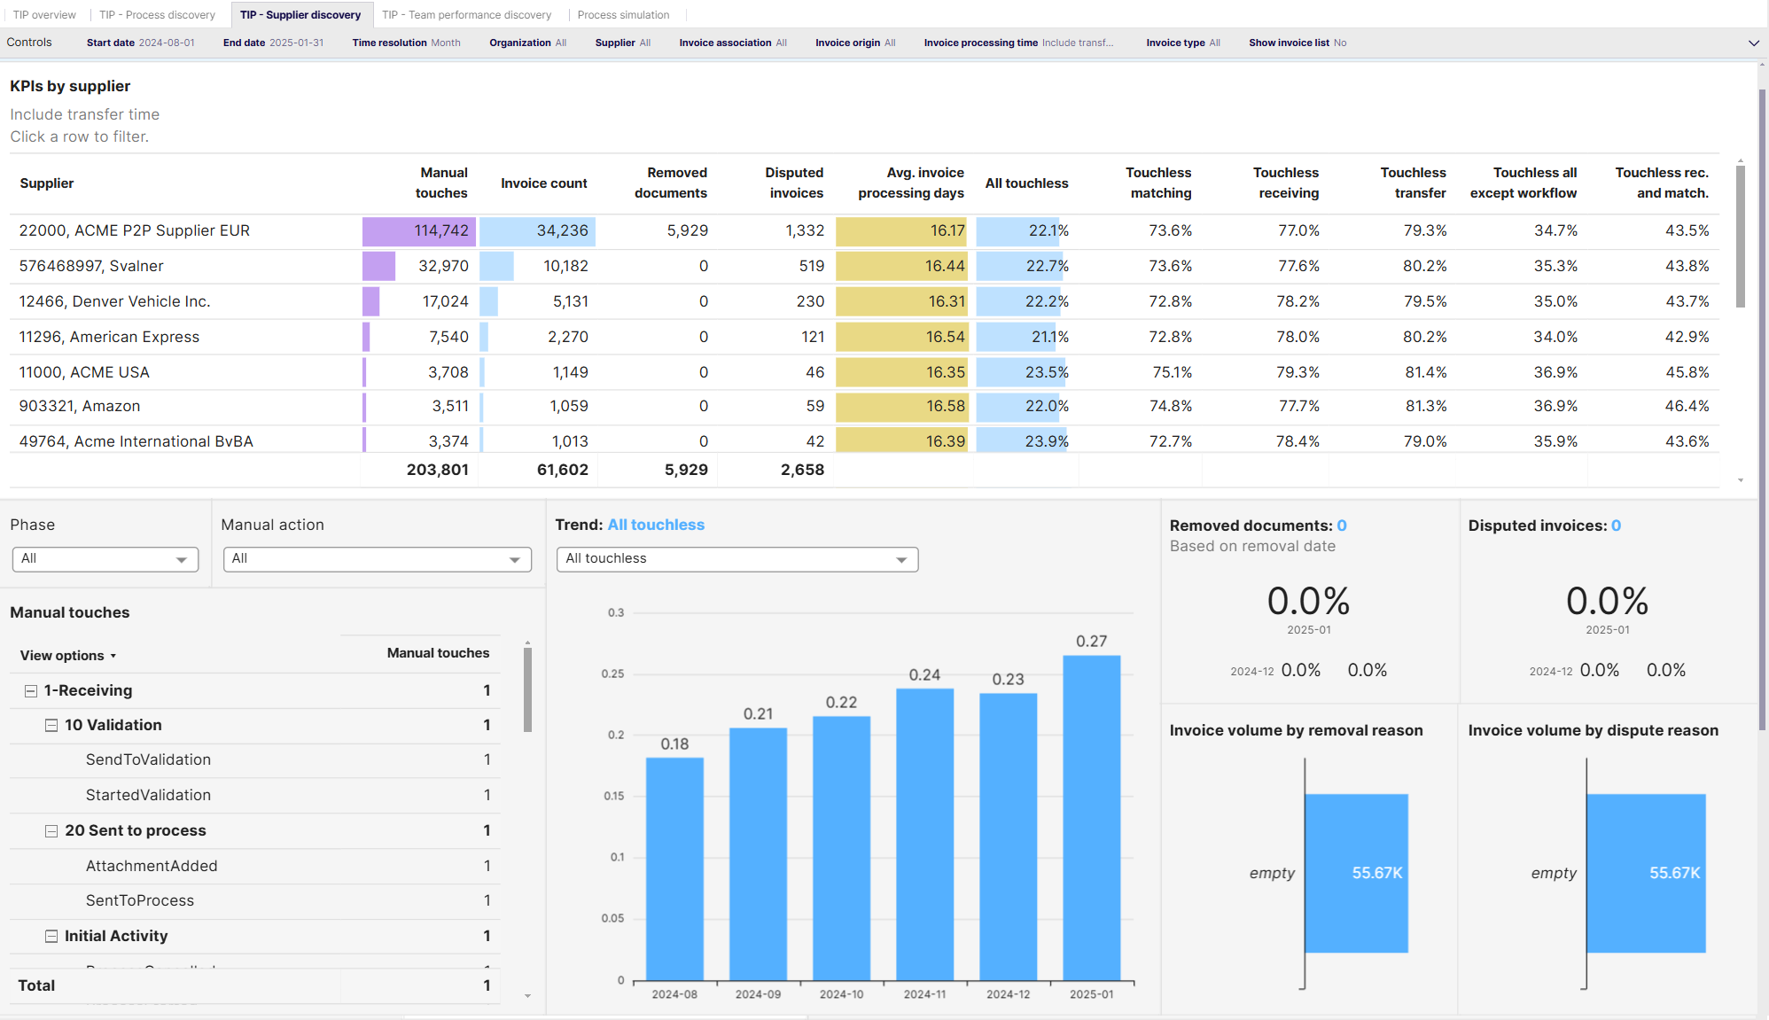
TIP Supplier Discovery

Slide 21
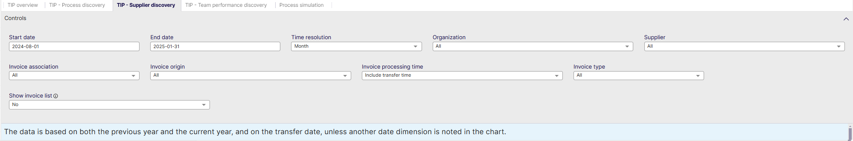
TIP Supplier Discovery - Controls
Start date: Select the beginning of the time interval. The selected date is included.
End date: Select the end of the time interval. The selected date is included
Time resolution for KPIs: Select how to group data over time. Options include per month, per quarter, or per year.
Organization: Filter data by your company organizations.
Supplier: Filter data by suppliers.
Invoice Association: Filter data based on whether the invoices are PO, Spend Plan or Non-PO invoices
Invoice Origin: Filter data by invoice origin
Invoice Processing Time: Include or Exclude Transfer Time
Invoice Type: Filter data by invoice type.
Show Invoice List: Select whether to show a table containing all the invoices

Slide 22
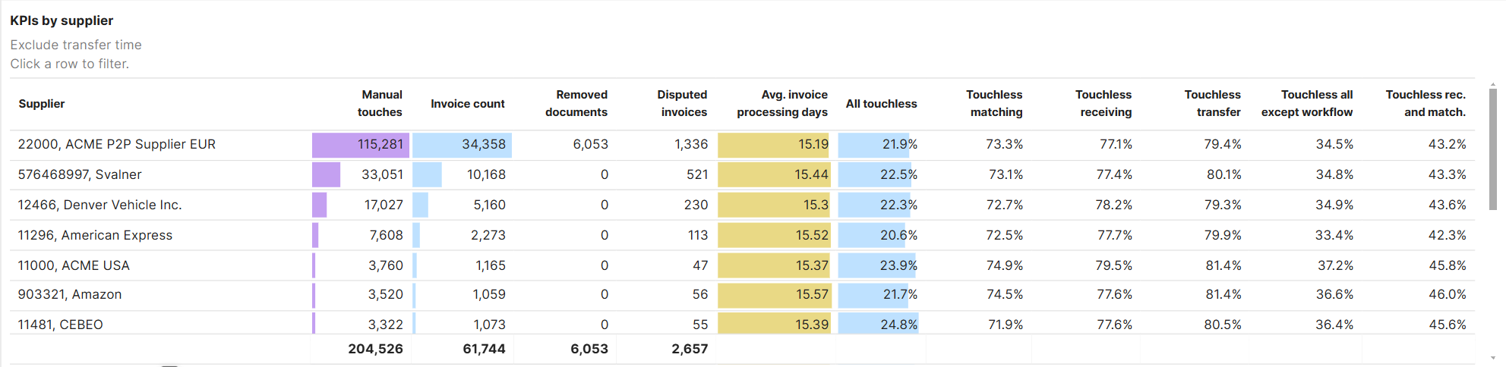
TIP Supplier Discovery – KPI’s
KPI’s by Supplier
This Visualisation shows the following KPI’s per supplier:
Manual Touches
Invoice count
Removed Documents
Disputed Invoices
Average Invoice processing days
Touchless Rate (all)
Touchless Matching
Touchless Receiving
Touchless Transfer
Touchless Rate (all) except workflow
Touchless rate in Receiving and matching

Slide 23
TIP Supplier Discovery – KPI’s
KPI’s by Supplier - Explained
All Touchless: The percentage of invoices created and processed automatically, with no manual task or actions of all of the invoices transferred
Touchless Matching: Percentage of invoices matched in a single pass, with no matching exceptions, and all coding rows are generated automatically.
Touchless Receiving: Percentage of Invoices moved to matching without a manual touch
Touchless Transfer: Percentage of Invoices transferred without a manual touch
Touchless Rate (all) except workflow: Percentage of touchless invoices during received, matching and transfer stages
Touchless rate in Receiving and matching: Percentage of Invoices moved to workflow without a manual touch

Slide 24
TIP Supplier Discovery – Trends
Manual Touches
This visualization shows all of the Phases, broken down into activities and further broken down on Task level
In the Phase drop-down, you can opt to see specific phases in the list below
In the Manual action drop-down, you can filter to show only specific manual tasks
For the controls you have set in the TIP supplier Discovery dashboard, the table shows the manual touches for each Phase, activity and task
Clicking rows also filters the removed or disputed visualization to the right

Slide 25
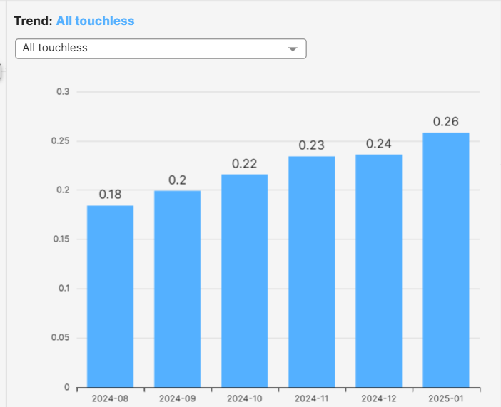
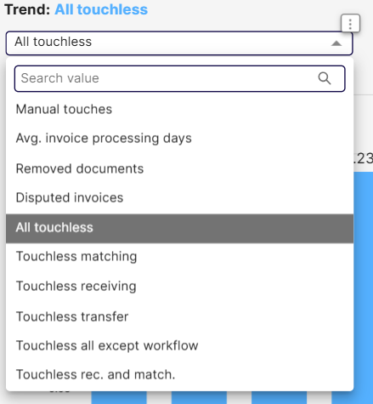
TIP Supplier Discovery – Trends
Trends per Touch
This visualisation shows the trend per selected KPI
Choose to filter the bar chart on:
Manual touches
Average Invoice processing days
Removed documents
Disputed invoices
Touchless KPI’s (see KPI’s by Supplier - Explained)

Slide 26
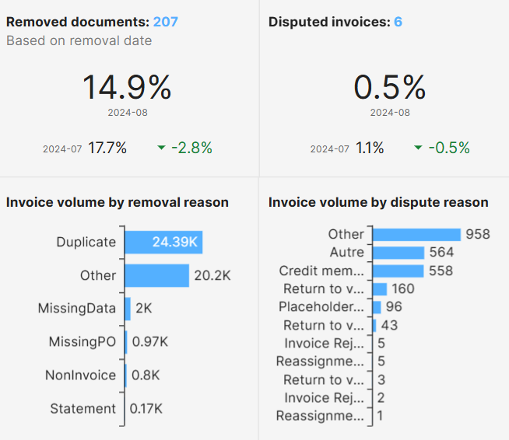
TIP Supplier Discovery – Removed & Disputed
Removed documents
Shows the amount of removed documents, for the selected time period, while comparing it to the previous time period.
The bottom part shows the number removed by recorded reason why the documents were removed
Disputed Invoices
Shows the amount of Disputed invoices, for the selected time period, while comparing it to the previous time period.
The bottom part shows number of Disputed invoices by the reason why the documents were disputed

Slide 27
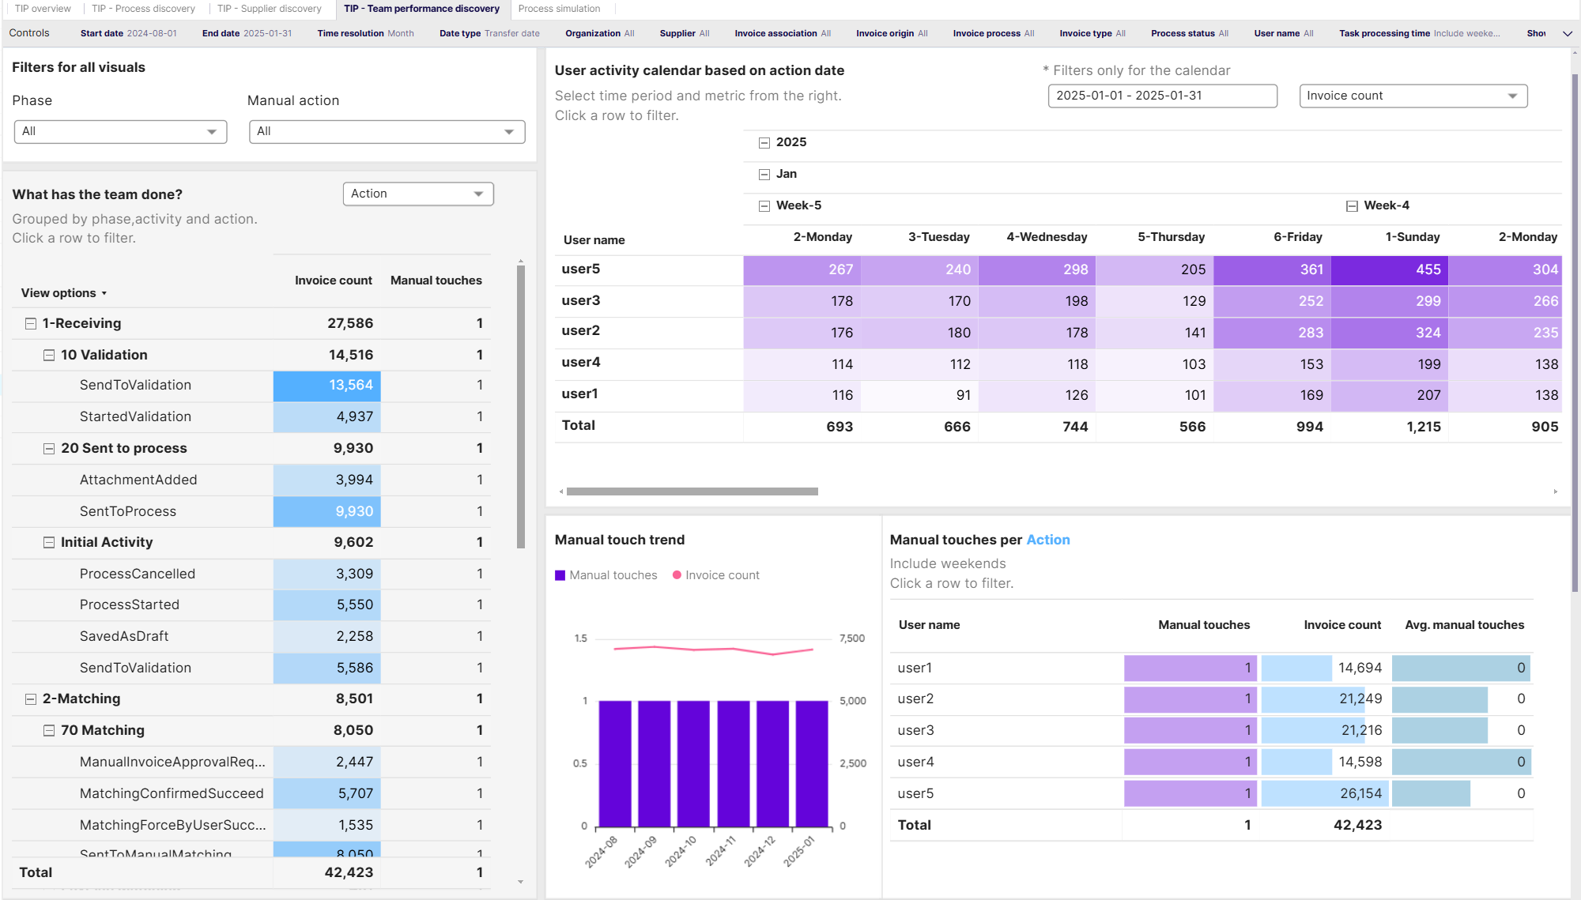
TIP Team Performance Discovery

Slide 28
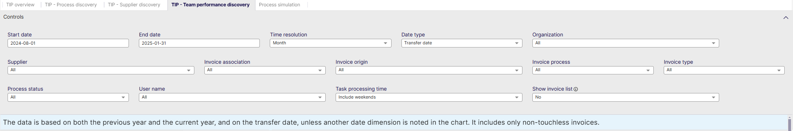
TIP Team Performance - Controls
Start date: Select the beginning of the time interval. The selected date is included.
End date: Select the end of the time interval. The selected date is included
Time resolution for KPIs: Select how to group data over time. Options include per month, per quarter, or per year.
Data Type: Select to Filter on Transfer or Creation date
Organization: Filter data by your company organizations.
Supplier: Filter data by suppliers.
Invoice Association: Filter data based on whether the invoices are PO, Spend Plan or Non-PO invoices
Invoice Origin: Filter data by invoice origin
Invoice Process: Select your specifically configured Invoice process
Invoice Type: Filter data by invoice type.
Process Status: Select whether to include Active or Non-Active Processes
User name: Filter based on a specific user
Task processing time: Select whether to include weekend performance or exclude it
Show Invoice List: Select whether to show a table containing all the invoices

Slide 29
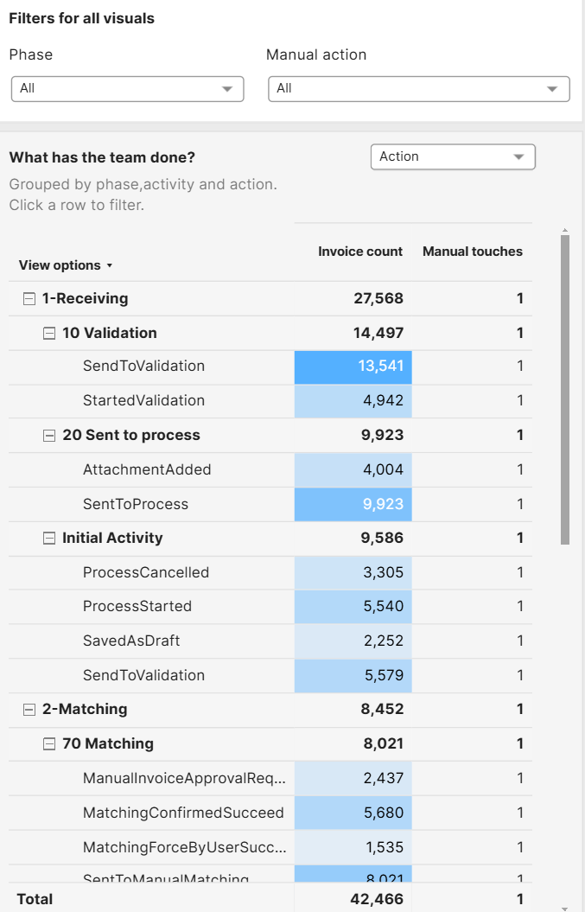
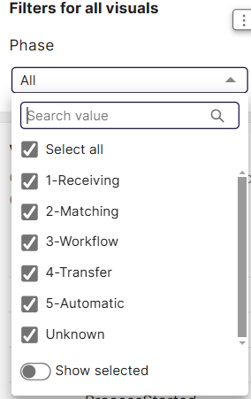
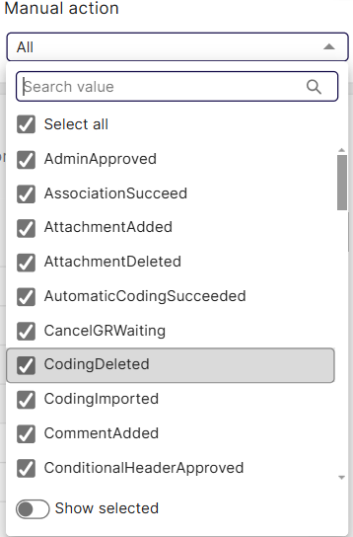
TIP Team Performance – Filters & Actions
Filters for all visuals & What has the team done?
This visualization shows all of the Phases, broken down into activities and further broken down on Task level
In the Phase drop-down, you can opt to see specific phases in the list below and other visuals on the dashboard
In the Manual action drop-down, you can filter to show only specific manual actions
For the controls you have set in the TIP supplier Discovery dashboard, the table shows the invoice count and manual touches for each Phase, activity and task or action – Choose between Action or Task from the dropdown
Clicking rows also filters activity calendar and touches visualizations to the right

Slide 30
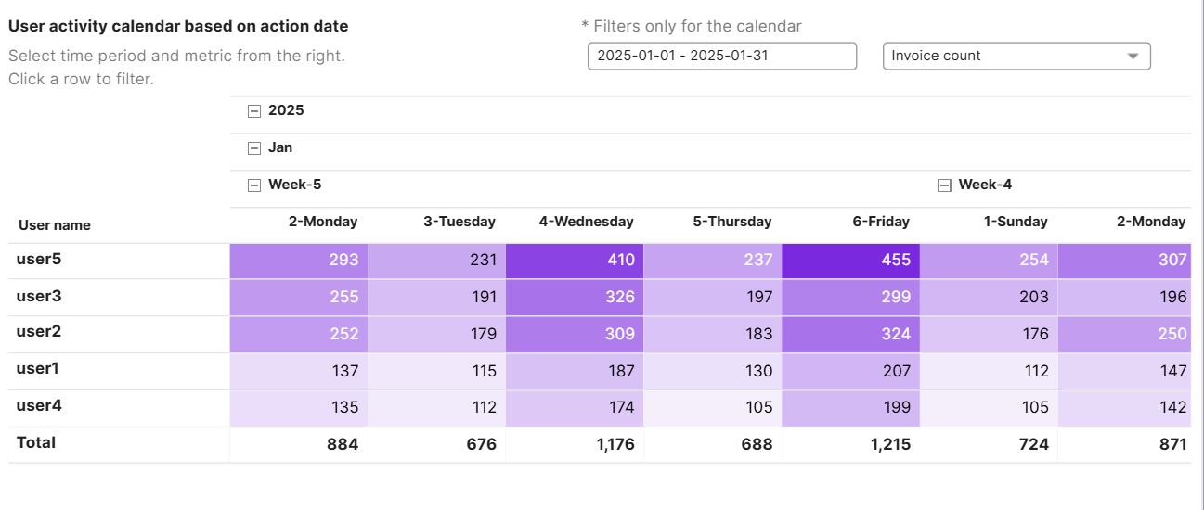
TIP Team Performance – Activity Calendar
User activity calendar based on action date
This visualization shows the invoices touched by different employees in the organisation
Using the drop downs above you are able to change the shown Timeframe, and switch between showing the worked on invoice count or the number of manual touches done
Please note that it is possible that each invoice can be touched multiple times, even by the same employee

Slide 31
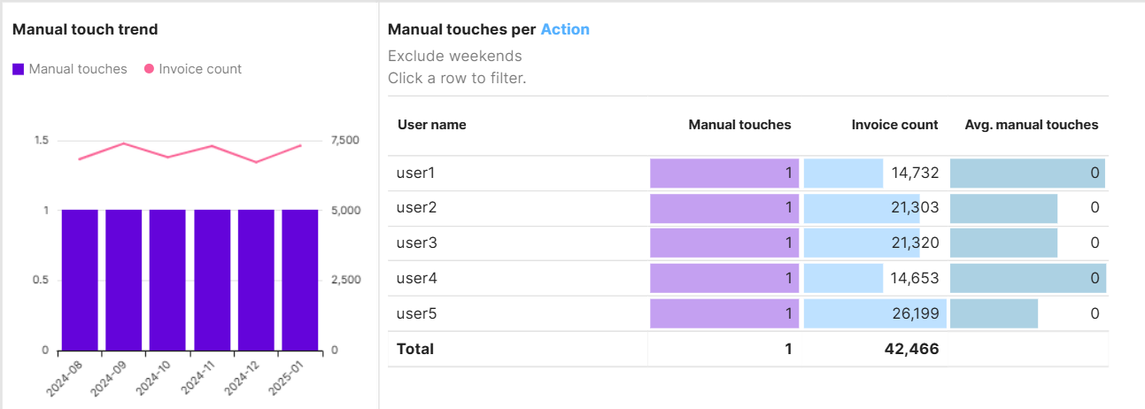
TIP Team Performance – Touch trend
Manual Touch Trend & Touches per Action
This visualisation shows the trend of manual touches and invoice volume for the selected time period
On the right you can see manual touches and touched invoices per user as well as average manual touches
Manual touches can be shown per Action or task. This can be set via Dropdown on the left in ‘what has the team done?’.

Slide 32
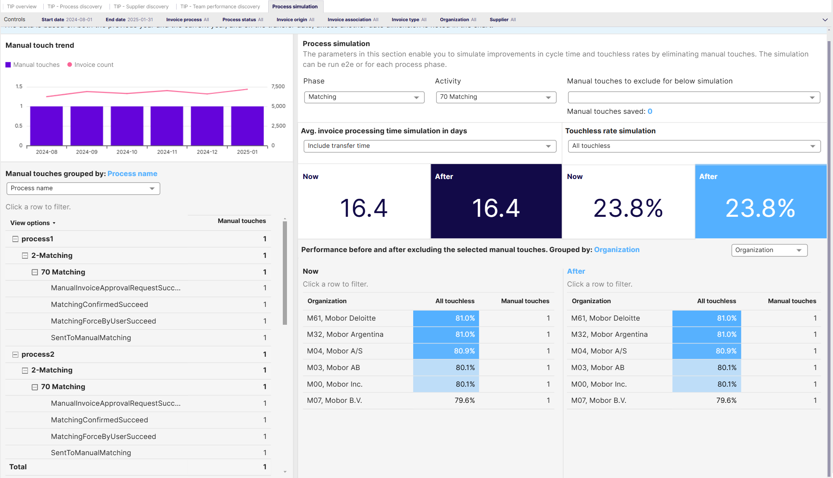
TIP Process Simulation

Slide 33
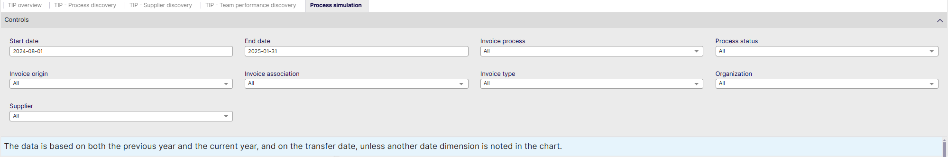
TIP Process Simulation - Controls
Start date: Select the beginning of the time interval. The selected date is included.
End date: Select the end of the time interval. The selected date is included
Invoice Process: Select your specifically configured Invoice process
Process status: Filter out Active or Inactive processes
Supplier: Filter data by suppliers.
Invoice Origin: Filter data by invoice origin
Invoice Association: Filter data based on whether the invoices are PO, Spend Plan or Non-PO invoices
Invoice Type: Filter data by invoice type.
Organization: Filter data by your company organizations.
Supplier: Filter data by suppliers.

Slide 34
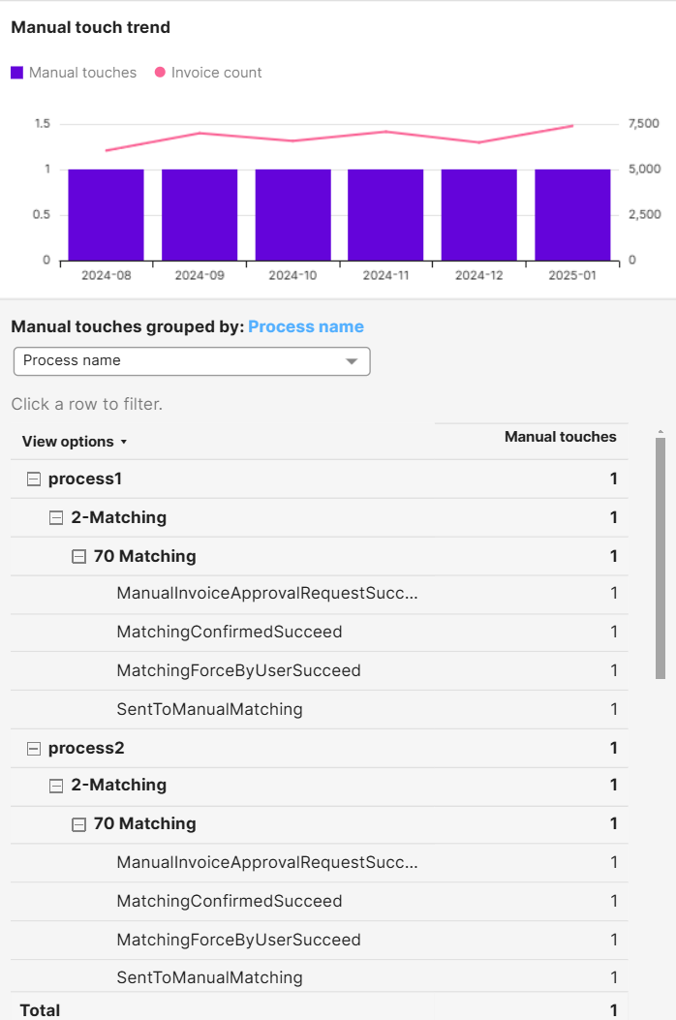
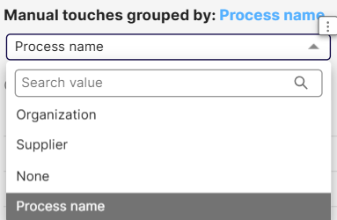
TIP Process Simulation – Touch Trend
Manual Touch Trend
This visualisation shows the trend of manual touches and invoice volume for the selected time period
The red line shows the invoice count
The blue bars show the amount of touches
Group Manual Touches
This visualisation allows you to group specific manual touches per process name, organization or supplier, or not at all.

Slide 35
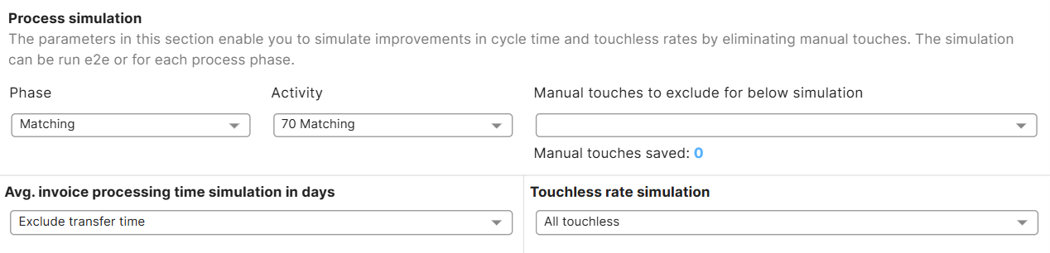
TIP Process Simulation
Process Simulation
Process simulation allows you to simulate Touchless KPI’s while excluding different manual touches in different phases and different activities.
The filters on the top right allow you to set the phases, activities and specific manual touches to exclude in the below touchless KPI’s

Slide 36
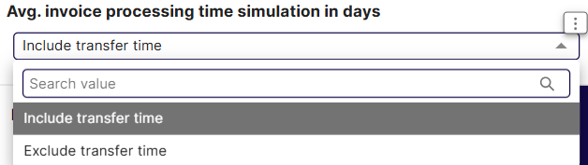
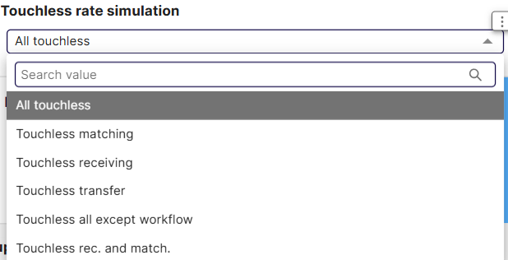
TIP Process Simulation
Average processing time simulation in days
Allows you to filter out or include Transfer times in the below metrics
Touchless rate simulation
This drop-down allows you to set the touchless KPI to simulate below

Slide 37
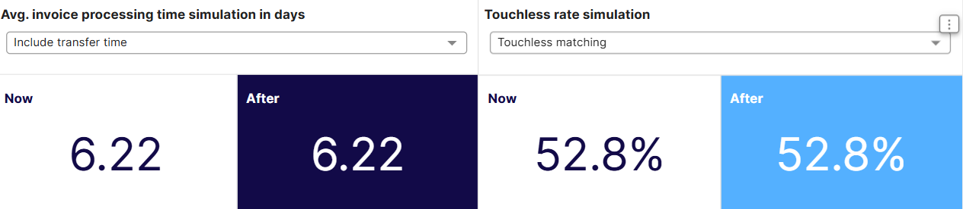
TIP Process Simulation
Simulation results
The left part of the simulation shows the current invoice processing time and the simulated invoice processing time influenced by the Phases, Activities and manual touches or actions selected above.
The right part of the simulation shows the current and simulated Touchless KPI or rate as set in the drop-downs above.

Slide 38
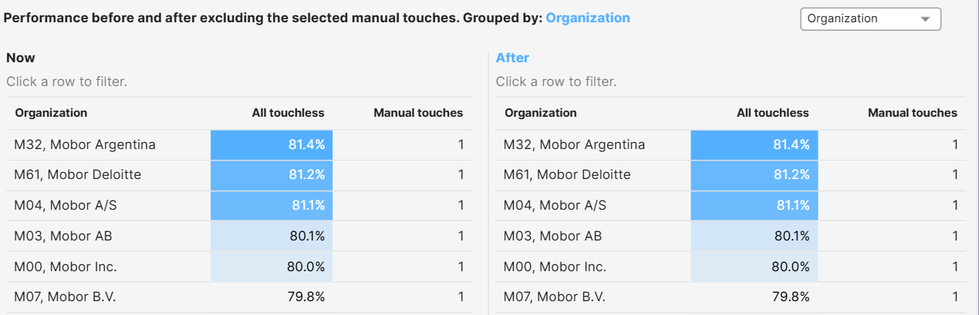
TIP Process Simulation - Results
Performance Before & After
Just like the above high level KPI’s, these visualizations show you how excluding certain Phases, Activities or specific types of manual touches would have an effect on organization or supplier performance, shown in change of touchless rate and number of manual touches in these tables.
Change the drop downs on the top of the page and

