Slide 1
Realized Spend
Insights Pro
Insights Essentials

Slide 2
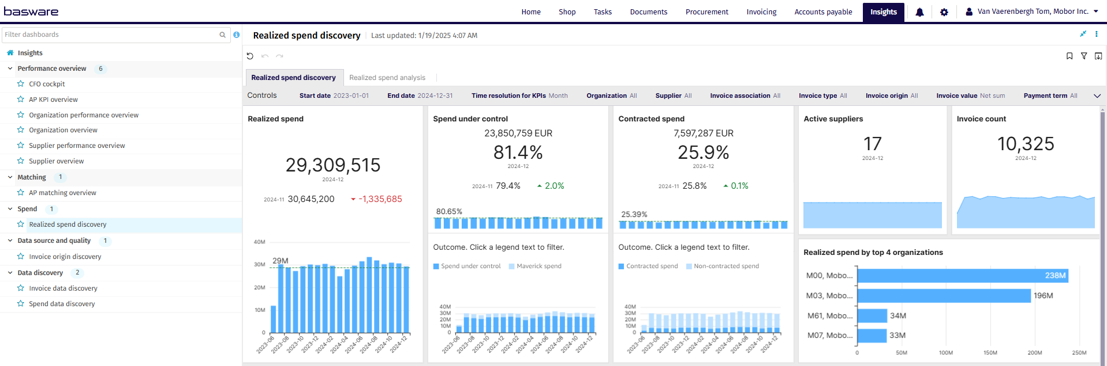
Realized Spend Discovery

Slide 3
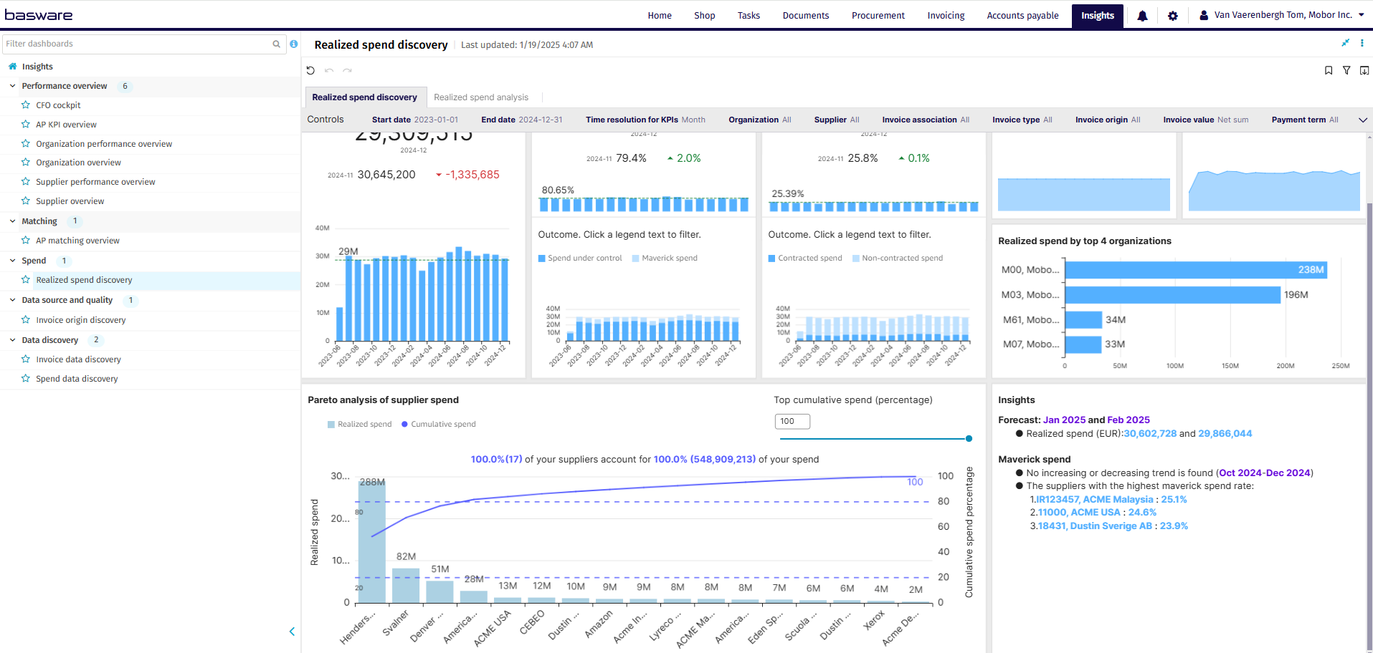
Realized Spend Discovery

Slide 4
Realised Spend Discovery Controls
List settings options: Describe the settings users can modify, such as data ranges, department filters, metric types
Start date: Select the beginning of the time interval. The selected date is included.
End date: Select the end of the time interval. The selected date is included
Time resolution for KPIs: Select how to group data over time. Options include per month, per quarter, or per year.
Organization: Filter data by your company organizations.
Supplier: Filter data by suppliers.
Invoice Association: Filter data based on whether the invoices are PO, Spend Plan or Non-PO invoices
Invoice Type: Filter data by invoice type.
Invoice Origin: Filter data by invoice origin
Invoice Value: Select if the invoice and spend values are shown as net sums or gross sums.
Payment Term: Filter by Payment Term defined for your company

Slide 5
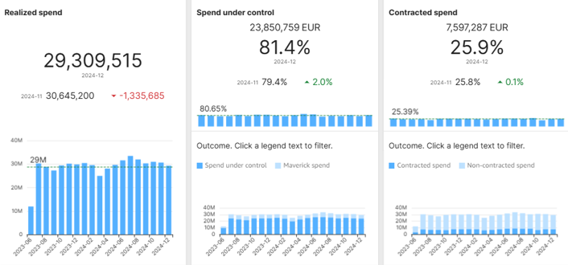
Spend Discovery
Spend Metrics and KPI’s
Realized Spend:
Amount of total Spend, only includes invoices if they have a transfer date
Spend Under Control:
This metric compares the amount of controlled spend on all invoices with the total amount of all realized spend
Contracted Spend:
This metric compares the total amount of invoices that have a contract number with the total amount of all realized spend

Slide 6
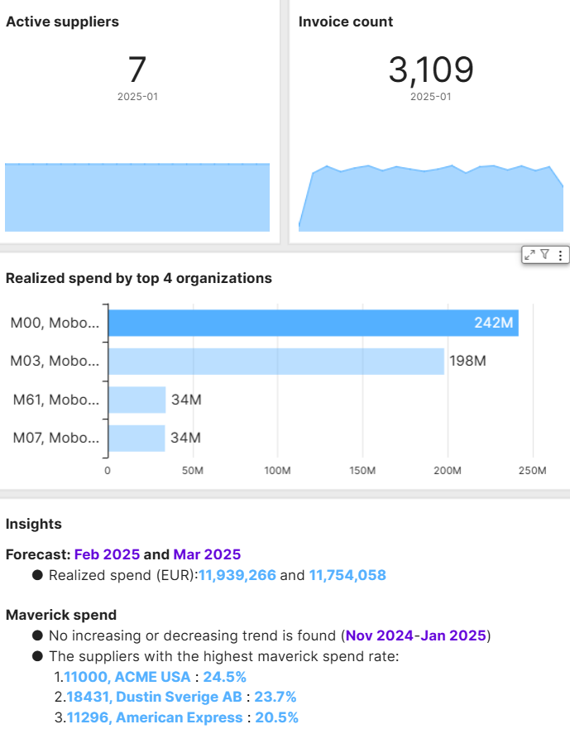
Spend Discovery
Active Suppliers, Invoice Count and Realized spend by top 4 organizations
Active Suppliers:
Total amount of suppliers that were active during the specified period
Invoice count:
Total invoice volume during the specified period
Realized Spend by top 4 organizations:
Shows the top 4 organizations in your organization and ranks them by total realized spend
Metric is shown as the spend for the last 12 months, while total realized spend is monthly
Clicking a bar refilters the entire dashboard to focus on this one organization
Insights: Provides helpful AI generated insights into maverick spend and calculates a forecast based on all available spend data

Slide 7
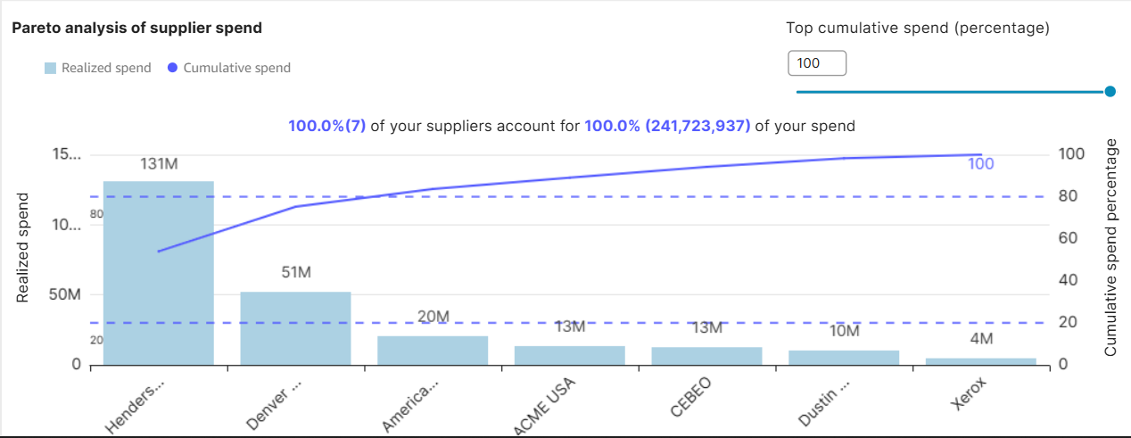
Spend Discovery
Pareto analysis of supplier spend
Analyses your company’s spend by supplier
Shows both realized spend and cumulative spend figures
Clicking a bar in the graph will refilter the entire dashboard (click again to deselect)
Spend is visualized as what was spend the last 12 months with this supplier

Slide 8
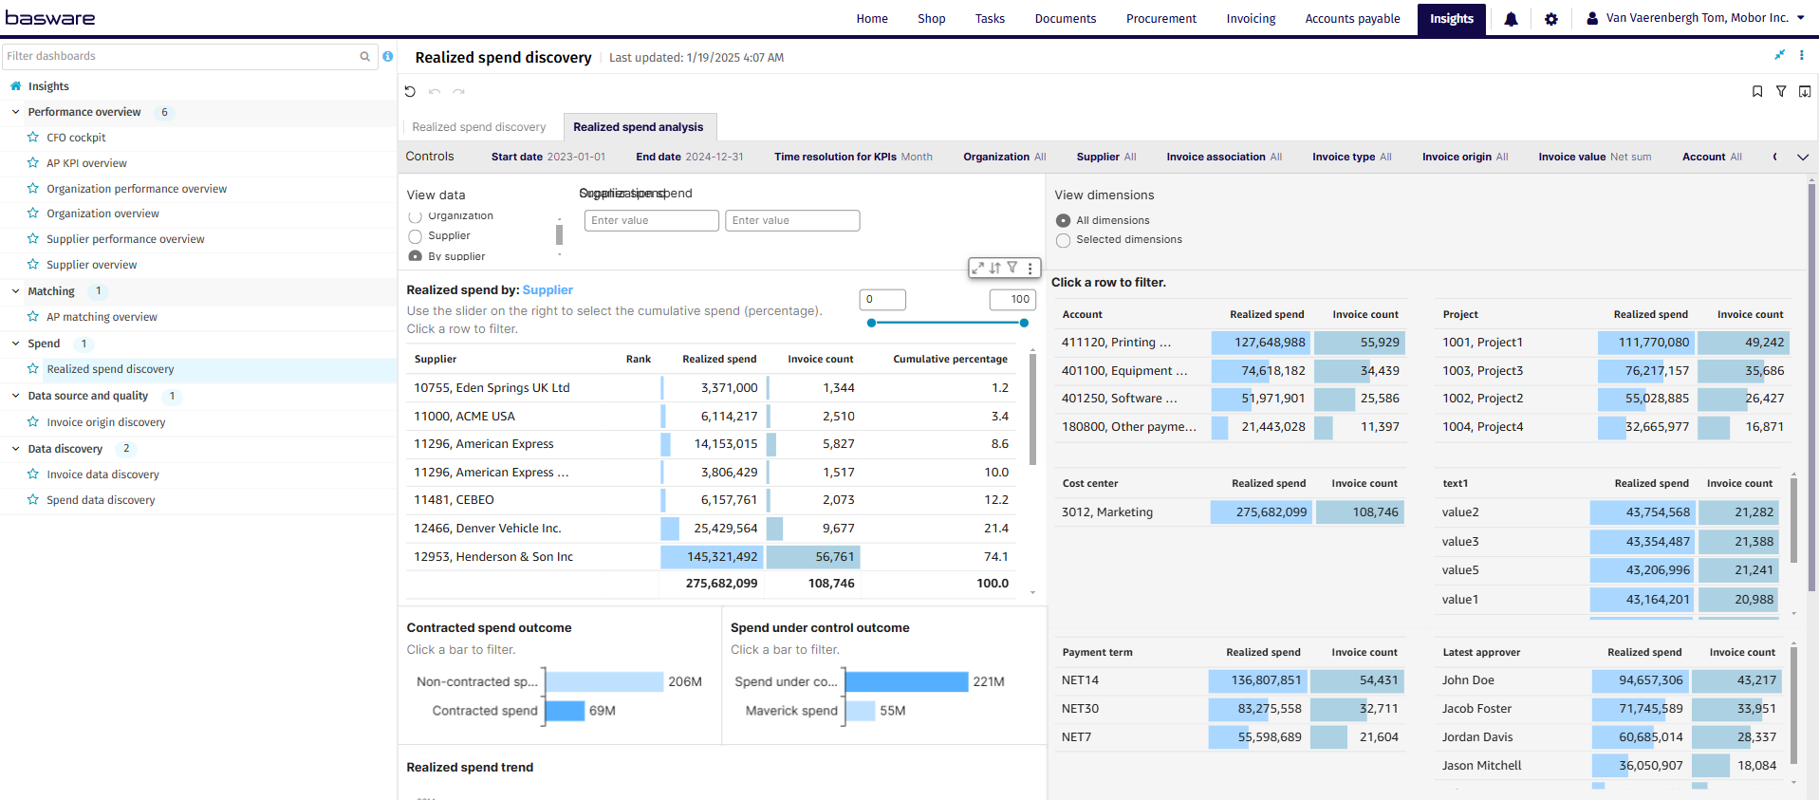
Realized Spend Analysis

Slide 9
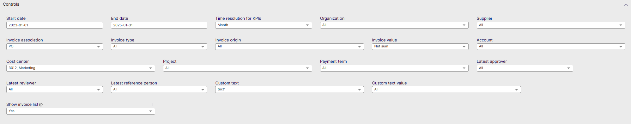
Realised Spend Analysis Controls
Start date: Select the beginning of the time interval. The selected date is included.
End date: Select the end of the time interval. The selected date is included
Time resolution for KPIs: Select how to group data over time. Options include per month, per quarter, or per year.
Organization: Filter data by your company organizations.
Supplier: Filter data by suppliers.
Invoice Association: Filter data based on whether the invoices are PO, Spend Plan or Non-PO invoices
Invoice Type: Filter data by invoice type.
Invoice Origin: Filter data by invoice origin
Invoice Value: Select if the invoice and spend values are shown as net sums or gross sums.
Invoice Type: Filter data by invoice type.
Invoice Origin: Filter data by invoice origin
Invoice Value: Select if the invoice and spend values are shown as net sums or gross sums.
Account: Select the company account to filter on
Cost Center: Filter data by cost centers
Project: Filter data by defined project
Payment term: Filter by Payment Term defined for your company
Latest approver: Filter data by the last person to approve
Latest reviewer: Filter data by the last person to review
Latest reference person: Filter data by the latest reference person
Custom Text: Filter on custom text field
Custom Text Value: Filter on custom text value
Show Invoice List: Select whether to show a table containing all the invoices

Slide 10
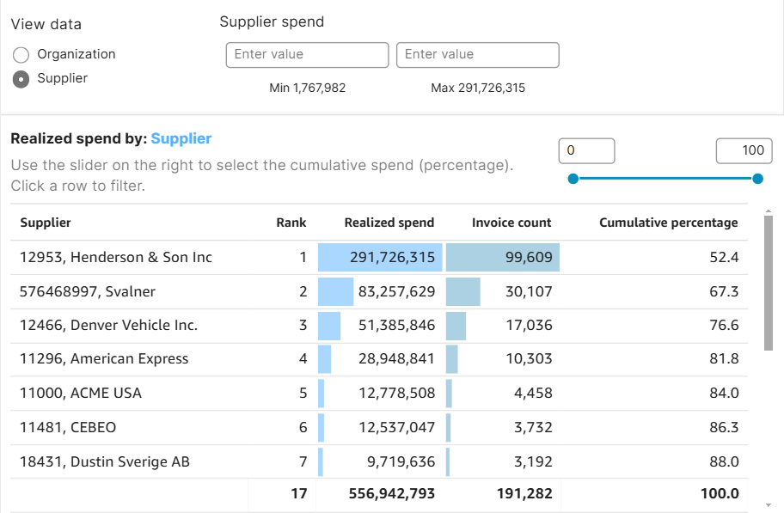
Realized Spend Analysis
Realized Spend Analysis
View data: per organization or per supplier
Will refilter the entire dashboard on the selected entity (organization or supplier)
Organization Spend Filter: Allows you to select a value between which to filter for selected organizations or suppliers
Realized spend Visualization:
Rank of the entity (by Realized spend)
Realized spend: Amount of total Spend, only includes invoices if they have a transfer date
Invoice count (number of invoices)
Cumulative percentage : Rank suppliers/organizations on descending/ascending order and calculates cumulative realized spend percentage

Slide 11
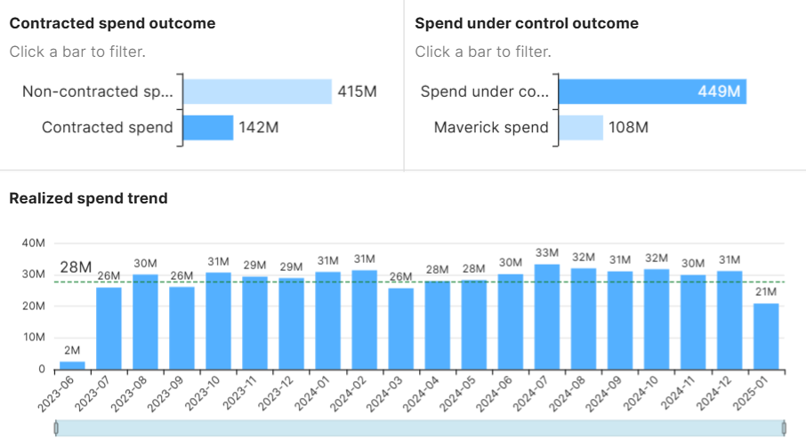
Realized Spend Analysis
Realized Spend Analysis
Contracted spend outcome
Graph that compares the contracted spend (transferred invoices that have a contract number) with the non-contracted spend
Spend under control outcome
Graph that compares the spend under control (spend amount that can be associated with a PO or SP) with the non-contracted or maverick spend
Realized spend trend
Shows the trend of Realized spend over the past months, set as the period in the controls, while also showing the average as the dotted line

Slide 12
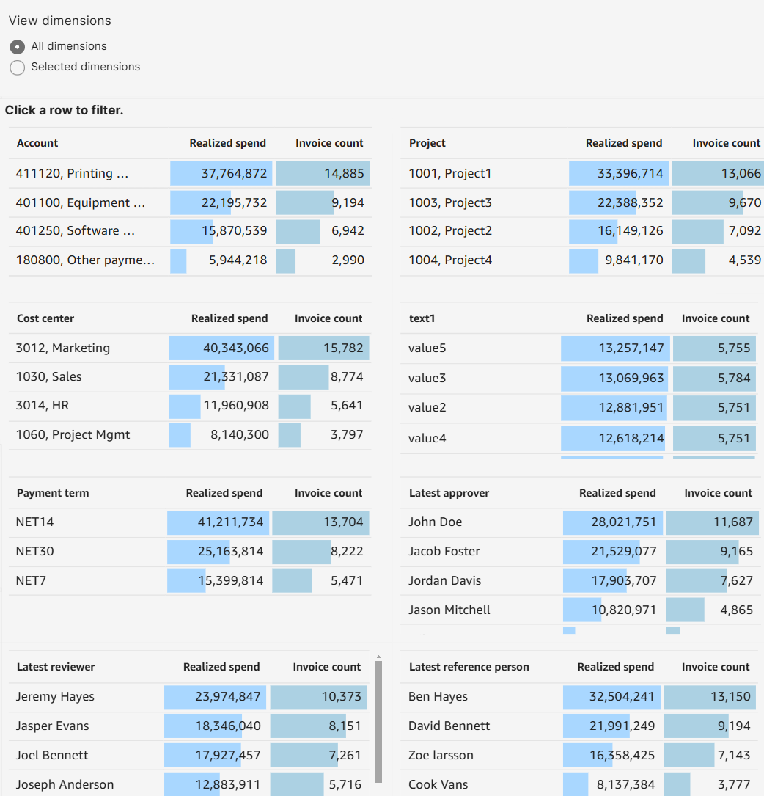
Realized Spend Analysis
Spend Dashboard for all Dimensions
Shows Realized spend (transferred invoices only) and Invoice count (total number of invoices for all Dimensions
Account
Cost Center
Payment Term
Latest reviewer
Project
Custom Field
Latest approver
Latest reference person
Clicking 1 record will filter the entire dashboard (deselect by clicking again on that same record)

Slide 13
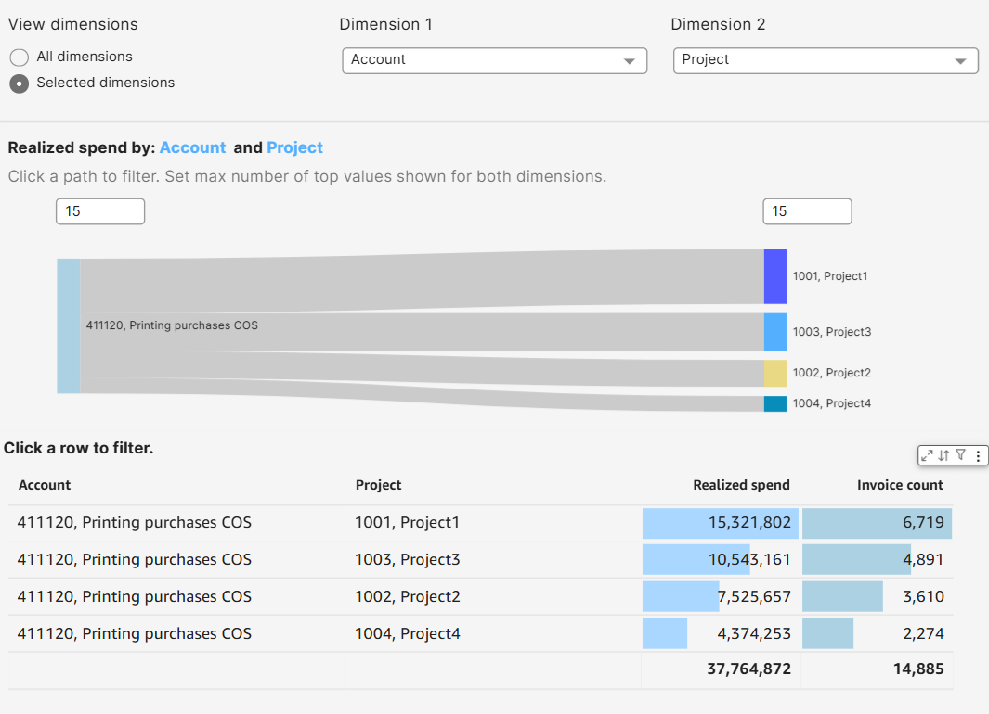
Realized Spend Analysis
Spend Dashboard for Selected dimensions
Shows Realized spend (transferred invoices only) and Invoice count (total number of invoices for specific Dimensions which you can select in the top 2 drop downs
Account
Cost Center
Payment Term
Latest reviewer
Project
Custom Field
Latest approver
Latest reference person
Clicking 1 record will filter the entire dashboard (deselect by clicking again on that same record)
There is also a Sankey diagram which will show the relationship between the 2 selected dimensions

