Slide 1
Process Exceptions
Insights Pro
Insights Essentials

Slide 2
Process Exceptions
Process Exceptions Dashboard
Summary of the Reporting:
These dashboards provide a comprehensive overview of which process exceptions are stopping invoices from being processed without any manual intervention (Touchless) over the entire AP process
It will show you what each specific exception is, and how long it takes to resolve these on average
You will also be able to see who in your organisation is working on the exceptions currently.
The goal of the dashboard is to allow you to prioritize which exceptions to focus on in your effort to avoid them as much as possible, and where you need to start your root cause analysis.
Suppliers can cause exceptions by the data they send, so make sure to also see which suppliers trigger the most exceptions, so you can contact them to avoid these situations.
Data quality and organization culture could also contribute, so make sure to also check how many exceptions are triggered within these dimensions aswell.
After taking action, the dashboard will allow you to track your progress in avoiding exception flows, period by period.

Slide 3
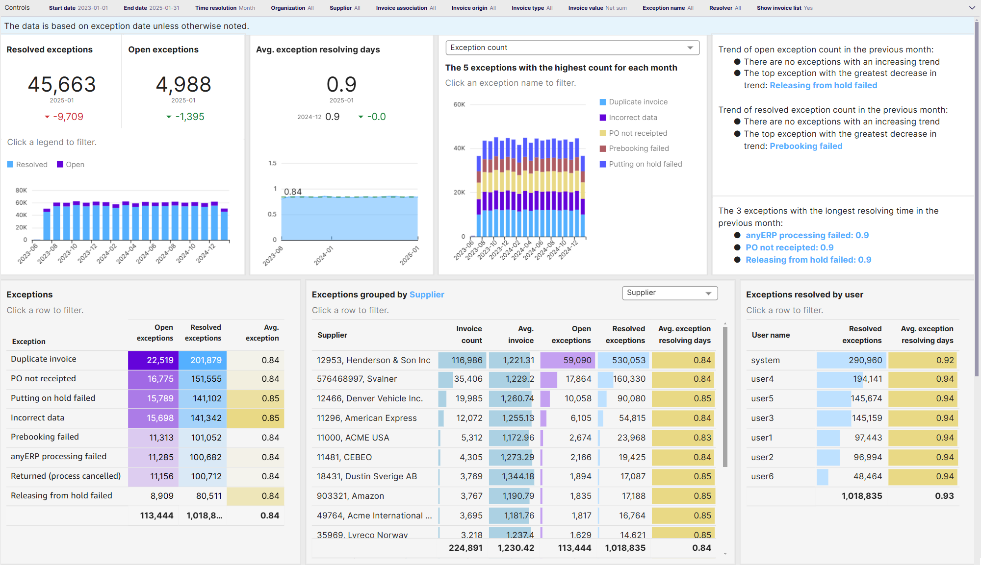
Process Exception

Slide 4
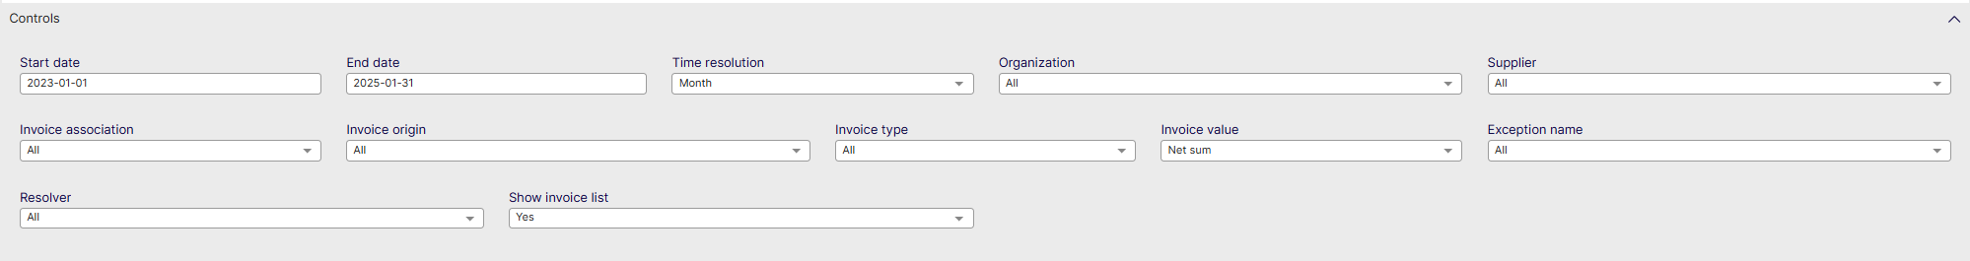
Process Exception - Controls
Start date: Select the beginning of the time interval. The selected date is included.
End date: Select the end of the time interval. The selected date is included
Time resolution for KPIs: Select how to group data over time. Options include per month, per quarter, or per year.
Organization: Filter data by your company organizations.
Supplier: Filter data by suppliers.
Invoice Association: Filter data based on whether the invoices are PO, Spend Plan or Non-PO invoices
Invoice Origin: Filter data by invoice origin
Invoice Type: Filter data by invoice type.
Invoice Value: Shows data based on Net Sum or Gross Sum
Exception Name: Filter data on specific exceptions detected
Resolver: Filter data based on a user who resolves exceptions, can be a person in your organisation or the system itself.
Show Invoice List: Select whether to show a table containing all the invoices

Slide 5
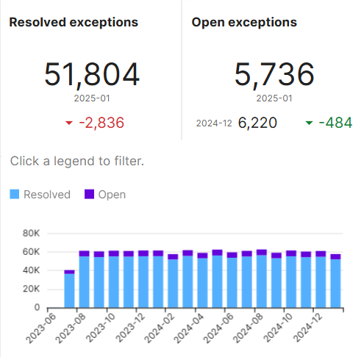
Process Exception – Resolved & Open
Resolved exceptions
Shows the amount of resolved exceptions for the selected time period
Also shows the change in exceptions since the previous time period (default = per month)
Open exceptions
Shows the amount of exceptions that remained open in the selected time period, while also showing the change in amount of exceptions open from the previous period.
In the Table below these are shown month by month and how Resolved and combine

Slide 6
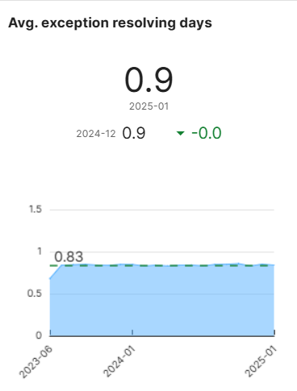
Process Exception – Avg. Resolving days
Average exceptions resolving days
This visualisation shows the average number of days it took in the selected time period, to resolve exceptions
This metric is shown in number of days
You are also able to see what the average days to resolve were in the previous month and how long it took
On the bottom of the screen these metrics are visualised in a table over the different time periods selected (default = months)

Slide 7
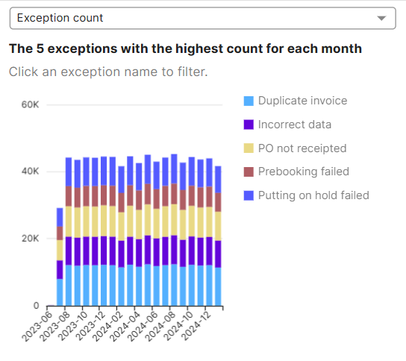
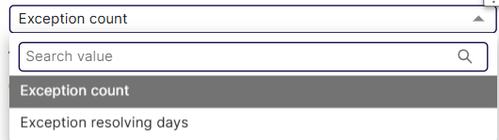
Process Exception – Exception count
Highest exception count
This visualisation shows the top 5 exceptions spread out over the different time periods selected
The drop down on the top allows you to show this data on count of exceptions or number of days it took to resolve them
Use this data to show & analyse which exceptions are happening the most, and take the most time out of processing your invoices

Slide 8
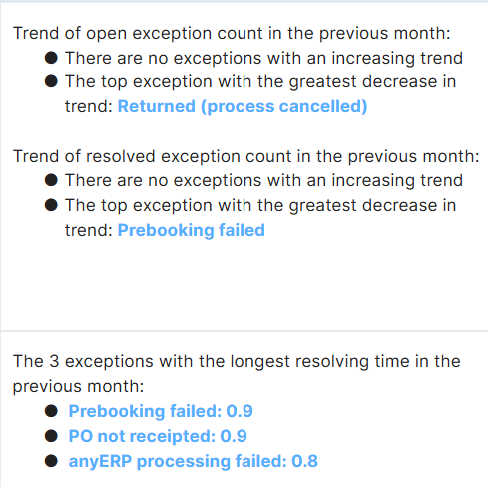
Process Exception – Exception Trend
Trend and longest resolving time
These insights exist to summarize which exceptions are seen with increasing frequency, and show you the nr 1 exception that occurred less in the past 2 time periods selected
The insights are available for both open and resolved exceptions
On the bottom of the insight it will show the 3 exceptions that took the longest to resolve in the previous time period

Slide 9
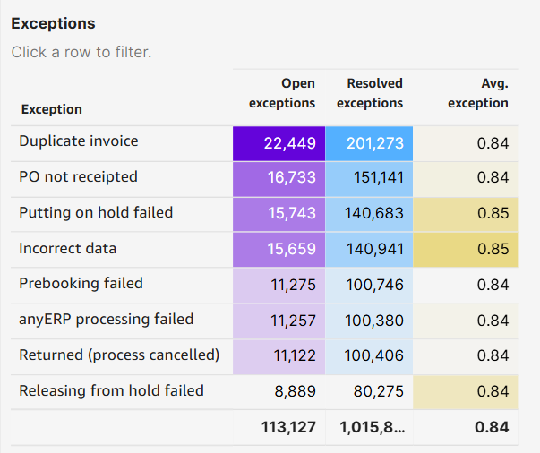
Process Exception – Exceptions list
Exceptions list
This visualisation shows the list of exceptions by type of exception.
Shows how many of a specific type are open, resolved and shows the average resolution time for the specific exception

Slide 10
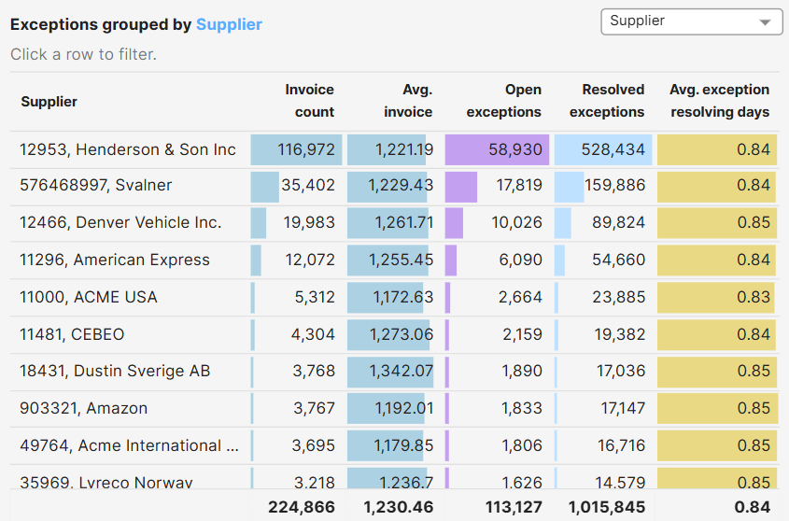
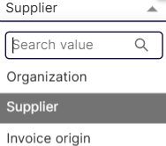
Process Exception – Exceptions Grouped
Exceptions grouped by
This visualisation shows the exception metrics per
Organisation
Supplier
Invoice Origin
As in other charts, it will show the invoice count for the dimension, the average invoice value, the amount of open exceptions, resolved exceptions and average days it takes to resolve an exception

Slide 11
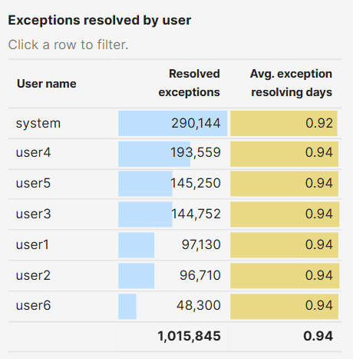
Process Exception – Exceptions user
Exceptions resolved by user
This table shows the number of exceptions resolved by people in your organisation and how long on average an exception took for the users to resolve.
Use this to see who to contact to find out how to avoid these exceptions towards the future.

