Slide 1
Invoice Origin discovery
Insights Pro
Insights Essentials

Slide 2
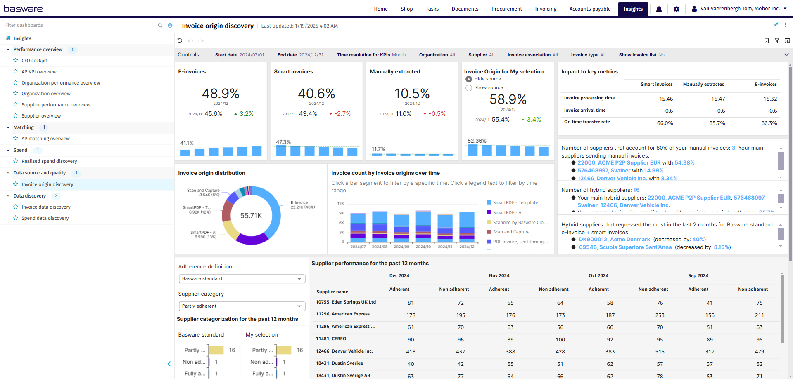
Invoice Origin Discovery

Slide 3
Invoice Origin Overview
Invoice Origin Overview
Summary of the goals:
  This dashboard provides a visual representation of the invoice origin landscape, highlighting the volume of invoices based on their origins. It also identifies which suppliers are utilizing the preferred origins and shows how various metrics and KPIs are influenced by these invoice origins.
Main questions answered:
Improved e-invoice or smart invoice adoption leads to better quality invoices, quicker throughput and better and faster processing of invoices. This will lead to improved Touchless matching rates, Touchless rates and overall process efficiency.
  Which e-Invoice receiving solution do our supplier use most?
  Can I compare the different Invoice origins, and track whether suppliers are switching to electronic?
  How is the number of e-invoices and/or smart invoices we receive developing?
  Are there Hybrid suppliers (paper + e-invoicing), which solution do they use the most, and in which way are they moving?
  Which are the non-compliant suppliers still sending manual invoices despite the roll out of smart ingestion services or e-invoicing requirements?

Slide 4
Invoice Origin Controls
List settings options: Describe the settings users can modify, such as data ranges, department filters, and other settings.
Start date: Select the beginning of the time interval. The selected date is included.
End date: Select the end of the time interval. The selected date is included
Time resolution for KPIs: Select how to group data over time. Options include per month, per quarter, or per year.
Organization: Filter data by your company organizations.
Supplier: Filter data by suppliers.
Invoice Association: Filter data based on whether the invoices are PO, Spend Plan or Non-PO invoices
Invoice Type: Filter data by invoice type.
Show Invoice List: Select whether to show a table containing all the invoices

Slide 5
Invoice Origin Groups
Invoice origin groups | Invoice origins included
E-invoice | E-invoice: Electronic invoice from direct Basware connection or virtual operator E-invoice (Interop): Electronic invoice from another e-invoice service provider (operator) network E-invoice (PEPPOL): Electronic invoice from Peppol network E-invoice (EDI): Electronic invoice from point-to-point EDI integration Portal Key-in: Basware Portal for Suppliers - Invoice key-in PO-Flip: Basware Portal for Suppliers - PO flip P2P Self billing: Basware P2P self-billing P2P Chargeback: Basware P2P chargeback 3rd party Electronic: One directional point-to-point delivery to AP automation
Smart invoice | PDF e-invoice: PDF e-Invoice, sent by email SmartPDF - AI: PDF invoice sent through SmartPDF and processed by machine learning SmartPDF - template: PDF invoice sent through SmartPDF and processed by template SmartPDF - self-validation: PDF invoice sent through SmartPDF and self-validated
Manually extracted invoice | SmartPDF-OCR: PDF invoice sent through SmartPDF and processed by Scan Partner Scan and Capture - email: Send via email as an image and processed by Scan Partner Scan and Capture - paper: Sent via postal mail and processed by Scan Partner Scan and Capture - self-scanned: Sent via postal mail, self-scanned and uploaded to Basware CloudScan self-validation - Scanned with CloudScan, self-validated CloudScan Basware validation, Scanned with CloudScan application, validated by Basware Manual: Manually created by user in Basware AP Automation Migration Basware P2P - migration External - External invoices imported from other sources than BT 3rd party OCR: One directional point-to-point integration of OCR service providers

Slide 6
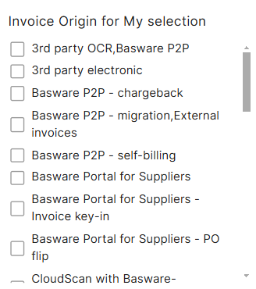
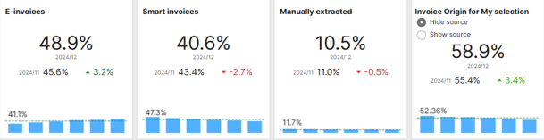
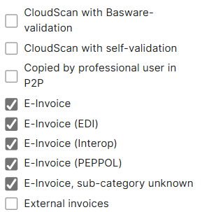
Invoice Origin Discovery
Main KPI’s
E-invoices are issued, received, and processed in digital form throughout its life- cycle. (e.g. XML, data file, EDI,...)
Smart invoices are digitized through automated extraction of invoice content. (mostly from PDF)
Manually extracted invoices require manual intervention for content extraction.
In visualizations, smart invoices and manually extracted invoices together are referred to as non-e-invoices
Invoice Origin for my selection: This KPI allows you to choose the specific invoice origin to filter on, als show the percentage of invoices from the total, received via this solution.

Slide 7
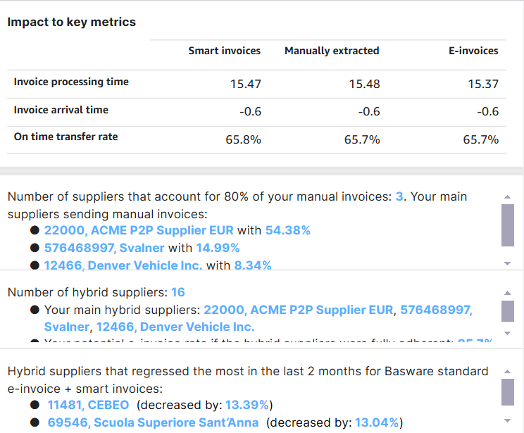
Insights Origin Discovery
Impact to Key Metrics
Invoice Processing time: Calulates the average time taken between the invoice creation in AP automation and the transfer completed time of the invoice for all received invoices of the defined origin type (column header).
  Times are in number of days
Invoice Arrival time: Average time for an invoice to arrive in Basware AP automation after the supplier has issued it. It is calculated as the difference between the invoice date and creation date in AP automation
  Times are in number of days lost
On time transfer rate: Calculates the amount of Invoices transferred before the due date on the invoice, compared to the total number of transferred invoices of the defined origin type (column header
Insights: Provides helpful insights to pinpoint on which suppliers to focus to reach a higher e-invoicing rate. Who to focus on to get better results with converting suppliers and points out hybrid suppliers who have regressed.

Slide 8
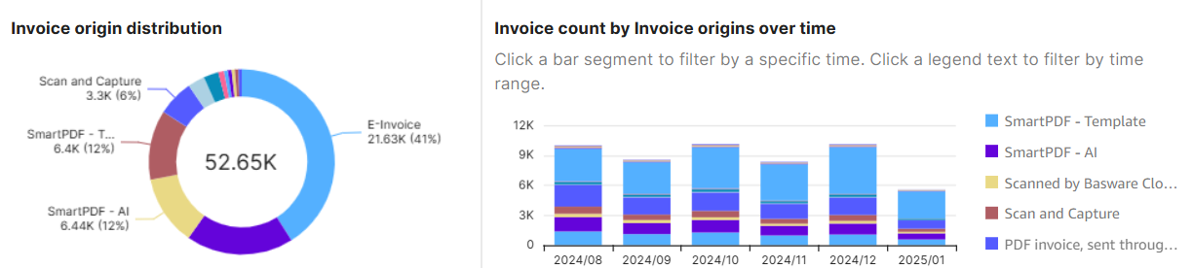
Invoice Origin Discovery
Invoice origin distribution and Invoice Count by Invoice origins over time
Invoice Origin Distribution:
  This Diagram shows how all of the invoice origins used by suppliers compare to each other in terms of invoice volumes
  The number in the middle is the total number of received invoices, clicking on 1 of the metrics will allow you to show you how much are received via the selected invoice origin, or exclude the origin from the metric entirely.
  Clicking a specific origin also allows you to drill down on volumes of selected months in the circle diagram.
Invoice Count by Invoice origins over time
  This chart also shows how many invoices are received via which invoice origin, but details how these invoice volumes per solution evolve over different timeframes.
  Clicking a specific invoice origin will allow for not only the bar graph but also the circle diagram to filter. Deselect by clicking the origin again in the bar chart.

Slide 9
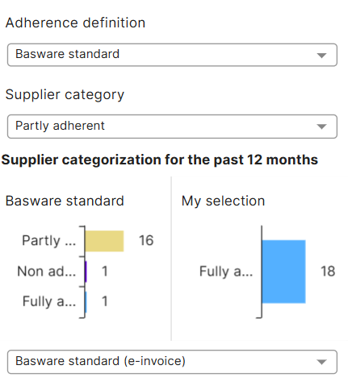
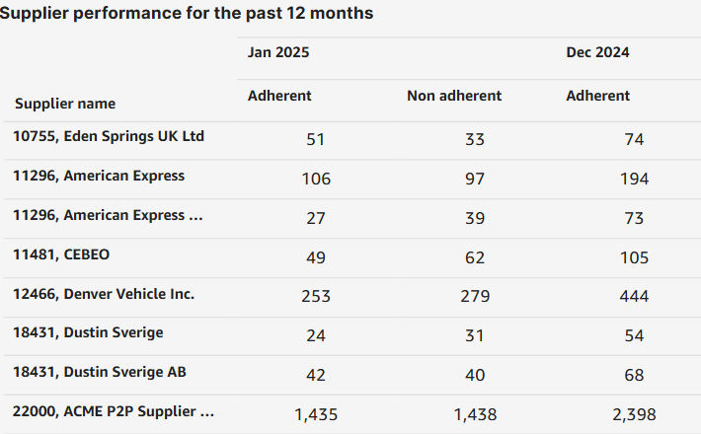
Invoice Origin Discovery
Adherence Definition
This visualization categorizes suppliers based on their
Adherence to e-invoicing:
Suppliers can be fully adherent (e-invoicing only, no pdf, no manual), non adherent (no e-invoicing), or partially compliant (sends both e-invoice and pdf/paper or invoices created manually).
Suppliers are categorized based on how they have sent invoices
for the past 12 months (default – can not be changed via controls).
Fully Adherent supplier: has sent only compliant invoices
Partially Adherent supplier: has sent both adherent and non adherent invoices
Non Adherent supplier: has sent only non adherent invoices
You can also change the adherence filters based on your selection in the top of the dashboard in the section: “Invoice origin for my selection”
Changing the filters will also change the table on the right where supplier adherency is shown month by month for the timeframe selected

