Slide 1
Data & Spend Discovery
Insights Pro
Insights Essentials

Slide 2
Invoice & Spend Data Discovery
Invoice & Spend Data Discovery Summary
Summary of the Reporting:
These dashboards will provide a visual representation of all Invoice header data along with calculated KPIs.
It provides a solution for building invoice data reporting, invoice lists and makes them downloadable.
Features:
All Invoice header fields are available, even custom fields and enriched fields from the network and AP automation
All Invoice data for the last 3 years is available but by default the date filter will be applied for 1 year.
Any user is able to apply dimensions and date filters to the invoice data and view the result.
Any user can download the full data of any search result.
Invoice, supplier and value counts (even per currency) are available, as well as a bar chart to create high level reporting
These dashboards will end the need for building own custom dashboards to have access to intermittent reporting in older solutions, it gives the user free reign over all of the invoice data and will allow for quality data access and reporting

Slide 3
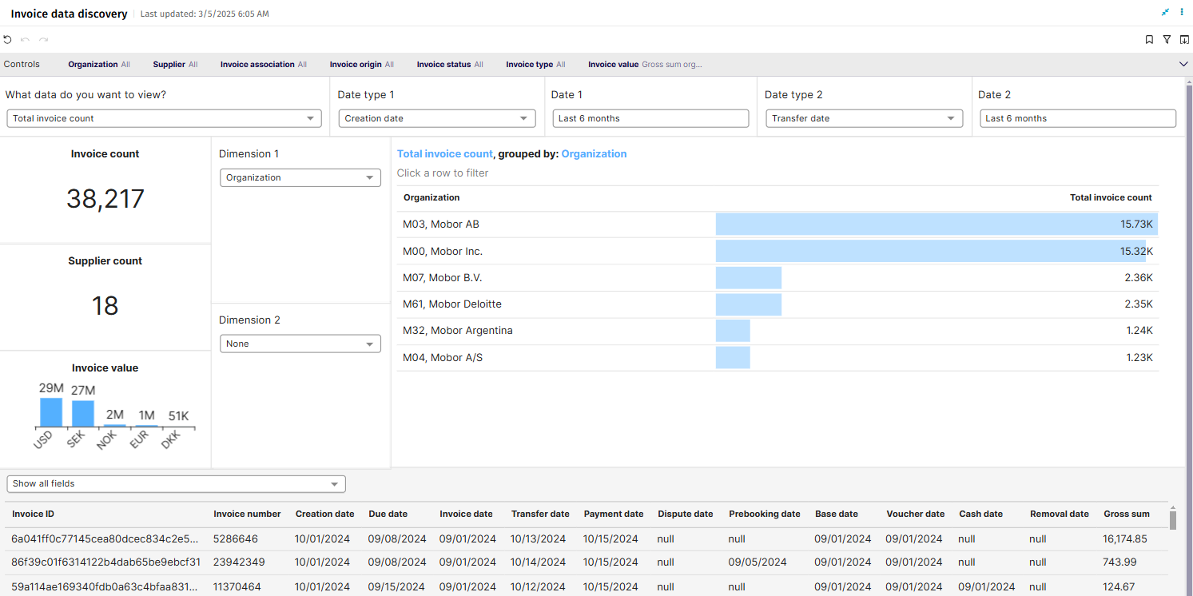
Invoice Data Discovery

Slide 4
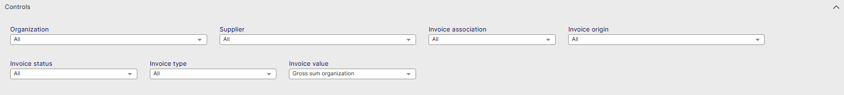
Invoice Data Discovery Controls
Organization: Filter data by your company organizations.
Supplier: Filter data by suppliers.
Invoice Association: Filter data based on whether the invoices are PO, Spend Plan or Non-PO invoices
Invoice Origin: Filter data by invoice origin
Invoice Status: Choose to see the invoices that are in a specific status (Cancelled, Closed, Completed, Matching...)
Invoice Type: Filter data by invoice type.
Invoice Value: Shows data based on Net Sum or Gross Sum but this time also per organization or for the company

Slide 5
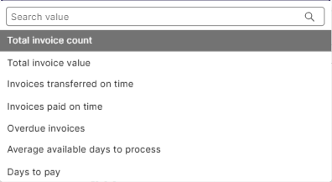
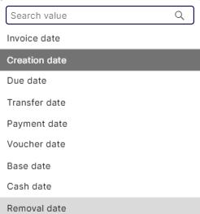
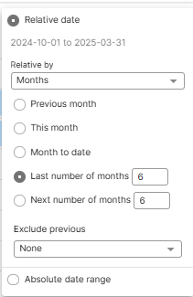
Invoice Data Discovery
Top controls for vizualisations

Slide 6
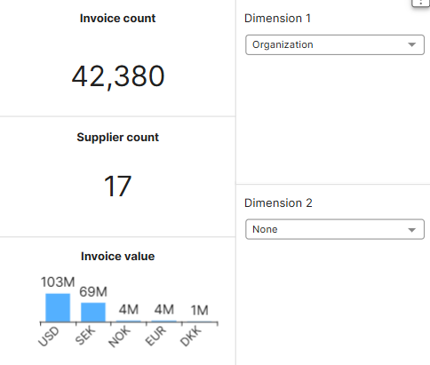
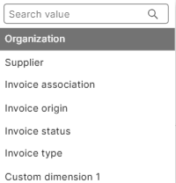
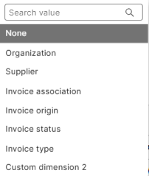
Invoice Data Discovery
Main KPI’s
Invoice count: Total number of Invoices
Supplier Count: Total number of suppliers
Invoice Value: Total invoice value per Currency
Dimension 1: Select the first dimension to represent the data in the column to the right
Dimension 2: Select the second dimension to represent the data in the column to the right

Slide 7
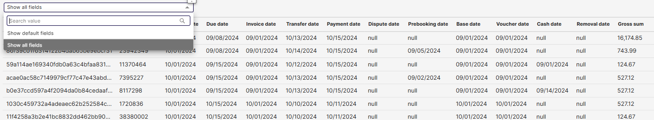
Invoice Data Discovery
Invoice List
You can choose to show only Basware’s Default fields, or show all fields, which will expand the data to show all custom fields configured in your AP automation solution

Slide 8
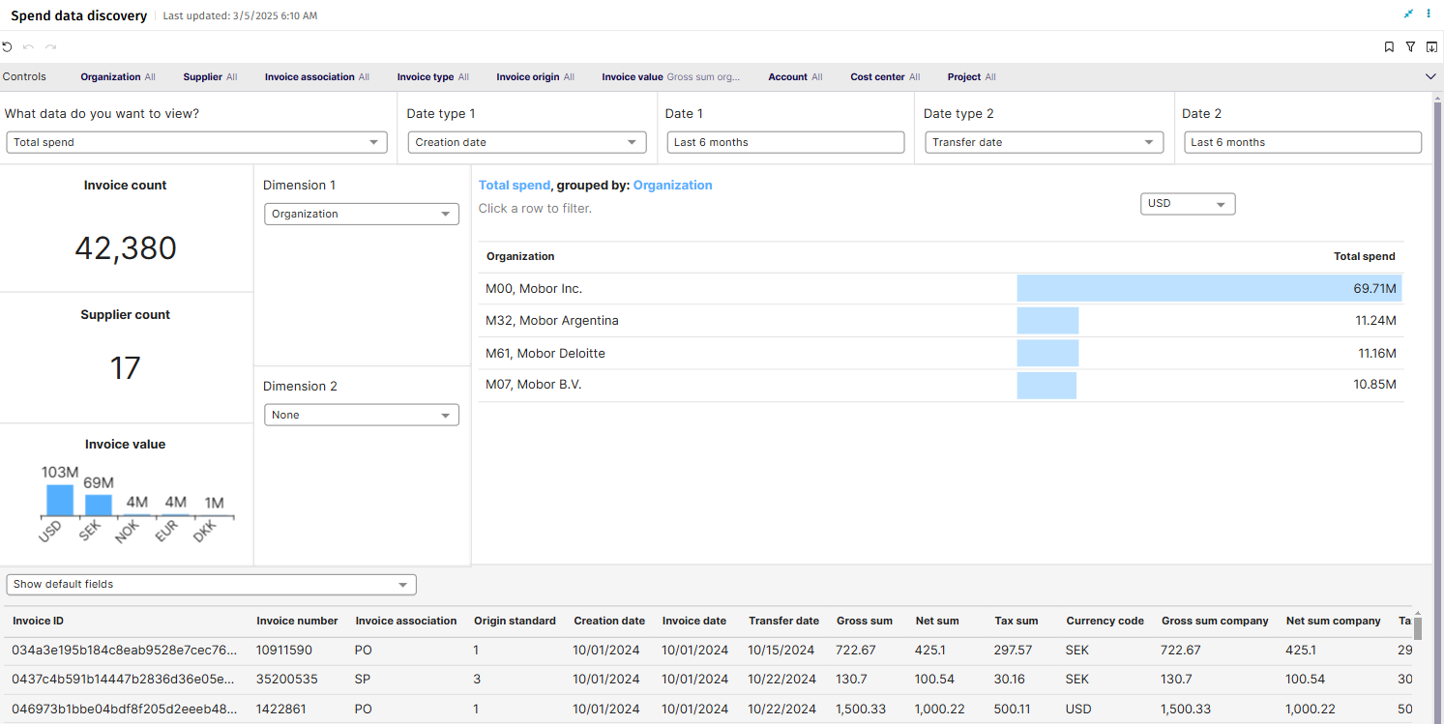
Spend Data Discovery

Slide 9
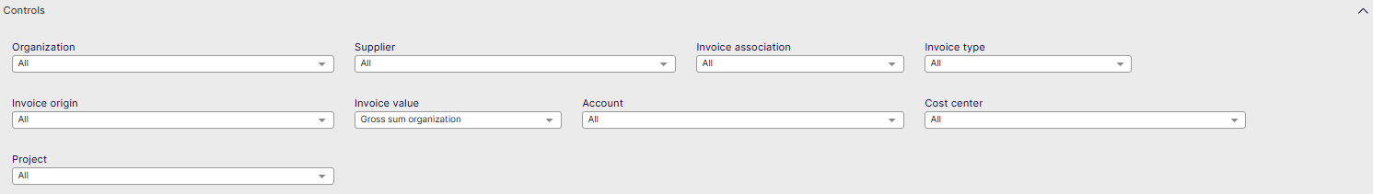
Spend Data Discovery Controls
Organization: Filter data by your company organizations.
Supplier: Filter data by suppliers.
Invoice Association: Filter data based on whether the invoices are PO, Spend Plan or Non-PO invoices
Invoice Type: Filter data by invoice type.
Invoice Origin: Filter data by invoice origin
Invoice Value: Shows data based on Net Sum or Gross Sum but this time also per organization or for the company
Account: Filter data by specific internal account
Cost Center: Filter Data by cost center
Project: Filter Data by internal project

Slide 10
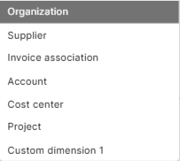
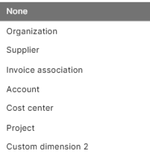
Spend Data Discovery
Main KPI
Invoice count: Total number of Invoices
Supplier Count: Total number of suppliers
Invoice Value: Total invoice value per Currency
Dimension 1: Select the first dimension to represent the data in the column to the right
Dimension 2: Select the second dimension to represent the data in the column to the right

Slide 11
Spend Data Discovery
Invoice List
You can choose to show only Basware’s Default fields, or show all fields, which will expand the data to show all custom fields configured in your AP automation solution

