Slide 1
CFO Cockpit
Insights Pro

Slide 2
CFO Cockpit Dashboard Overview
CFO Cockpit Summary
The CFO Cockpit Dashboard provides a strategic snapshot of key performance indicators relevant to accounts payable and procurement. This dashboard facilitates immediate visibility into financial metrics such as invoice volume, average processing times, and compliance rates with after-the-fact purchase orders (ATF POs).
It integrates critical data points across the P2P cycle with advanced filtering options, allowing CFOs to swiftly gauge short-term changes and long-term trends, ensuring effective oversight and proactive management of financial operations.
An AP manager can drive AP operations to achieve efficiency, enhanced productivity, and improved outcomes. The ability to forecast upcoming invoice volumes enables AP teams to better prepare for upcoming workload. Increased productivity and compliance contribute to cost reduction.
Lagging Areas Identification: The dashboard helps users identify AP areas that need attention. Insights helps to get the user to focus exactly where attention is needed. By analyzing metrics, it highlights where improvements are necessary.
Monitoring Improvement Actions: The dashboard tracks improvement initiatives. Users can assess whether implemented actions are positively impacting AP performance.
KPI Details: Each Key Performance Indicator (KPI) is accompanied by a detailed outcome. This provides visibility into the success level of each KPI, allowing users to make informed decisions.
Cross-Filtering: The dashboard incorporates cross-filtering, enabling users to explore correlations between different outcomes. For example, they can analyze how changes in one KPI affect others

Slide 3
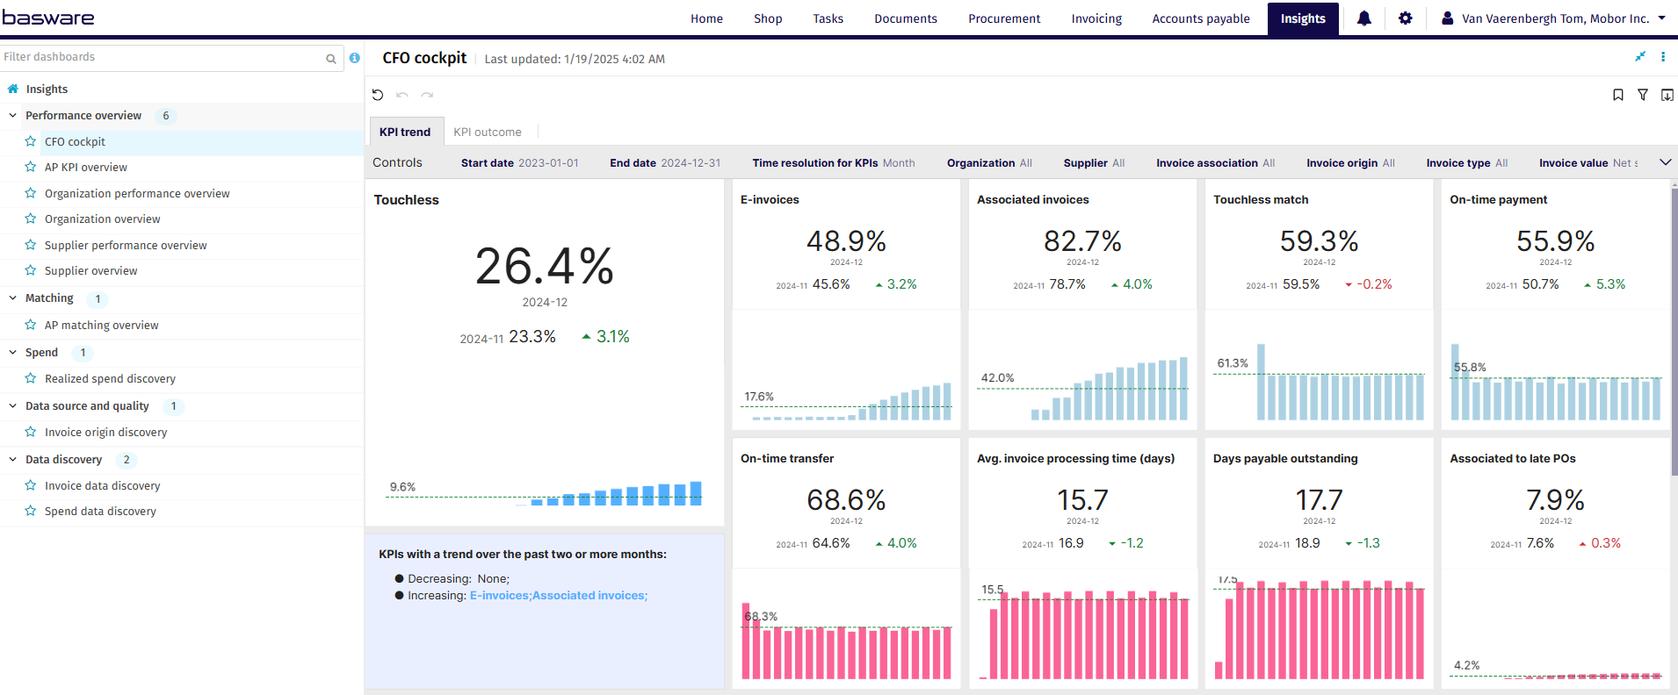
CFO Cockpit – KPI trend

Slide 4
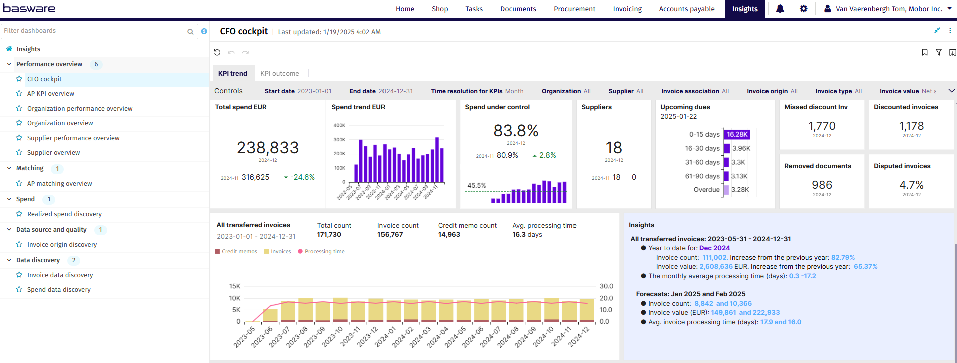
CFO Cockpit – KPI trend

Slide 5
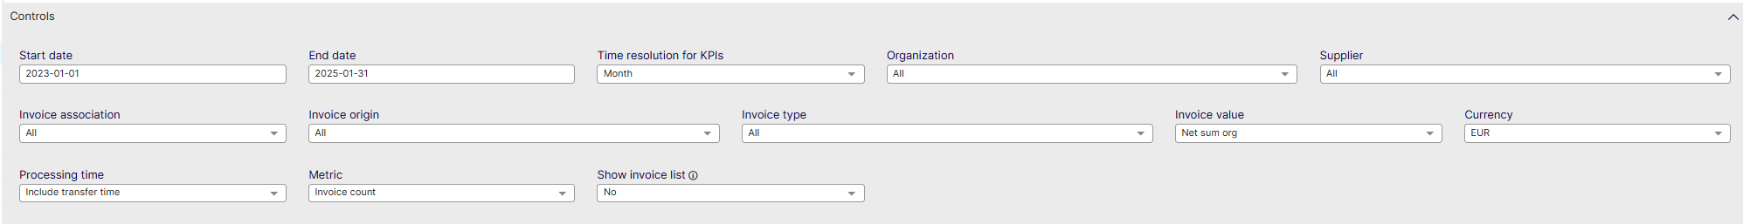
CFO Cockpit Controls
List settings options: Describe the settings users can modify, such as data ranges, department filters, and currency settings.
Start date: Select the beginning of the time interval. The selected date is included.
End date: Select the end of the time interval. The selected date is included
Time resolution for KPIs: Select how to group data over time. Options include per month, per quarter, or per year.
Organization: Filter data by your company organizations.
Supplier: Filter data by suppliers.
Invoice Association: Filter data based on whether the invoices are PO, Spend Plan or Non-PO invoices
Invoice Origin: Filter data by invoice origin
Invoice Type: Filter data by invoice type.
Invoice Value: Select if the invoice and spend values are shown as net sums or gross sums.
Currency: Select the currency used in value-based calculations. Currencies are not converted.
Processing Time: Select whether transfer time is included in processing time calculation: Include transfer time, Exclude transfer time.
Metric: Select the metric applied in KPI visuals: Invoice count, Invoice value.
Show Invoice List: Select whether to show a table containing all the invoices

Slide 6
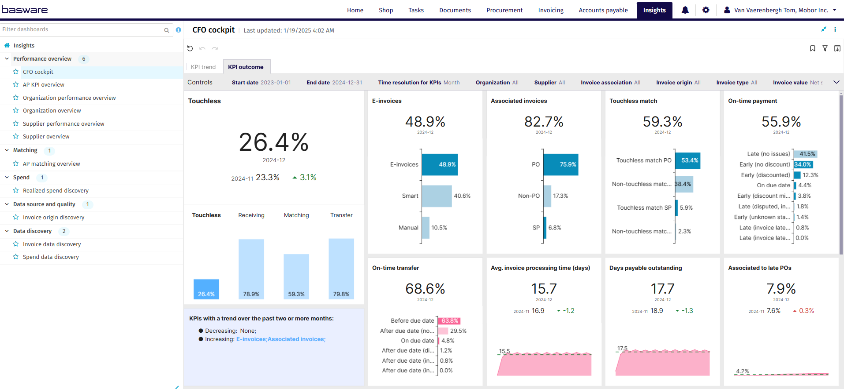
CFO Cockpit – KPI outcome

Slide 7
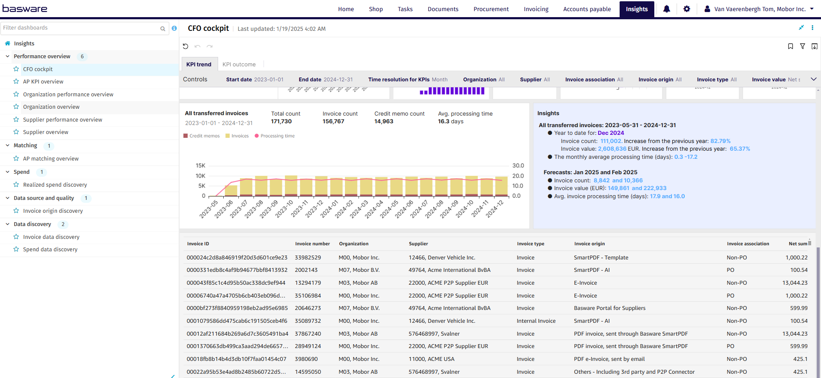
CFO Cockpit – KPI outcome

Slide 8
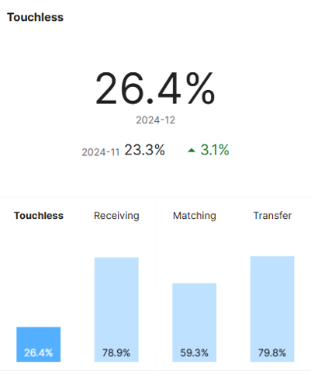
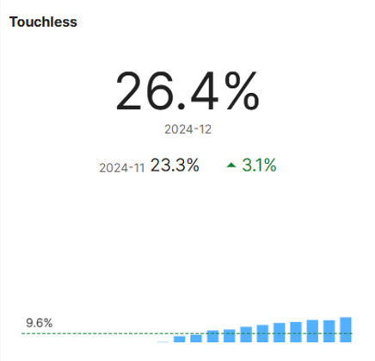
CFO Cockpit – Touchless Rate
Percentage of associated invoices that are touchless
The Touchless Rate is the percentage of invoices created and processed automatically, with no manual task or actions of all of the invoices transferred
Measured either by invoice count or value.
Document is not created manually
All tasks are executed automatically
No user actions performed
All actions are automatic across Receiving, Matching, Workflow and Transfer
In previous versions, a customer could have had cancel and resend done but all tasks executed automatically, which gave a false positive, meaning the invoice was touched but showed as touchless.
Similarly, in previous versions a manually created invoice may have had all tasks executed automatically which is wrong because someone in AP spent time doing manual work to get the invoice into the system

Slide 9
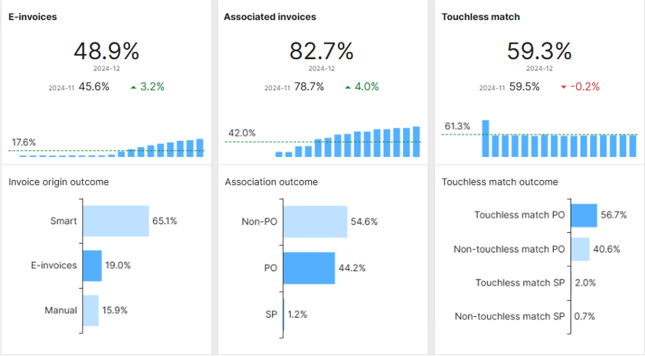
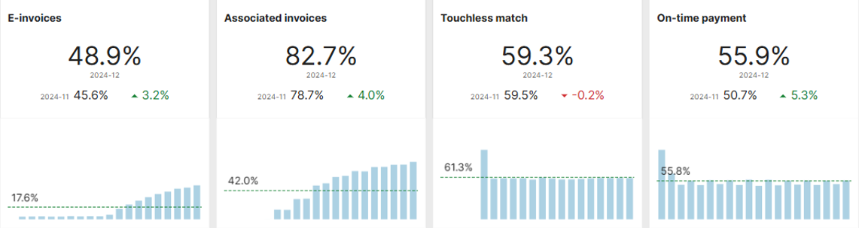
CFO Cockpit – E-invoices
Percentage of transferred invoices classified as e-invoices
Measured either by count or value. This metric outcome is a break down of all invoice receiving channels in three groups: e-invoices, smart invoices, and manually extracted invoices.
E-invoices are issued, received, and processed in digital form throughout its life cycle. (e.g. XML, data file, EDI,...)
Smart invoices are digitized through automated extraction of invoice content. (mostly from PDF)
Manually extracted invoices require manual intervention for content extraction. In visualizations, smart invoices and manually extracted invoices together are referred to as non-e-invoices

Slide 10
CFO Cockpit– Associated Invoices
Percentage of invoices associated with purchase orders or spend plans
Measured either by count or value.
PO: invoices associated with purchase order
SP: invoices associated with spend plan
Non-PO: non- associated invoices
If line level matching is used, please note that an invoice is considered associated as soon as 1 line could be associated with a PO or Spend Plan

Slide 11
CFO Cockpit – Touchless Match
Percentage of associated invoices that are touchless matched
Measured either by count or value.
An invoice is matched touchless if it is matched in a single pass, with no matching exceptions, and all coding rows are generated automatically.
The Information is broken down in 4 categories:
Touchless match PO (with Purchase Order)
Non-Touchless match PO (with Purchase Order)
Touchless match SP (with Spend Plan)
Non-Touchless match SP (with Spend Plan)
*Important* Non-PO invoices that did not go through matching are no longer included in this metric

Slide 12
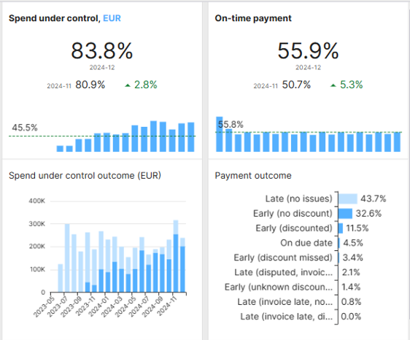
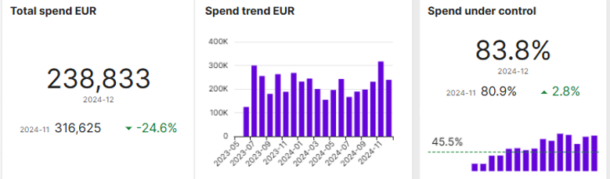
CFO Cockpit – Spend Under Control
Percentage of controlled spend
This metric is not measured by number of invoices, rather always by total value of the spend.
This metric compares the amount of controlled spend on all invoices in range with the amount of spend that was not controlled (un-ordered).
Controlled spend includes all pre-approved spend.
1 invoice may contain both ordered and un-ordered spend.
E.g. if an invoice contains 3 lines that were ordered, but 2 that were not, this metric will only consider the value of the 3 ordered lines as ‘under control’, and consider the other 2 as ‘uncontrolled spend’

Slide 13
CFO Cockpit – On-Time Payment
Percentage of invoices paid on time
An invoice is considered paid on time if it is paid on or before the due date. This can be measured either by count or value.
Note: This metric is calculated only for invoices with payment information, which may be missing from the most recent invoices. As a result, this KPI may change over time.

Slide 14
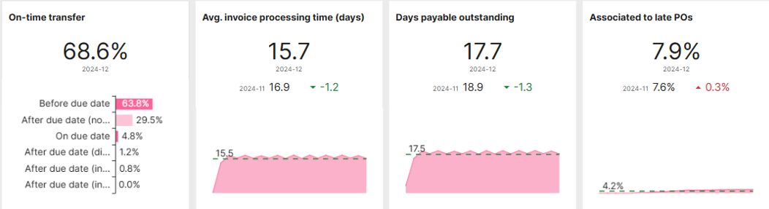
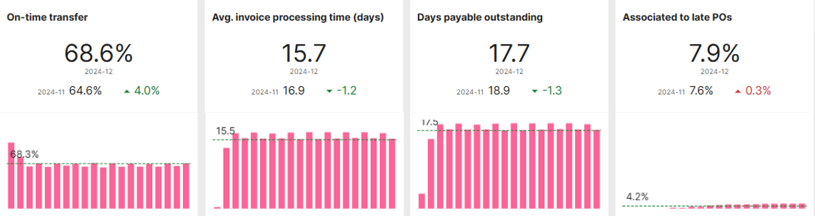
CFO Cockpit – On-time transfer
Percentage of Invoices that are transferred on time
An invoice is considered transferred on time if it is transferred on or before the due date. This can be measured either by count or value of the invoices, and shows segmentation of the invoices by their transfer outcome:
Before Due Date
After Due Date (no Issues)
After Due Date(Disputed, Invoice On Time)
After Due Date(Invoice Late, not disputed)
After Due Date(Disputed, Invoice Late)

Slide 15
CFO Cockpit – Average Invoice processing time
Analysis of the average invoice processing time
Sample mean of the invoice processing time: Invoice processing time is measured in days from the creation date to either the transfer date or to the date when it is ready for transfer.
The used definition is selectable by the user. If the metric is set to “Value”, then only invoices in the selected currency are considered.
The lower this metric is, the better.
In the example, the average time an invoice took to move from its Creation date to Transfer date is 15,7 days
It also shows the average over different months, which is 15,5.
It also shows the difference between December and the month before, which in this case is a decline of 1,2 days on average per invoice (positive)

Slide 16
CFO Cockpit – Days payable outstanding
Days payable outstanding
Average days to pay. This is measured as the average number of days between the invoice creation date and payment date. If the metric is set to “Value”, then only invoices in the selected currency are considered.
This dashboard shows an analysis of the processing time from invoice creation to payment.
It shows the days payable outstanding for two of the most recent time periods and their difference.

Slide 17
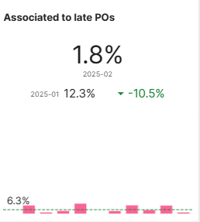
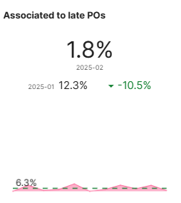
CFO Cockpit – Associated to late PO’s
Associated to late POs
Shows how many invoices were associated with PO’s that were created too late.
Any PO that was provided after the invoice was received are considered

Slide 18
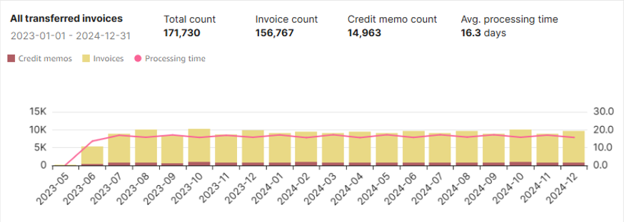
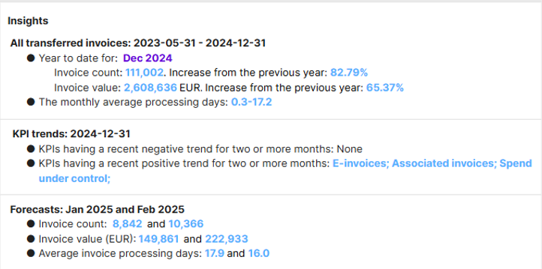
CFO Cockpit – All Transferred & Insights
Mean value of the processing time for all invoices in the selected period
Insights
Invoice processing time is measured in days from the creation date to either the transfer date or to the date when it is ready for transfer.
If the metric is Invoice value, then only invoices in the selected currency are considered.
Provides an analysis on how the dashboard KPI’s have evolved over time
Provides a forecast based on past events as to how KPI’s will develop over time

