Slide 1
Shared dashboard functionality
Insights Essentials
Insights Pro

Slide 2

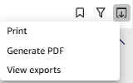

Overall Functionality
Functionality present on every Dashboard
The Arrow keys will allow you to:
Reload the entire dashboard
Go back one step – undo a previous selection
Go forward one step – redo an undone selection
The bookmark functionality allows you to save any dashboards with filters applied, and set that bookmark as your default view after saving
The filters tab wish show the filters currently applied, these can be changed here as well, but will require knowledge on specific naming conventions
The download and Export capabilities:
These features allow you to export all data, either by printing, generating PDF or exporting the data to CSV or XLS
These features are also available for every specific visualization by hovering over it and clicking the 3 dots.
Every Visualization can be put to full screen to focus on it, show all the data or increase the visuals for easy screenshots, simply hover over and click expand

Slide 3
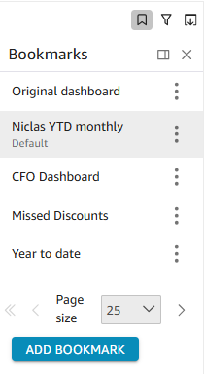
Bookmarks
Bookmarks saved by your users
Bookmarks can be created by your users on any dashboard
These are useful if users:
Wish to save a specific view for reporting
Always have the data they need to see in front of them by clicking once
Make sure they do not need to repeat filters every time
Bookmarks can be added and removed per user
A description needs to be provided for every bookmark created
Note: At the moment bookmarks cannot be shared but this will be possible in the future

Slide 4
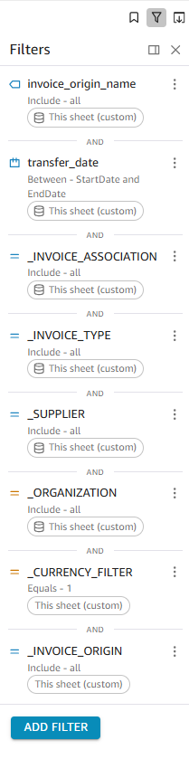
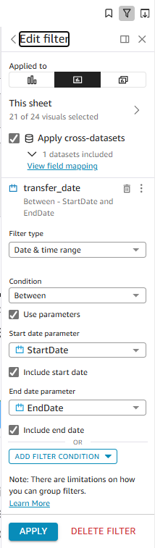
Filters
Advanced Filters
These advanced filters can be used to check what the original naming conventions are of the data used in creating and filtering the insights reporting
With the advanced filters feature, a user could in theory reshape how a dashboard looks like
To use this feature effectively, it is recommended that users do have a deep knowledge of technical processes and naming

Slide 5
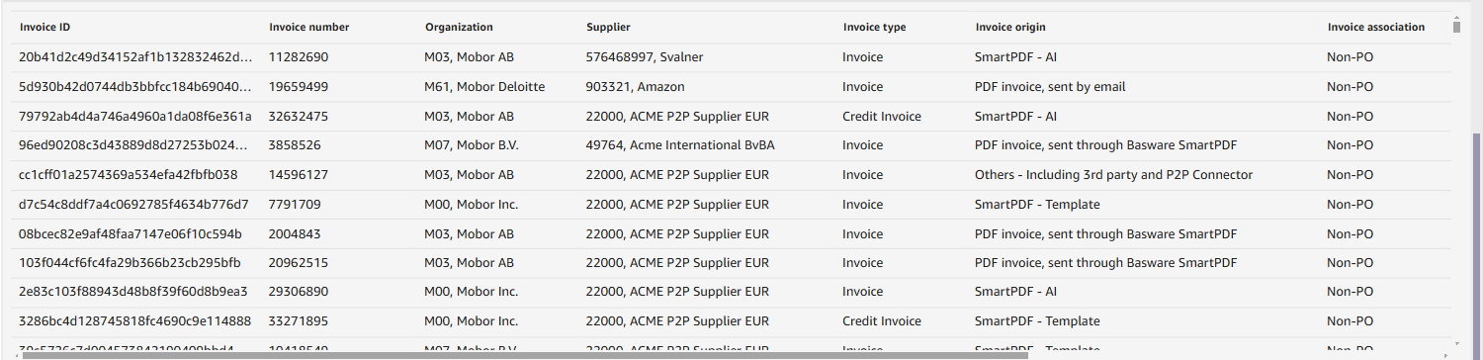
Invoice List
Invoice list
In almost every insights dashboard, an invoice list can be accessed for you to easily have a list of invoices that are behind a selection you made on the dashboard in question
This gives you a way to see actual real-life examples of the invoices affecting the metrics shown, dive deeper into matching exceptions or see examples of invoices that were send from a specific invoice origin

