Slide 1
Insights Home
Insights Essentials
Insights Pro

Slide 2
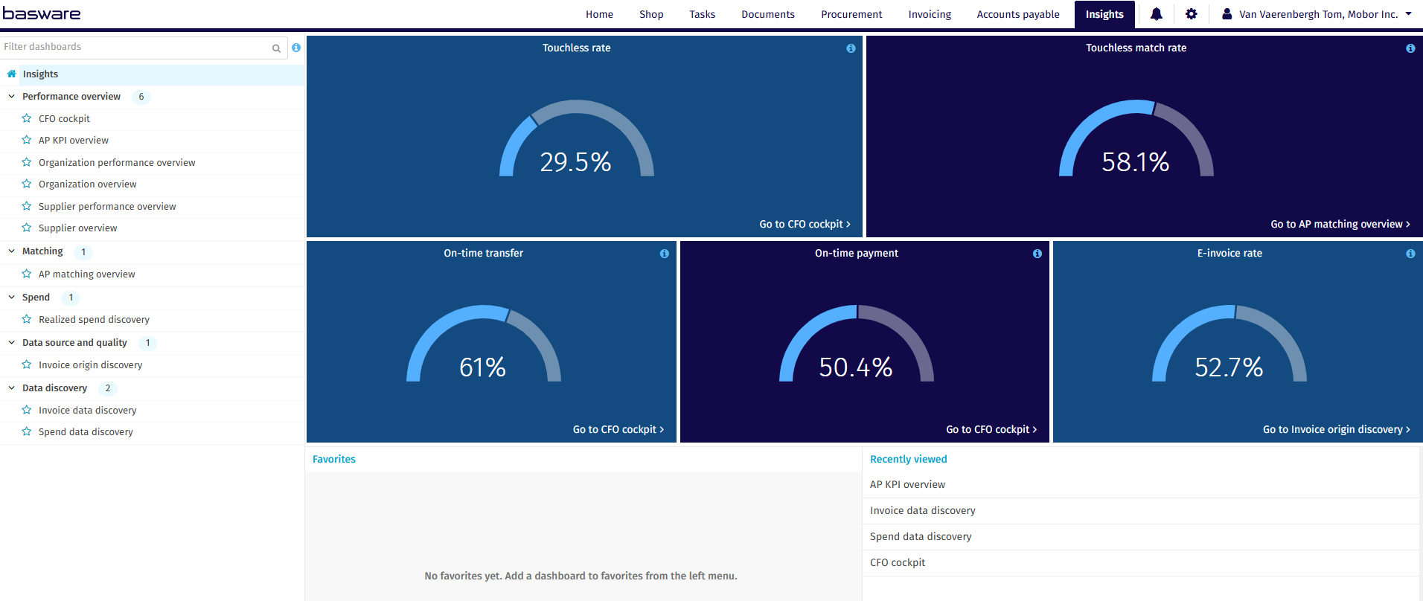
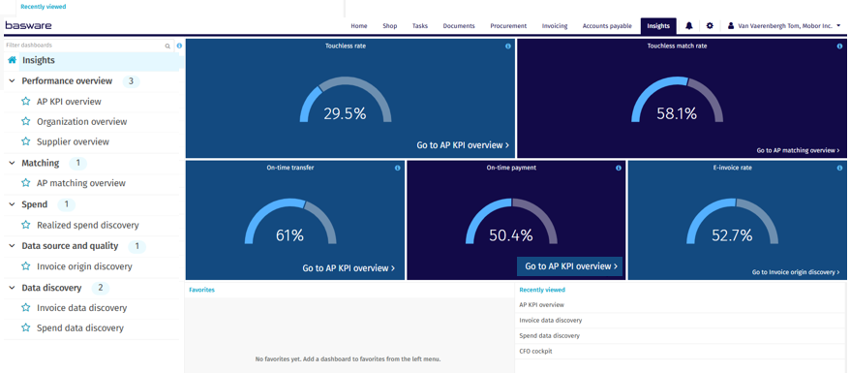
Insights Home
Insights Pro
The value of the metrics is shown based on the organisation rights a user has. In practice this means that a user will only see the performance of a metric for organisations they have rights to in Admin
Insights Essentials

Slide 3

Touchless Rate
Touchless Rate
The Touchless Rate is the percentage of invoices created and processed automatically, with no manual task or actions of all of the invoices transferred in the last 30 days

Slide 4

Touchless Match Rate
Touchless Match Rate
The Touchless Match Rate is the percentage of invoices matched automatically in a single pass, with no exceptions and with all coding rows generated automatically from all invoices transferred in the last 30 days.

Slide 5
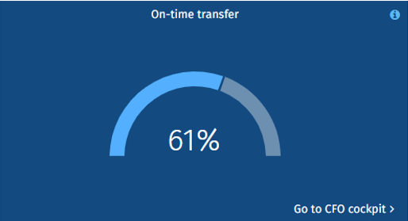
On-time Transfer
On-time Transfer
On-time transfer rate is the percentage of invoices transferred by or before their due date out of all transferred invoices in the last 30 days

Slide 6
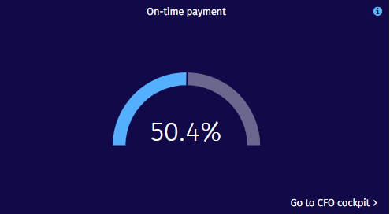
On-time Payment
On-time Payment
On-time payment rate is the percentage of invoices paid on or before their due date out of all paid invoices in the last 30 days.

Slide 7
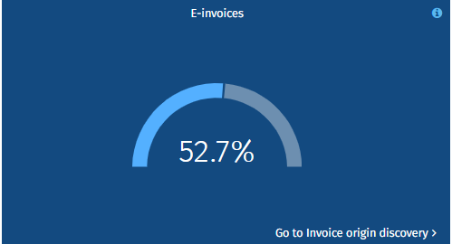
E-Invoicing Rate
E-Invoices
E-Invoice rate is the percentage of invoices classified as
e-invoices out of all invoices transferred in the last 30 days. As a standard this metric does not include PDF processed by AI or template (Smart Invoices), but can this can be customized in the Invoice Origin Discovery Dashboard

