Slide 1
Supplier overview
Insights Essentials

Slide 2
Supplier Overview
Supplier Overview Summary
Summary of the goals:
  This dashboard provides a comprehensive analysis of supplier performance relative to accounts payable KPIs.
  Users can access detailed outcomes for any supplier, measured using either value-based or volume-based metrics.
  The dashboard enables users to easily distinguish between high and low performers for each KPI.
Main questions answered:
A user of this dashboard can come away with a clear strategy for which suppliers to engage with, to enhance each AP KPI. The dashboard also provides visibility into whether the KPIs are improving as a result of the implemented improvement actions. Additionally, users can analyze each KPI in depth, examining the relationships between different metrics.
  Which are the top suppliers with whom we do the most purchases with?
  Out of those suppliers which the low performers for each of the KPIs?
  What is the distribution of suppliers that are using e-invoices, smart invoices and manual invoices?
  Which are the suppliers that are sending manual invoices?
  Which are the suppliers who are sending non-PO invoices?
  Which are suppliers which has high spend not under control?
  What is the distribution of suppliers for different invoice associations?
  What is the distribution of suppliers for different payment outcomes?
  Which suppliers are sending late invoices?
  Which suppliers are we missing out on discounts ?
  Which suppliers have high processing time especially for e-invoices and associated invoices ?
  Which are the suppliers to pay attention to improve e-invoice rate, association rate, spend under control, payment outcome, processing time ?

Slide 3
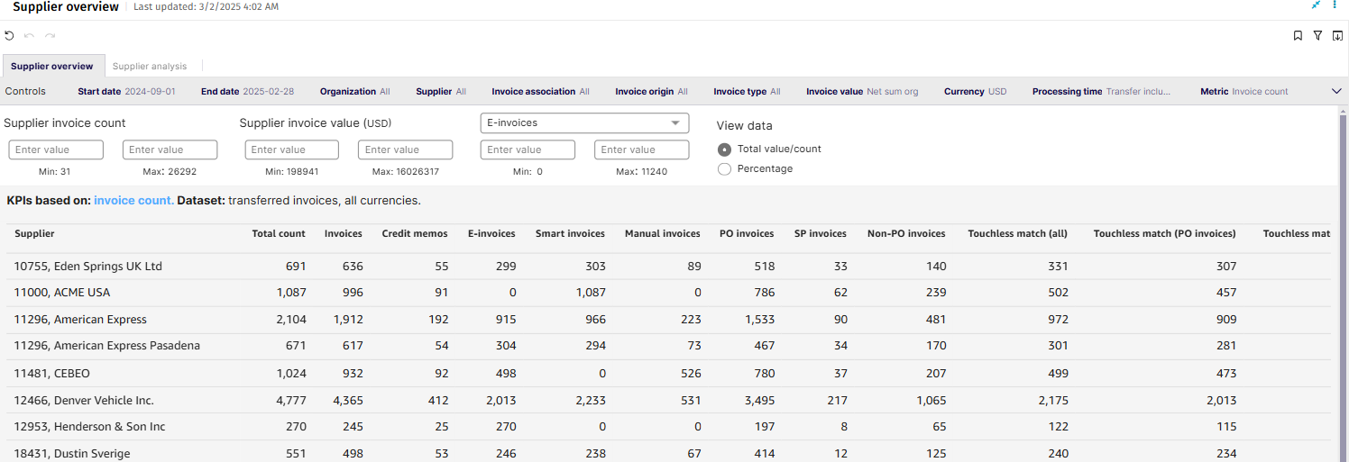
Supplier Overview

Slide 4
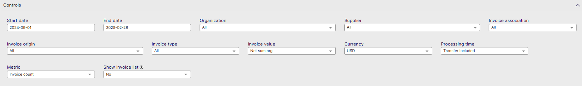
Supplier Overview Controls
List settings options: Describe the settings users can modify, such as data ranges, department filters, and currency settings.
Start date: Select the beginning of the time interval. The selected date is included.
End date: Select the end of the time interval. The selected date is included
Organization: Filter data by your company organizations.
Supplier: Filter data by suppliers.
Invoice Association: Filter data based on whether the invoices are PO, Spend Plan or Non-PO invoices
Invoice Origin: Filter data by invoice origin
Invoice Type: Filter data by invoice type.
Invoice Value: Select if the invoice and spend values are shown as net sums or gross sums.
Currency: Select the currency used in value-based calculations. Currencies are not converted.
Processing Time: Select whether transfer time is included in processing time calculation: Include transfer time, Exclude transfer time.
Metric: Select the metric applied in KPI visuals:
Invoice count, Invoice value, Invoice Processing time
Show Invoice List: Select whether to show a table containing all the invoices

Slide 5
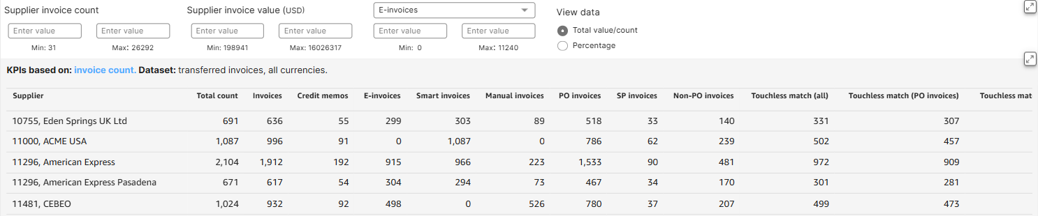
Supplier Overview
Supplier Overview in-sheet controls (top)
Supplier Invoice count: Select the set of suppliers based on their invoice count.
Supplier invoice value: Select the set of suppliers based on their invoice value.
Supplier KPI value: Select the main KPI and between which values from that KPI to filter between
View data: Select whether totals or percentages are used in the tables and supplier filters.

Slide 6
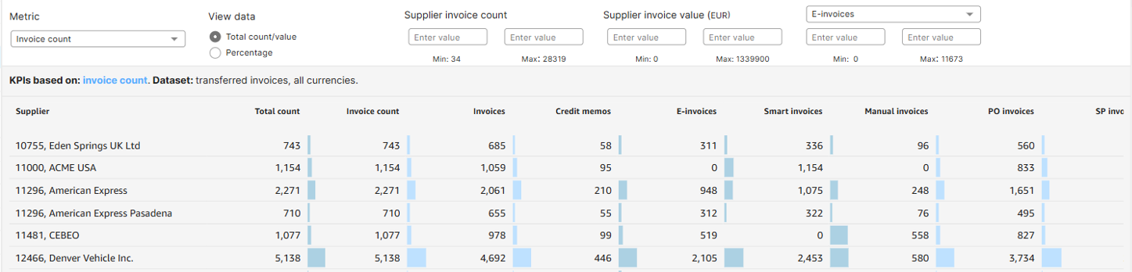
Supplier Overview
Supplier Overview Columns
Total count: Total count of invoices (includes invoices, credit memos and other)
Invoice Count: Total count of invoices (includes credit memos) (if the table is formatted to percentage, absolute value is displayed
Invoices: Total count of all invoices (excludes credit memos)
Credit Memos: Total count of all credit memos (excludes invoices)
E-Invoices: Total amount of electronic invoices (excludes Smart & Manual)
Smart Invoices: Invoices classified as smart invoices
Manual invoices: Invoices classified as manual invoices
PO invoices: Invoices associated to purchase orders are called PO invoices
SP invoices: Invoices associated to spend plans are called SP invoices.
Non-PO invoices: Invoices that are not associated to purchase orders or spend plans are called Non-PO invoices.

Slide 7
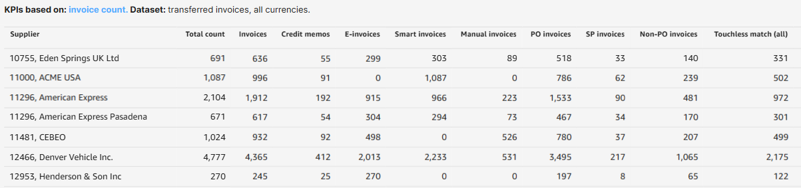
Supplier Overview
Supplier Overview Columns
Total count: Total count of invoices (includes invoices, credit memos and other)
Invoices: Total of all invoices (excludes credit memos)
Credit Memos: Total of all credit memos (excludes invoices)
E-Invoices: Total of invoices classified as electronic invoices (excludes Smart & Manual)
Smart Invoices: Invoices classified as smart invoices
Manual invoices: Invoices classified as manual invoices
PO invoices: Invoices associated to purchase orders are called PO invoices
SP invoices: Invoices associated to spend plans are called SP invoices.
Non-PO invoices: Invoices that are not associated to purchase orders or spend plans are called Non-PO invoices.
Touchless match(all): Matching phase is done for all invoices without any manual actions

Slide 8
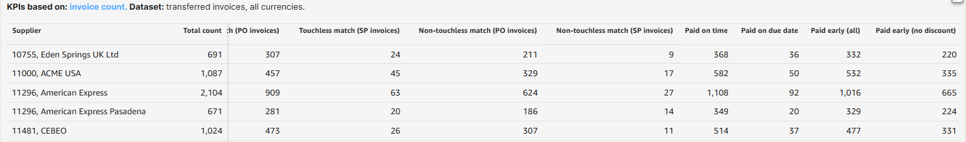
Supplier Overview
Supplier Overview Columns
Touchless match (PO invoices): Touchless matched, for invoices that have a PO associated
Touchless match (SP invoices) : Touchless matched, for invoices that have a Spend Plan associated
Non-touchless match (PO invoices) : Invoices not matched without manual intervention for invoices that have a PO associated
Non-touchless match (SP invoices) : Invoices not matched without manual intervention for invoices that have a Spend plan associated
Paid on time: Invoice Payment date is before on the due date
Paid on due date: Payment date is the same as the due date
Paid early(all): Payment date is earlier than the due date
Paid early(no discount): Paid early without a chance of a discount
Paid early (discount captured): Paid early, lead to discount
Paid early (discound missed): Paid early, but to late enough not to receive a discount

Slide 9
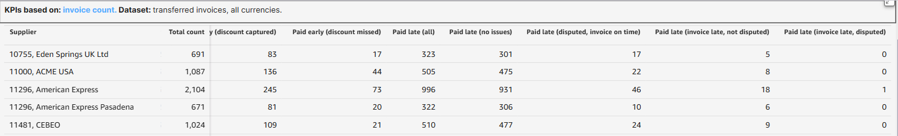
Supplier Overview
Supplier Overview Columns
Paid late (all): Payment date is after the due date
Paid late (no issues): Paid late without any reason detected
Paid late (disputed, invoice on time): Paid late but disputed
Paid late (invoice late, not disputed): Paid late because the invoice was late, invoice not disputed
Paid late (invoice late, disputed): Paid late because the invoice was late, and the invoice was also disputed.

Slide 10
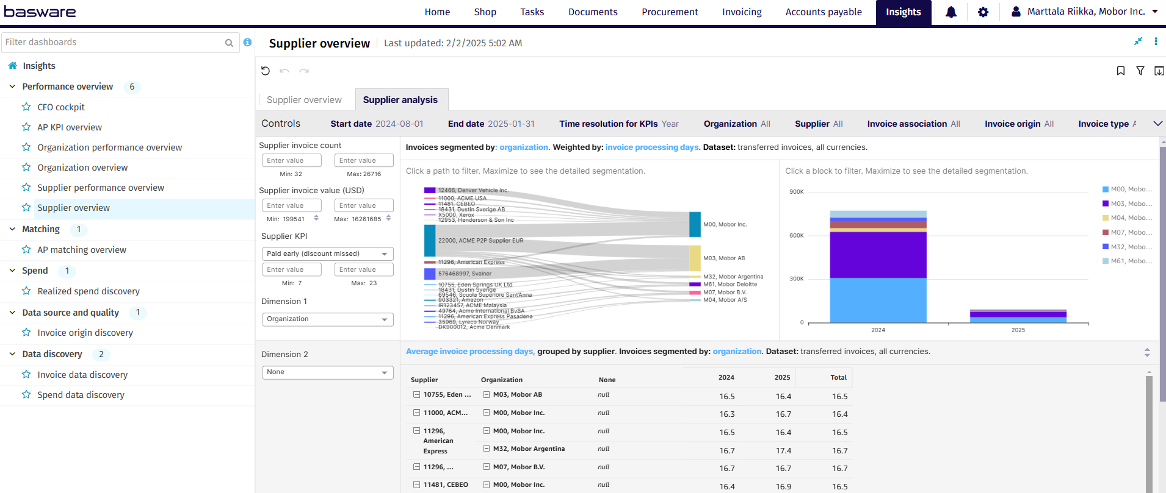
Supplier Analysis

Slide 11
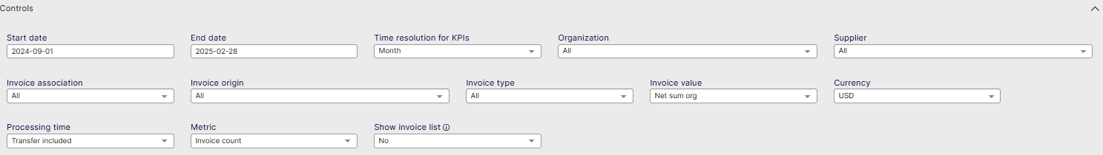
Supplier Analysis Controls
List settings options: Describe the settings users can modify, such as data ranges, department filters, and currency settings.
Start date: Select the beginning of the time interval. The selected date is included.
End date: Select the end of the time interval. The selected date is included
Time resolution for KPIs: Select how to group data over time. Options include per month, per quarter, or per year.
Organization: Filter data by your company organizations.
Supplier: Filter data by suppliers.
Invoice Association: Filter data based on whether the invoices are PO, Spend Plan or Non-PO invoices
Invoice Origin: Filter data by invoice origin
Invoice Type: Filter data by invoice type.
Invoice Value: Select if the invoice and spend values are shown as net sums or gross sums.
Currency: Select the currency used in value-based calculations. Currencies are not converted.
Processing Time: Select whether transfer time is included in processing time calculation: Include transfer time, Exclude transfer time.
Metric: Select the metric applied in KPI visuals:
Invoice count, Invoice value, Invoice processing time
Show Invoice List: Select whether to show a table containing all the invoices

Slide 12
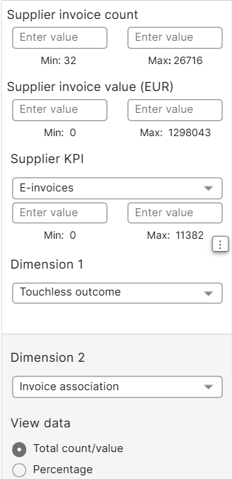
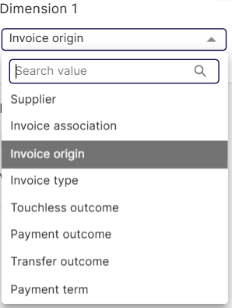
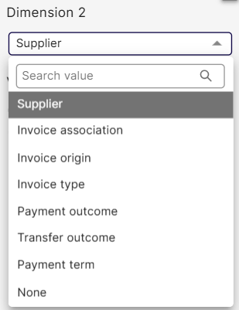
Supplier Analysis
Supplier Analysis in-sheet controls (left side)
Supplier Invoice count: Select the set of suppliers based on their invoice count.
Supplier invoice value: Select the set of suppliers based on their invoiced value.
Supplier KPI: Select the metric applied in KPI visuals: e-Invoices, Manual invoices, Touchless Match...
Supplier KPI value: 2 possible dimensions to filter:
  Dimension 1: Applies to the whole sheet; select dimension to segment the invoices: Invoice Association,Invoice Origin, Invoice type, Payment outcome, Touchless matching outcome
  Dimension 2: Applies to the table only; Select dimension to segment the invoices: Invoice Association,Invoice Origin, Invoice type, Payment outcome, Touchless matching outcome, none
View data: Select whether totals or percentages are used in the tables and supplier filters.

Slide 13
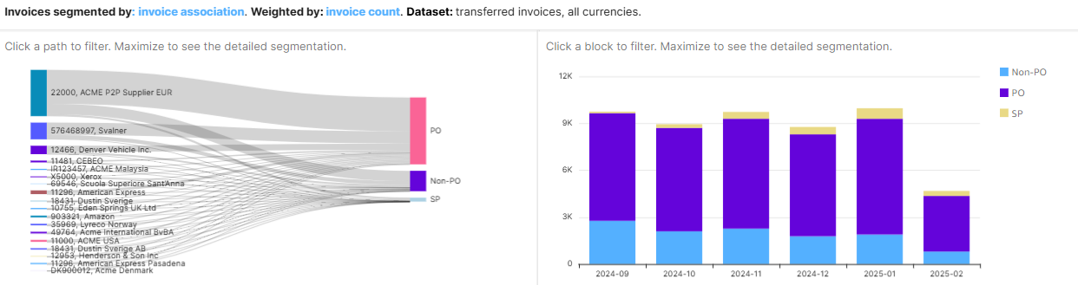
Supplier Analysis
Organization Analysis
Supplier by segment (KPI) and selected weight visualization
The Sankey Diagram shows the selected supplier in relation to the selected segment or KPI, and the thickness of the lines show the weight
The Block diagram shows the same, but in a bar graph over the selected period
To filter the below Invoice count table on specific supplier or segment:
  Click a path joining supplier and segment in the Sankey diagram or inside a bar on the bar chart.
To deactivate the filter:
  Click the Sankey diagram or block graph visual somewhere outside the paths.

Slide 14
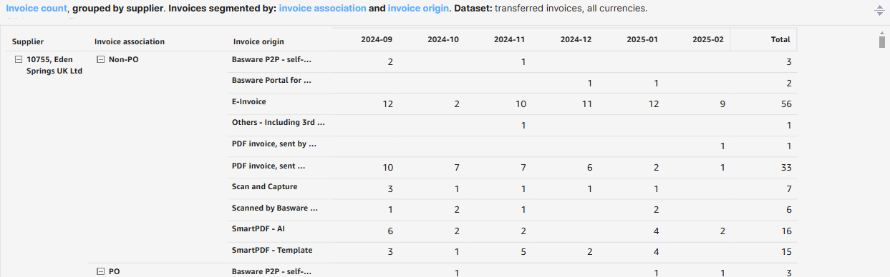
Supplier Analysis
Supplier Analysis
Segments by data view per Supplier, data table
  To filter the below Invoice count table on specific supplier or flow:
    Click a bar to select time period and segment in time series.
    You can click to select specific single bars or inside the area
    of a month to activate a specific timeframe for all the flows
  To deactivate the filter:
    Click the same item which activated the filter.

