Slide 1
AP Matching
Insights Essentials

Slide 2
AP Matching Overview
AP Matching Summary
Summary of the goals:
  This dashboard provides a comprehensive analysis of the Accounts Payable matching performance. It details how many invoices were associated, were matched in a single pass or fully Touchless matched. It provides the user with a comprehensive overview on all of the exceptions that would stop touchless matching, which gives valuable insight into how to make your matching process more touchless. It can track the evolution of these exceptions per supplier, organization or invoice origin.
Main questions answered:
A user of this dashboard can come away with a clear strategy for which elements of the matching process to improve, to enhance each AP KPI. The dashboard also provides visibility into whether the KPIs are improving as a result of the implemented improvement actions. Additionally, users can analyze each KPI in depth, examining the relationships between different metrics.
  How many invoices does my company receive that can be associated with a PO or Spend plan?
  How many of my invoices are matched with a PO or Spend plan the first time right?
  How many invoices are matched without any human intervention?
  What are the instances where human intervention was still needed?
  What are the most important exceptions to focus on to improve?
  Can I see the evolution of touchless matching exceptions over time?
  Which of my organisations has the highest touchless matching rate?
  Which of my organisations do I need to focus on to improve my overall Touchless Matching rate?
  Which suppliers are causing the most matching exceptions?
  Can I track my improvements to the matching process over time?
  Can I analyse specific examples of invoices that had specific exceptions occur?

Slide 3
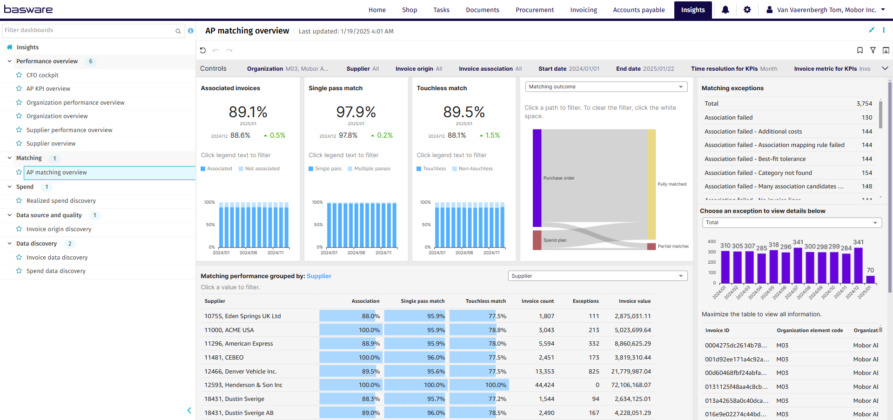
AP Matching Overview

Slide 4
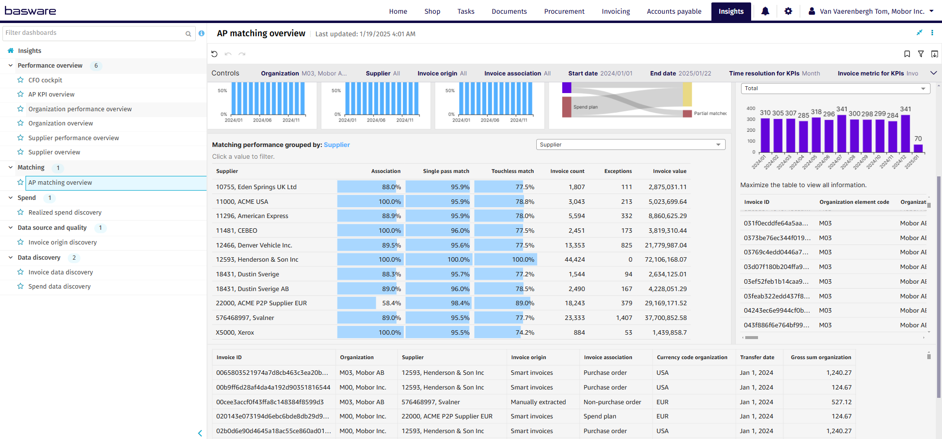
AP Matching Overview

Slide 5
AP Matching Controls
List settings options: Describe the settings users can modify, such as data ranges, department filters, metric types
Organization: Filter data by your company organizations.
Supplier: Filter data by suppliers.
Invoice Origin: Filter data by invoice origin
Invoice Association: Filter data based on whether the invoices are PO, Spend Plan or Non-PO invoices
Start date: Select the beginning of the time interval. The selected date is included.
End date: Select the end of the time interval. The selected date is included
Time resolution for KPIs: Select how to group data over time. Options include per month, per quarter, or per year.
Invoice Metric for KPI’s: Select the metric applied in KPI visuals: Invoice count, Invoice percentage.
Show Invoice List: Select whether to show a table containing all the invoices

Slide 6
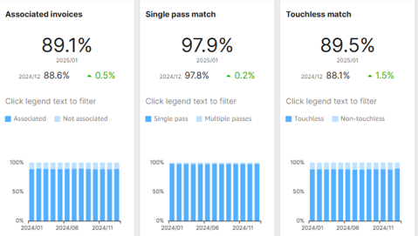
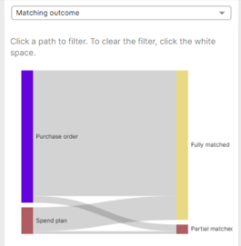
AP Matching Overview
Main Matching KPI’s
Associated Invoices: Percentage of invoices associated with purchase orders or spend plans
  If line level matching is used, please note that an
  invoice is considered associated as soon as
  1 line could be associated with a PO or Spend Plan
Single Pass Match: Percentage of matched invoices that were matched the first time right, without having the matching flow
to be restarted.
Touchless Match: The Touchless Match Rate is the percentage of invoices matched automatically in a single pass, with no exceptions and with all coding rows generated automatically
The KPI trends bar chart can be used to filter all other visuals (deselect by clicking the selected bar again)
The dropdown for the Sankey diagram can be individually filtered on matching outcome, automatically coded, single pass match and touchless match (Click a path to activate & filter the entire dashboard, deselect by clicking the Sankey diagram visual somewhere outside the paths.)

Slide 7
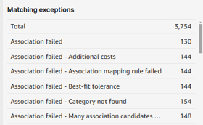
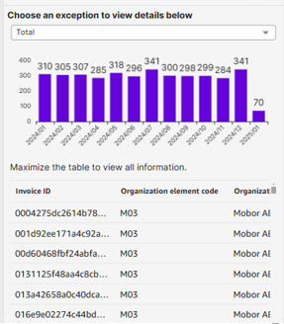
AP Matching Overview
Matching Exceptions
Matching exceptions: Count of total amount of exceptions and count of individual exception types
  Note: these can not be selected to filter the below chart and table
Exception amount over time:
  Here you can choose an exception to focus on and track the amount it occurs over time
  Note: Selecting a specific exception in the dropdown will also filter the bottom right table which countains a specific invoice list, this does not filter any other tables on the left side, and also not the bottom invoice list (which can be toggled on/off via the controls at the top of the page.

Slide 8
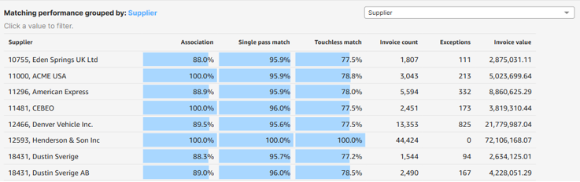
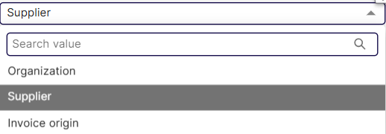
AP Matching Overview
Matching performance grouped by Supplier, Organization or Invoice Origin
Note: This pivot table will be affected by filtering in the above main KPI’s but not by selecting specific exceptions
Select the appropriate grouping via the drop-down in the top right of the table:
  By Organization, Supplier or Invoice Origin
Columns include Association rate, Single Pass match, Touchless match, Invoice count (total number of invoices) and number of matching Exceptions, as well as the invoice value of all invoices in the selected frame set in the dashboard controls.

