Slide 1
AP KPI overview
Insights Essentials

Slide 2
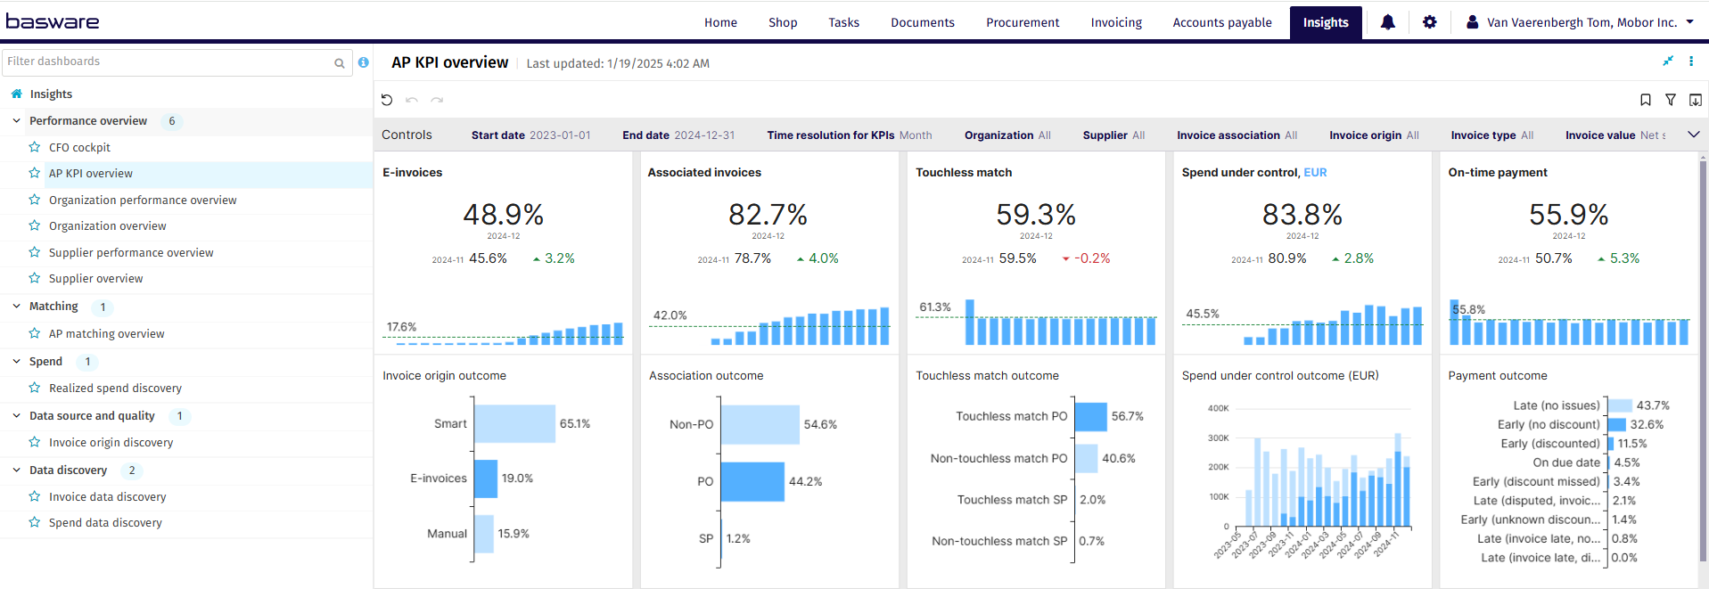
AP KPI Dashboard

Slide 3
AP KPI Dashboard Overview
AP KPI Summary
The Standard KPI Overview Dashboard is your centralized solution for monitoring key performance indicators (KPIs) critical to managing your accounts payable efficiently. This dashboard facilitates a comprehensive view of your financial metrics, including invoice processing performance, automation levels, and payment effectiveness, ensuring you have all the necessary tools to assess and optimize your financial operations..
An AP manager can drive AP operations to achieve efficiency, enhanced productivity, and improved outcomes. The ability to forecast upcoming invoice volumes enables AP teams to better prepare for upcoming workload. Increased productivity and compliance contribute to cost reduction.
Lagging Areas Identification: The dashboard helps users identify AP areas that need attention. Insights helps to get the user to focus exactly where attention is needed. By analyzing metrics, it highlights where improvements are necessary.
Monitoring Improvement Actions: The dashboard tracks improvement initiatives. Users can assess whether implemented actions are positively impacting AP performance.
KPI Details: Each Key Performance Indicator (KPI) is accompanied by a detailed outcome. This provides visibility into the success level of each KPI, allowing users to make informed decisions.
Cross-Filtering: The dashboard incorporates cross-filtering, enabling users to explore correlations between different outcomes. For example, they can analyze how changes in one KPI affect others

Slide 4
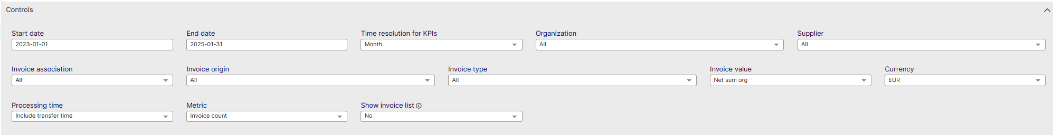
AP KPI Controls
List settings options: Describe the settings users can modify, such as data ranges, department filters, and currency settings.
Start date: Select the beginning of the time interval. The selected date is included.
End date: Select the end of the time interval. The selected date is included
Time resolution for KPIs: Select how to group data over time. Options include per month, per quarter, or per year.
Organization: Filter data by your company organizations.
Supplier: Filter data by suppliers.
Invoice Association: Filter data based on whether the invoices are PO, Spend Plan or Non-PO invoices
Invoice Origin: Filter data by invoice origin
Invoice Type: Filter data by invoice type.
Invoice Value: Select if the invoice and spend values are shown as net sums or gross sums.
Currency: Select the currency used in value-based calculations. Currencies are not converted.
Processing Time: Select whether transfer time is included in processing time calculation: Include transfer time, Exclude transfer time.
Metric: Select the metric applied in KPI visuals:
Invoice count, Invoice value.
Show Invoice List: Select whether to show a table containing all the invoices

Slide 5
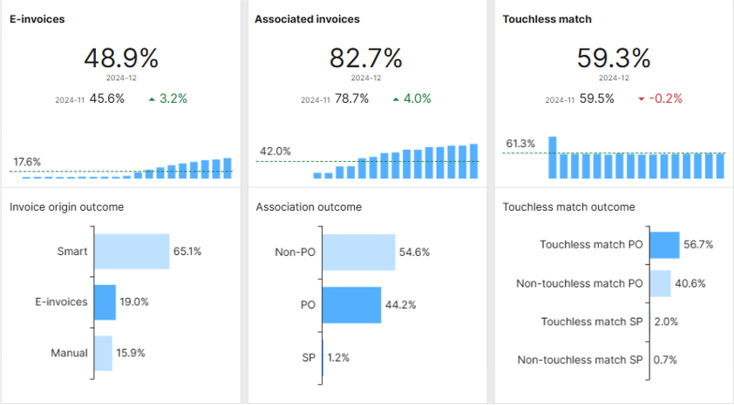
AP KPI – E-invoices
Percentage of transferred invoices classified as e-invoices
Measured either by count or value. This metric outcome is a break down of all invoice receiving channels in three groups: e-invoices, smart invoices, and manually extracted invoices.
E-invoices are issued, received, and processed in digital form throughout its life cycle. (e.g. XML, data file, EDI,...)
Smart invoices are digitized through automated extraction of invoice content. (mostly from PDF)
Manually extracted invoices require manual intervention for content extraction. In visualizations, smart invoices and manually extracted invoices together are referred to as non-e-invoices

Slide 6
AP KPI – Associated Invoices
Percentage of invoices associated with purchase orders or spend plans
Measured either by count or value.
PO: invoices associated with purchase order
SP: invoices associated with spend plan
Non-PO: non- associated invoices
If line level matching is used, please note that an invoice is considered associated as soon as 1 line could be associated with a PO or Spend Plan

Slide 7
AP KPI – Touchless Match
Percentage of associated invoices that are touchless matched
Measured either by count or value.
An invoice is matched touchless if it is matched in a single pass, with no matching exceptions, and all coding rows are generated automatically.
The Information is broken down in 4 categories:
  Touchless match PO (with Purchase Order)
  Non-Touchless match PO (with Purchase Order)
  Touchless match SP (with Spend Plan)
  Non-Touchless match SP (with Spend Plan)
*Important* Non-PO invoices that did not go through matching are no longer included in this metric

Slide 8
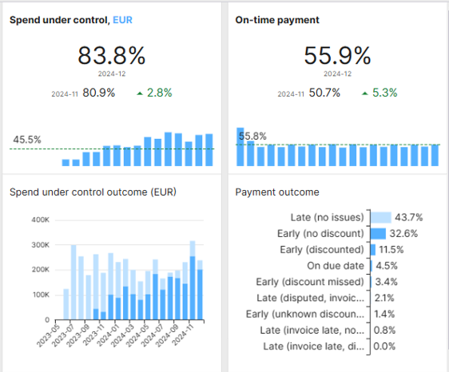
AP KPI – Spend Under Control
Percentage of controlled spend
This metric is not measured by number of invoices, rather always by total value of the spend.
This metric compares the amount of controlled spend on all invoices in range with the amount of spend that was not controlled (un-ordered).
Controlled spend includes all pre-approved spend.
1 invoice may contain both ordered and un-ordered spend.
E.g. if an invoice contains 3 lines that were ordered, but 2 that were not, this metric will only consider the value of the 3 ordered lines as ‘under control’, and consider the other 2 as ‘uncontrolled spend’

Slide 9
AP KPI – On-Time Payment
Percentage of invoices paid on time
An invoice is considered paid on time if it is paid on or before the due date. This can be measured either by count or value.
Note: This metric is calculated only for invoices with payment information, which may be missing from the most recent invoices.
As a result, this KPI may change over time.

Slide 10
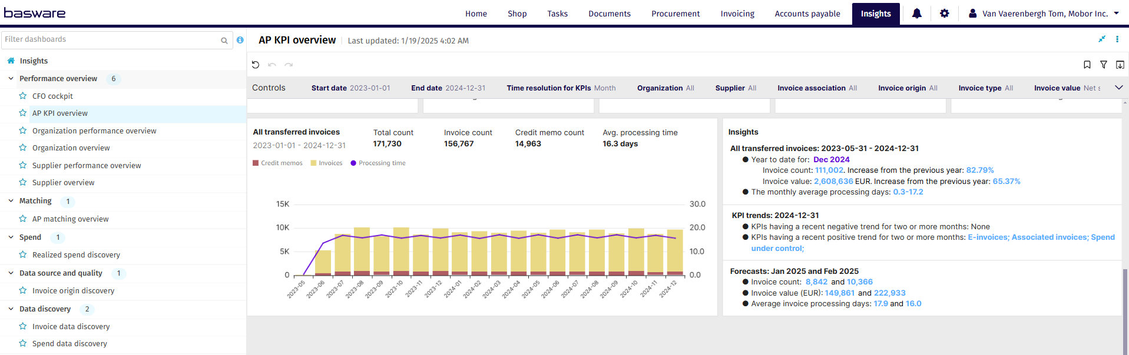
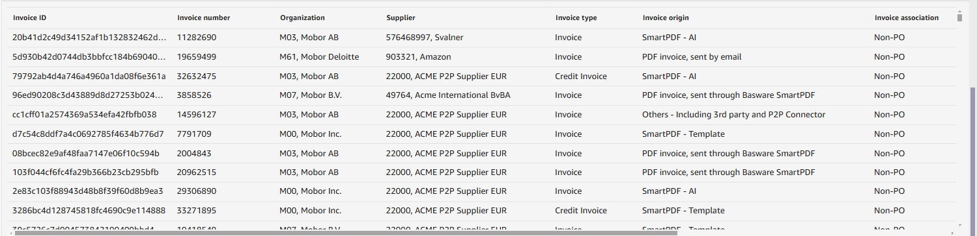
AP KPI

Slide 11
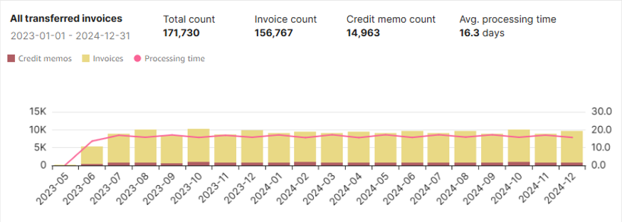
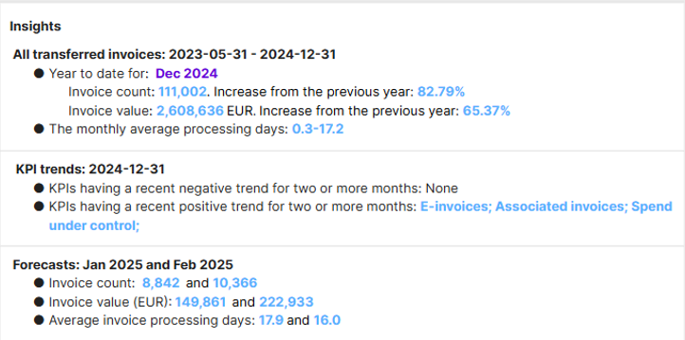
AP KPI – All Transferred & Insights
Mean value of the processing time for all invoices in the selected period
Insights
Invoice processing time is measured in days from the creation date to either the transfer date or to the date when it is ready for transfer.
If the metric is Invoice value, then only invoices in the selected currency are considered.
Provides an analysis on how the dashboard KPI’s have evolved over time
Provides a forecast based on past events as to how KPI’s will develop over time

