Slide 1
Purchase Overview
Insights Pro
Insights Essentials

Slide 2
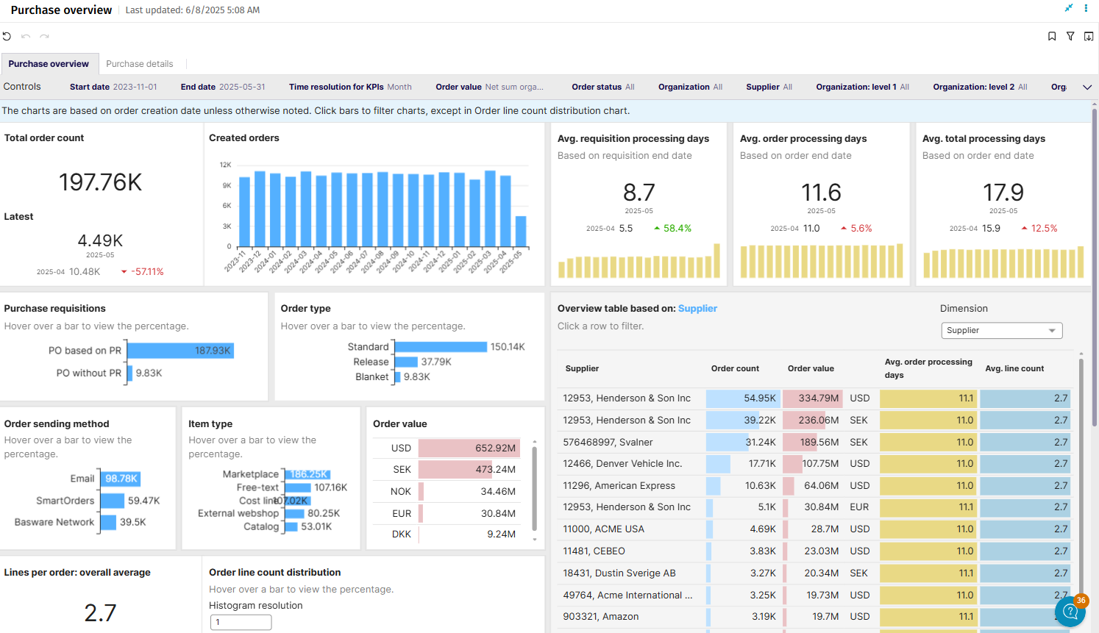
Purchase Overview

Slide 3
Purchase Overview
Purchase Overview
Summary of the goals:
  The Purchase Overview Dashboard is designed to provide a comprehensive analysis of procurement activities, helping organizations track and optimize their Purchase Order (PO) and Purchase Requisition (PR) processes.
  It consolidates key metrics into two intuitive sheets: one offering a high-level overview of PO and PR counts, average processing times, and supplier/organization performance, while the other dives deeper into line-level details such as category, cost center, payment terms, and project-level insights.
  By delivering a complete picture of procurement performance, the dashboard empowers decision-makers to streamline operations and enhance supplier relationships.
Main Questions Answered
  The overview sheet addresses questions such as:
    How many POs and PRs have been processed in a given period?
    What is the average processing time for POs and PRs across suppliers and organizations?
    Which suppliers and departments contribute most to procurement cycles?
  The line-level detail sheet focuses on more granular questions, such as:
    Which categories and cost centers incur the highest spend?
    What are the most frequently used payment terms?
    How do project-level purchases align with the organization’s procurement goals?

Slide 4
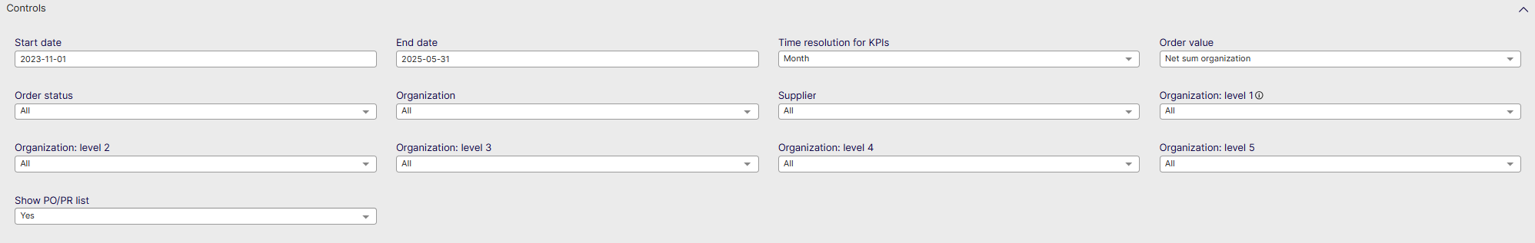
Purchase Overview Controls
List settings options: Describe the settings users can modify, such as data ranges, department filters, and other settings.
Start date: Select the beginning of the time interval. The selected date is included.
End date: Select the end of the time interval. The selected date is included
Time resolution for KPIs: Select how to group data over time. Options include per month, per quarter, or per year.
Order Value: Filter on Gross or Net Sum types
Order Status: Set a filter on closed or open orders
Organization: Filter data by your company organizations.
Supplier: Filter data by suppliers.
Organization Level 1: Filter on the highest level of Organization in AP
Organization Level 2: Filter on the Second highest level of Organization in AP
Organization Level 3: Filter on the Third highest level of Organization in AP
Organization Level 4: Filter on the Fourth highest level of Organization in AP
Organization Level 5: Filter on the Fifth highest level of Organization in AP
Show PO/PR List: Show the list of PO’s or PR’s for the data selected in the dashboard

Slide 5
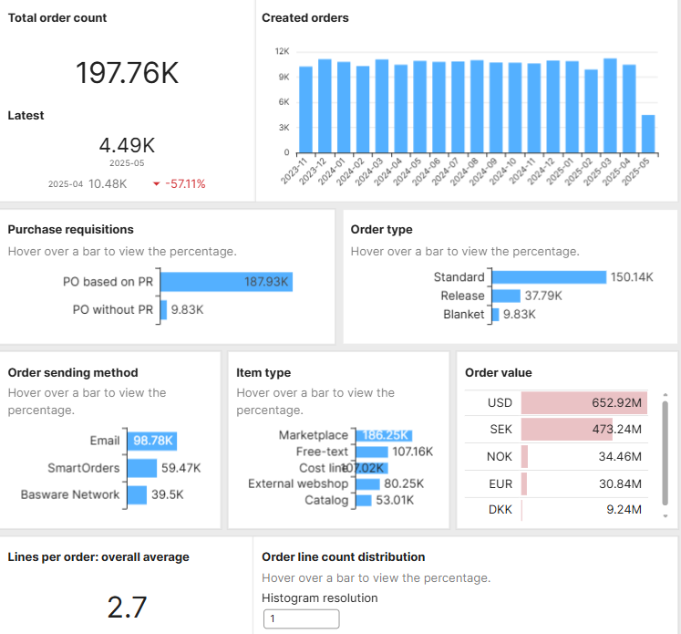
Purchase Overview
Main Graphics
Total Order Count for the period selected
Orders Created
PO based on PR or created without PR
Order Type (Standard, Release or Blanket)
Order Sending Method
Item type – How orders were created
Order Value – Value of orders in currency
Lines per order average
Order line count distribution – see next page

Slide 6
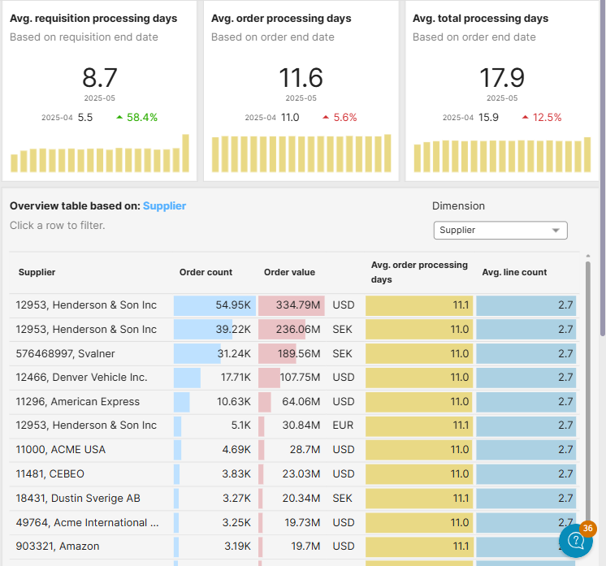
Purchase Overview
Average requisition processing days
  Shows the average days requisitions take to process
  The last month selected is shown + the evolution from the month prior
Average order processing days
  Shows the average days orders take to process
  The last month selected is shown + the evolution from the month prior
Average total processing days
  Shows the average total time of processing in the entire PR/PO process
Full Overview table listing per Supplier or Organization Dimension

Slide 7
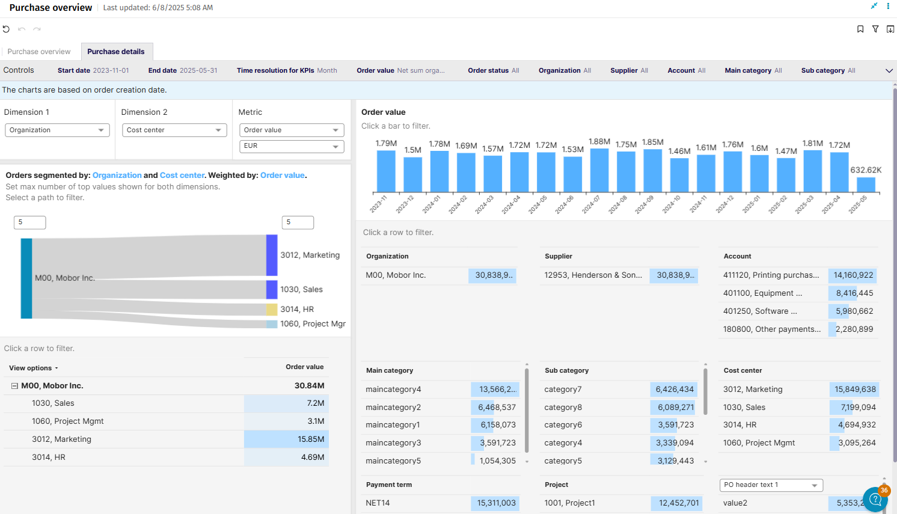
Purchase Details

Slide 8
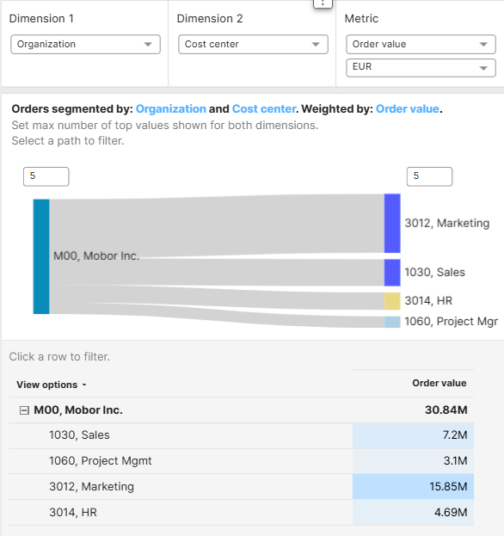
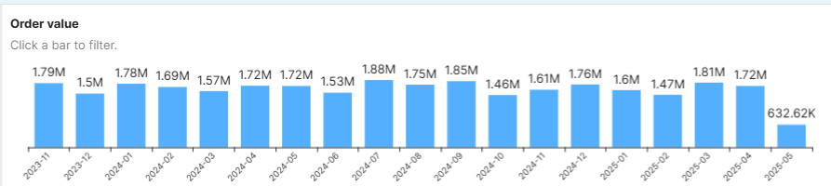
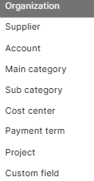
Purchase Details
Select these specific dimensions to show the order data in the below diagram:
The diagram shows how many order value is attributed to different dimensions
  In the example shown here, organizations vs cost center shown by order value
On the top right there is a listing of order value over the defined timeframe which is not affected by the selected dimensions

Slide 9
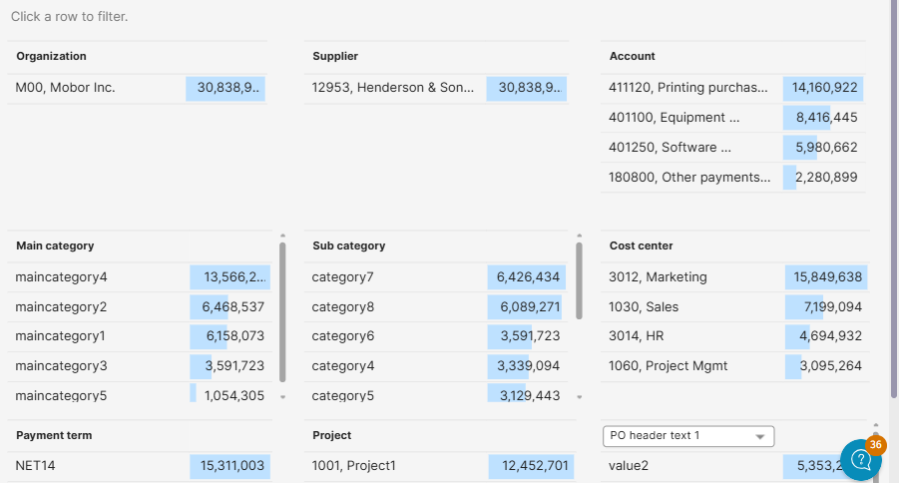
Purchase Details
Additional Dimensions
Click a dimension in this chart to replace the first dimension in the main dropdown
The Order Value Chart on the top of the page will also filter based on the selected dimension if applicable

