Slide 1
Purchase Process
Insights Pro
Insights Essentials

Slide 2
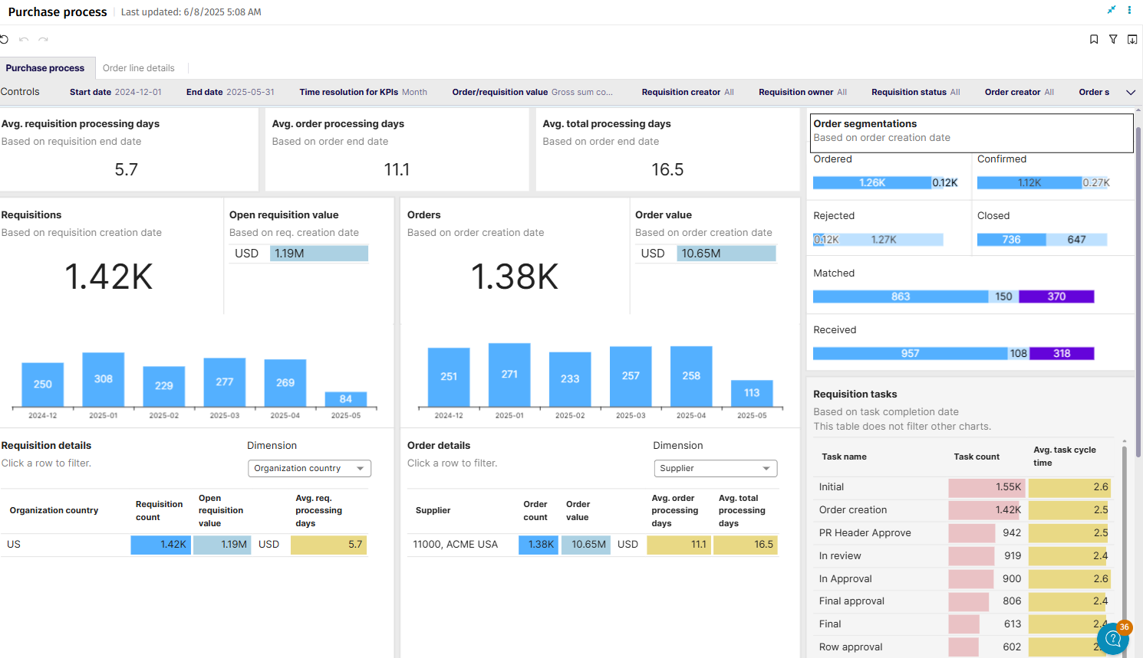
Purchase Process Dashboard

Slide 3
Purchase Process
Purchase Process
Summary of the goals:
  The Purchase Process Dashboard provides a streamlined view of procurement performance by tracking PO and PR processing times and task cycle durations patterns.
  It consists of two sheets: one offering an overview of key metrics, including average task cycle times and PO segmentation (such as ordered, confirmed, and rejected), and another focusing on lead time analysis between critical PR/PO milestones, such as order creation and closure.
Main Questions Answered
  The dashboard answers key questions to help stakeholders manage procurement more effectively.
  It highlights average PO and PR processing times, identifies how long PR tasks take to complete, and segments POs based on supplier responses.
  Additionally, it analyzes lead times between critical milestones, such as order creation, confirmation, and closure, helping identify delays and potential bottlenecks in the procurement lifecycle.
The Purchase Process Dashboard delivers significant value by enhancing procurement visibility, minimizing inefficiencies, and improving supplier collaboration. By providing insights into task cycles, supplier responses, and lead times, it enables organizations to streamline processes, optimize workflows, and improve overall procurement performance.
This leads to better decision-making, cost savings, and stronger supplier relationships.

Slide 4
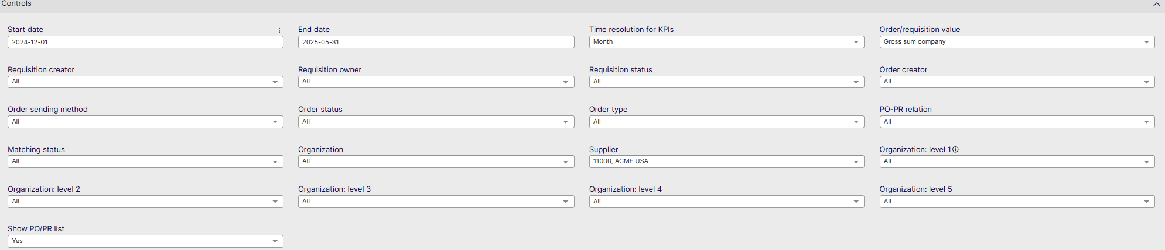
Purchase Process Controls
Start date: Select the beginning of the time interval. The selected date is included.
End date: Select the end of the time interval. The selected date is included
Time resolution for KPIs: Select how to group data over time. Options include per month, per quarter, or per year.
Order/Requisition Value: Filter on Gross or Net sum per company or org.
Requisition Creator: Filter on the creator of the PR
Requisition Owner: Filter on the owner of the PR
Requisition Status: Filter on where the PR is in the process
Order Creator: Filter on the creator of the PO
Order Sending Method: Select how the order was sent
Order Status: Set a filter on closed or open orders
Order Type: select which order type
PO-PR relation: select which type of PO and how it relates to PR
Matching Status: Select which match type the order has
Organization: Filter data by your company organizations.
Supplier: Filter data by suppliers.
Organization Level 1: Filter on the highest level of Organization in AP
Organization Level 2: Filter on the Second highest level of Organization in AP
Organization Level 3: Filter on the Third highest level of Organization in AP
Organization Level 4: Filter on the Fourth highest level of Organization in AP
Organization Level 5: Filter on the Fifth highest level of Organization in AP
Show PO/PR List: Show the list of PO’s or PR’s for the data selected in the dashboard

Slide 5
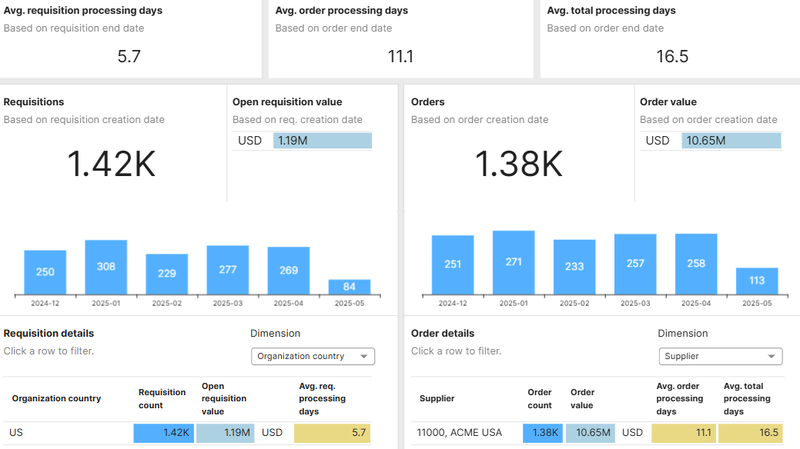
Purchase Process
Purchase Process Metrics
Average requisition processing days shows the average days requisitions take to process
Average order processing days shows the average days orders take to process
Average total processing days shows the average total time of processing in the entire PR/PO process

Slide 6
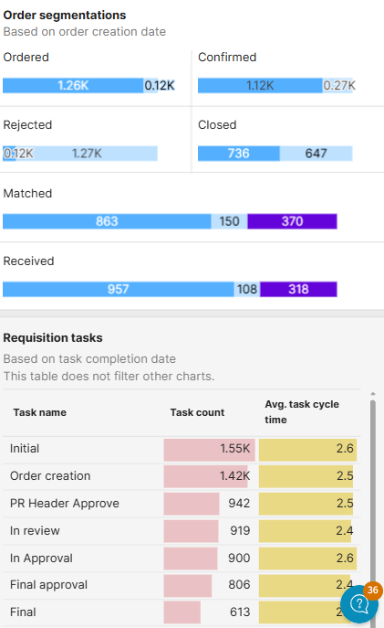
Purchase Process
Order Segmentations
These graphs show an overview of Orders that are Ordered, Confirmed, Rejected and closed
It also shows how many are matched and received
Requisition Tasks
This table shows an overview on the tasks pertaining to PR’s and Orders
It shows the amount of tasks and the average task cycle time per task

Slide 7
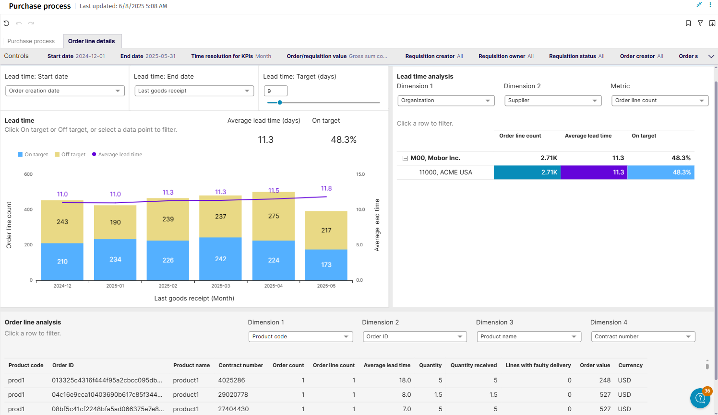
Order Line Details

Slide 8
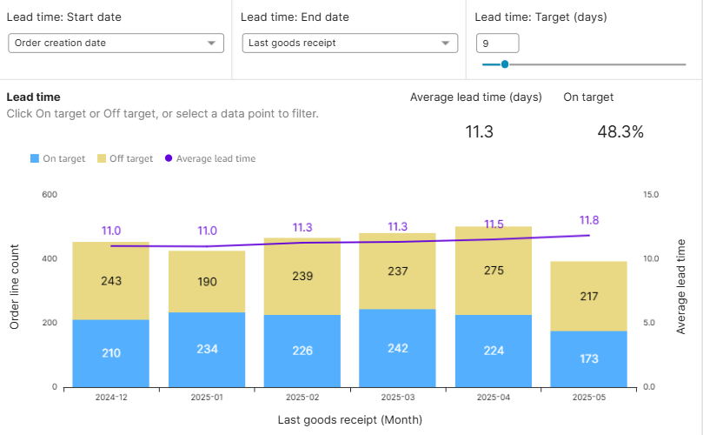
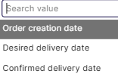
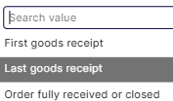
Order Line Details
Order Lead Time Analysis
Provide both time start and end time to find the average order lead time here.
Choose between creation, desired delivery or confirmed delivery date for start date
Choose between first goods receipt, last goods receipt or when the order was fully received or closed for end date
Set a target to show how many orders fall within the target date
The purple line and numbers show the average lead time for the timeframe selected in ‘controls’

Slide 9
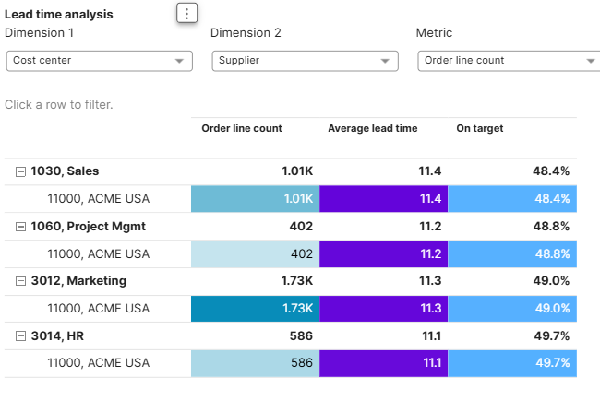
Order Line Details
Lead time analysis
Select Multiple dimensions and a specific metric to show in the table
The table will show all the data as a pivot
Order Line Count, Average Lead Time and whether the lead time is on target will be shown in the table
Lead time can be selected from the graph dropdown on the left

Slide 10
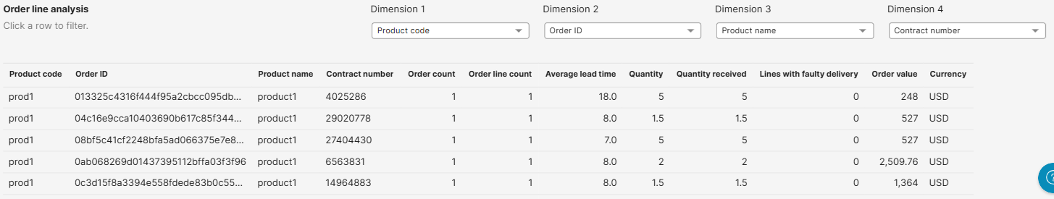
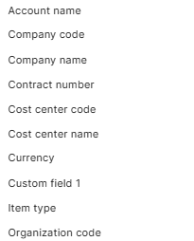
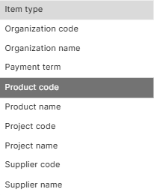
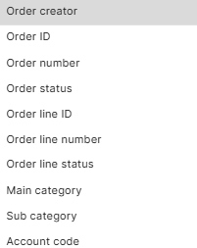
Order Line Details
In this table you are able to see specific information on the lines of your orders
Order Line Analysis
Select these dimensions in the 4 drop downs to show in the table:

