Slide 1
Process Discovery
Insights Essentials

Slide 2
Process Discovery
Process Discovery Dashboard
Summary of the Reporting:
These dashboards provide a comprehensive overview of various key Account Payable process metrics
They will help you monitor performance at a glance and allow you to drill down into specific areas as needed.
Features:
Main KPI’s: Associated Invoices, Touchless Match, Paid on Time & Average Invoice Processing days
Task Analysis: Task level summary of Invoice count, Average Task processing days and the count of Tasks
Task Breakdown on Organization, Supplier or Invoice Origin Level
List of Invoices handled per user
Use these dashboards to plan, execute, report on and track changes to your process, on task level
Find the opportunities to improve by looking at areas which are lagging behind, or look for manual tasks that could be avoided

Slide 3
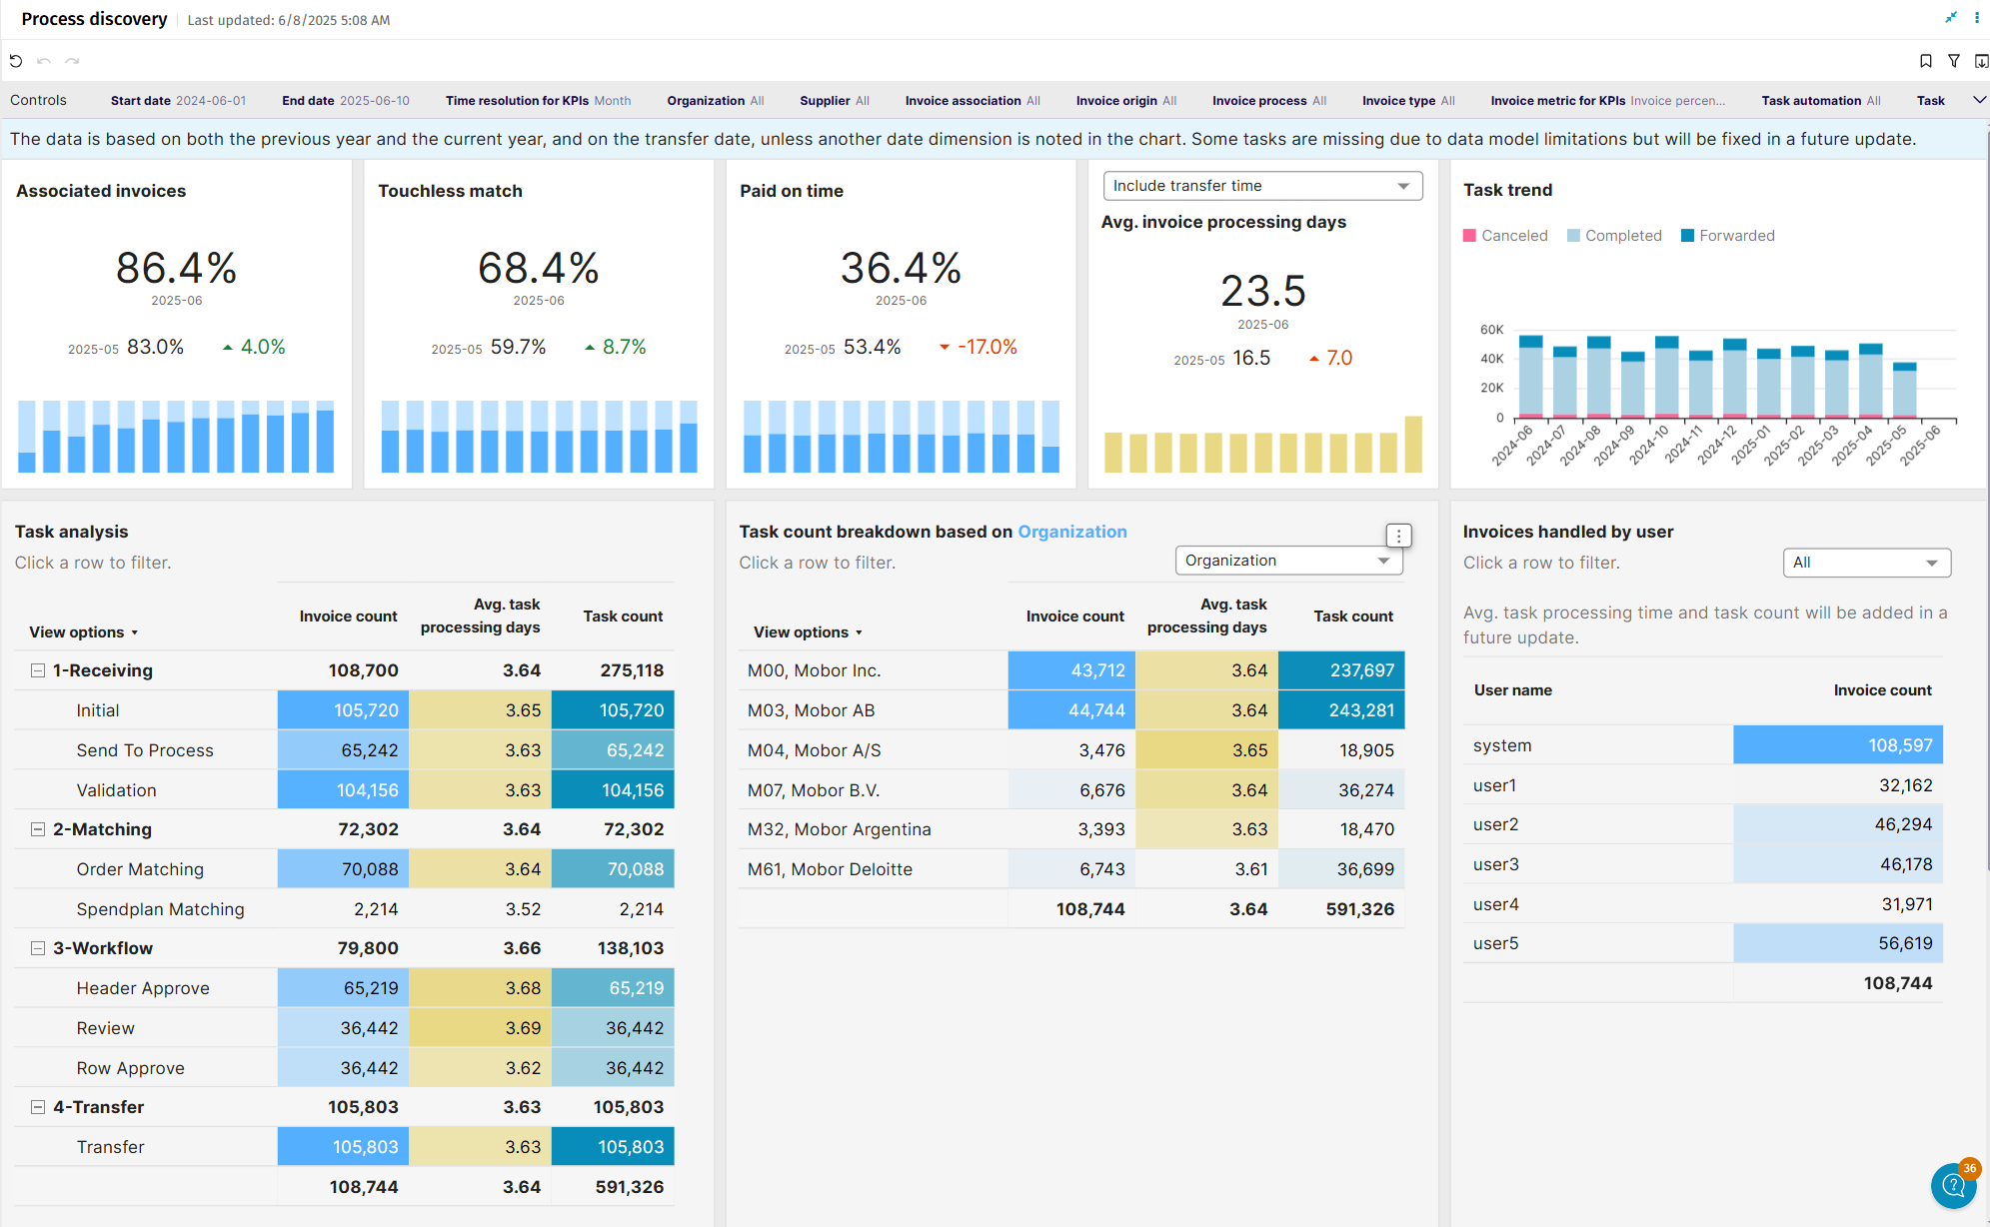
Process Discovery

Slide 4
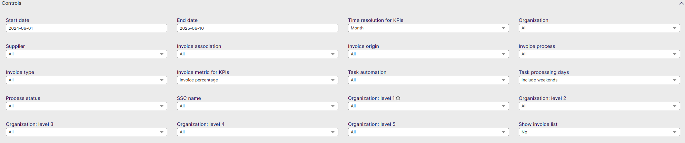
Process Discovery - Controls
Start date: Select the beginning of the time interval. The selected date is included.
End date: Select the end of the time interval. The selected date is included
Time resolution for KPIs: Select how to group data over time. Options include per month, per quarter, or per year.
Organization: Filter data by your company organizations.
Supplier: Filter data by suppliers.
Invoice Association: Filter data based on whether the invoices are PO, Spend Plan or Non-PO invoices
Invoice Origin: Filter data by invoice origin
Invoice Process: Process type defined in AP configuration for you
Invoice Type: Filter data by invoice type.
Invoice metric for KPI’s: Define the Invoice metric with which to visualize dashboard KPI's
Task Automation: Select whether you cant to see manual or automatic tasks
Task Processing Days: Include or Exclude Weekends
Process status: filter Active or non-active Processes
SSC name: Filter per your defined Shared Service Center
Organization Level 1: Filter on the highest level of Organization in AP
Organization Level 2: Filter on the Second highest level of Organization in AP
Organization Level 3: Filter on the Third highest level of Organization in AP
Organization Level 4: Filter on the Fourth highest level of Organization in AP
Organization Level 5: Filter on the Fifth highest level of Organization in AP
Show Invoice List: Show the list of Invoices for the data selected in the dashboard

Slide 5
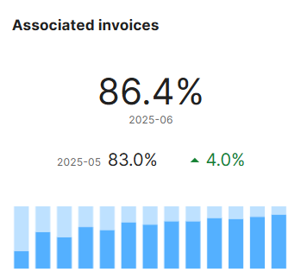
Process Discovery - Associated Invoices
Percentage of invoices out of the total associated with purchase orders or spend plans
Measured either by count or value.
Invoices can be associated with a PO: invoices associated with purchase order
Invoices can be associated with a SP: invoices associated with spend plan
If line level matching is used, please note that an invoice is considered associated as soon as 1 line could be associated with a PO or Spend Plan

Slide 6
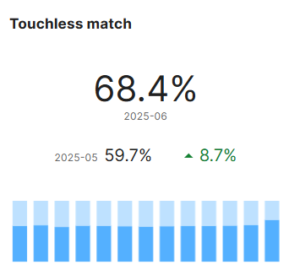
Process Discovery - Touchless Match
Percentage of associated invoices that are touchless matched
Measured either by count or value.
An invoice is matched touchless if it is matched in a single pass, with no matching exceptions, and all coding rows are generated automatically.
*Important* Non-PO invoices that did not go through matching are no longer included in this metric, as they were in previous iterations of Insights/Analytics

Slide 7
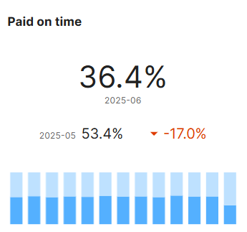
Process Discovery - Paid on Time
Percentage of invoices paid on time
An invoice is considered paid on time if it is paid on or before the due date. This can be measured either by count or value.
Note: This metric is calculated only for invoices with payment information, which may be missing from the most recent invoices. As a result, this KPI may change over time, and not reflect information from your ERP perfectly

Slide 8
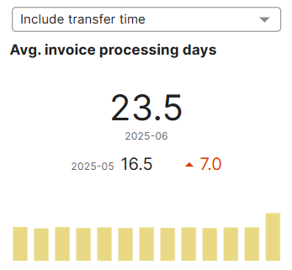
Process Discovery Average Invoice Processing days
Analysis of the average invoice processing time
Sample mean of the invoice processing time: Invoice processing time is measured in days from the creation date to either the transfer date or to the date when it is ready for transfer.
The used definition is selectable by the user. If the metric is set to “Value”, then only invoices in the selected currency are considered.
The lower this metric is, the better.
The dropdown allows you to choose whether to include the time the invoice stayed in the ‘Transfer’ phase.
In the example, the average time an invoice took to move from its Creation date to Transfer date is 23,5 days
It also shows the difference between June ‘25 and the month before, which in this case is an increase of 7 days on average per invoice (negative)

Slide 9
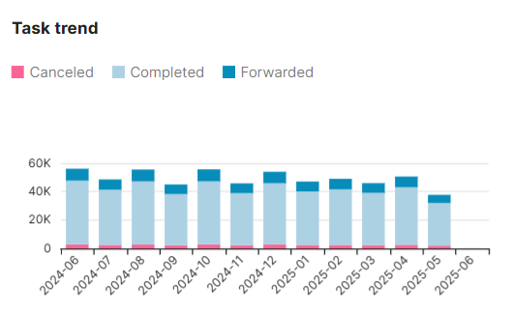
Process Discovery - Task Trend
Task Trend
This diagram shows the ratio of tasks over the timeframe defined in ‘Controls’
It shows how many tasks were Canceled, Completed or Forwarded

Slide 10
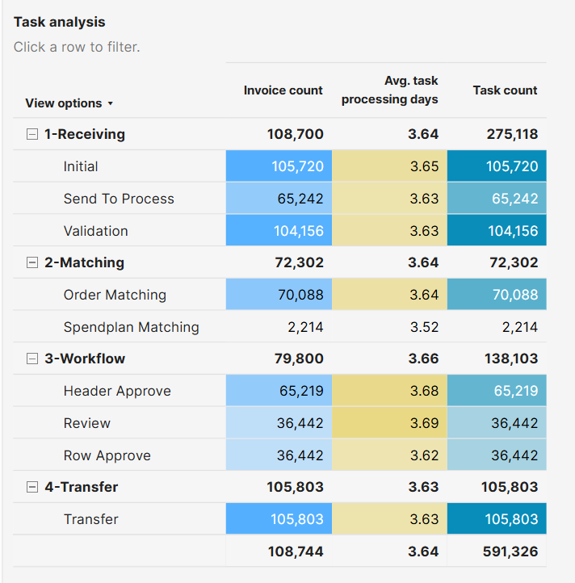
Process Discovery - Task Analysis
Task Analysis
Invoice count
Total amount of invoices per phase or task
Avg. Task processing days
Average amount of days taken for the invoices to go through the phase of task
Task Count
Amount of total tasks (Phase number is total amount in that phase)

Slide 11
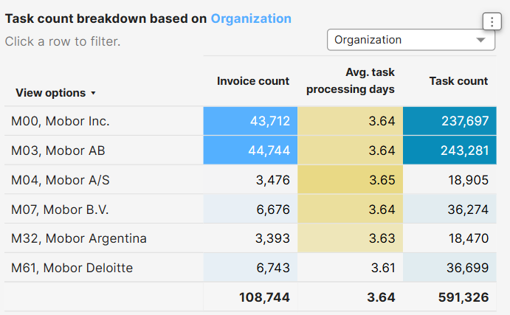
Process Discovery -Task Breakdown
Task Breakdown
The dropdown allows you to change the dimension from Organization to Supplier or Invoice origin.
Invoice count per dimension
Average task processing days per dimension
Task count shows the amount of tasks for the dimension

Slide 12
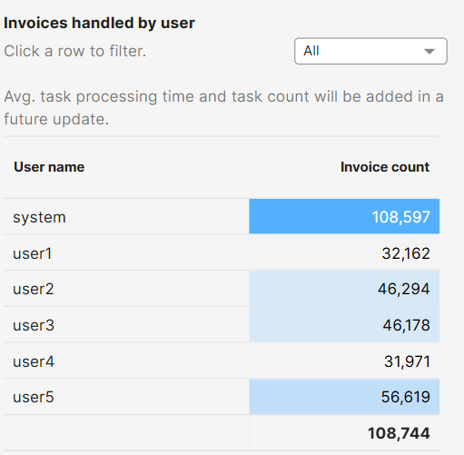
Process Discovery - Invoices handled by user
Invoices handled by user
Shows the amount of invoices where your users have been involved in a task for per user
Use the drop down menu to select a specific user
Please note that in this list you can also click a user in the list to filter the entire dashboard on this user

