Slide 1
Invoice Processing Time Discovery
Insights Pro
Insights Essentials

Slide 2
Invoice Processing Time Discovery
Invoice Processing Time Discovery
Summary of the Reporting:
  These dashboards provide a comprehensive overview on the time Invoices take to move through the AP process
  The dashboard provides valuable insights into invoice handling efficiency through two focused sheets: Invoice Lead Time Analysis and Task Cycle Time Analysis.
  The Invoice Lead Time Analysis sheet visualizes lead time between various invoice stages, offering a detailed breakdown of processing duration across key invoice dates. It also highlights performance trends by organization and supplier, enabling users to identify delays and optimization opportunities.
  The Task Cycle Time Analysis sheet focuses on task-level performance, displaying task counts and analyzing cycle times for individual tasks or the entire process collectively.
  Together, these sheets empower organizations to pinpoint inefficiencies, enhance processing speed, and improve overall invoice management.

Slide 3
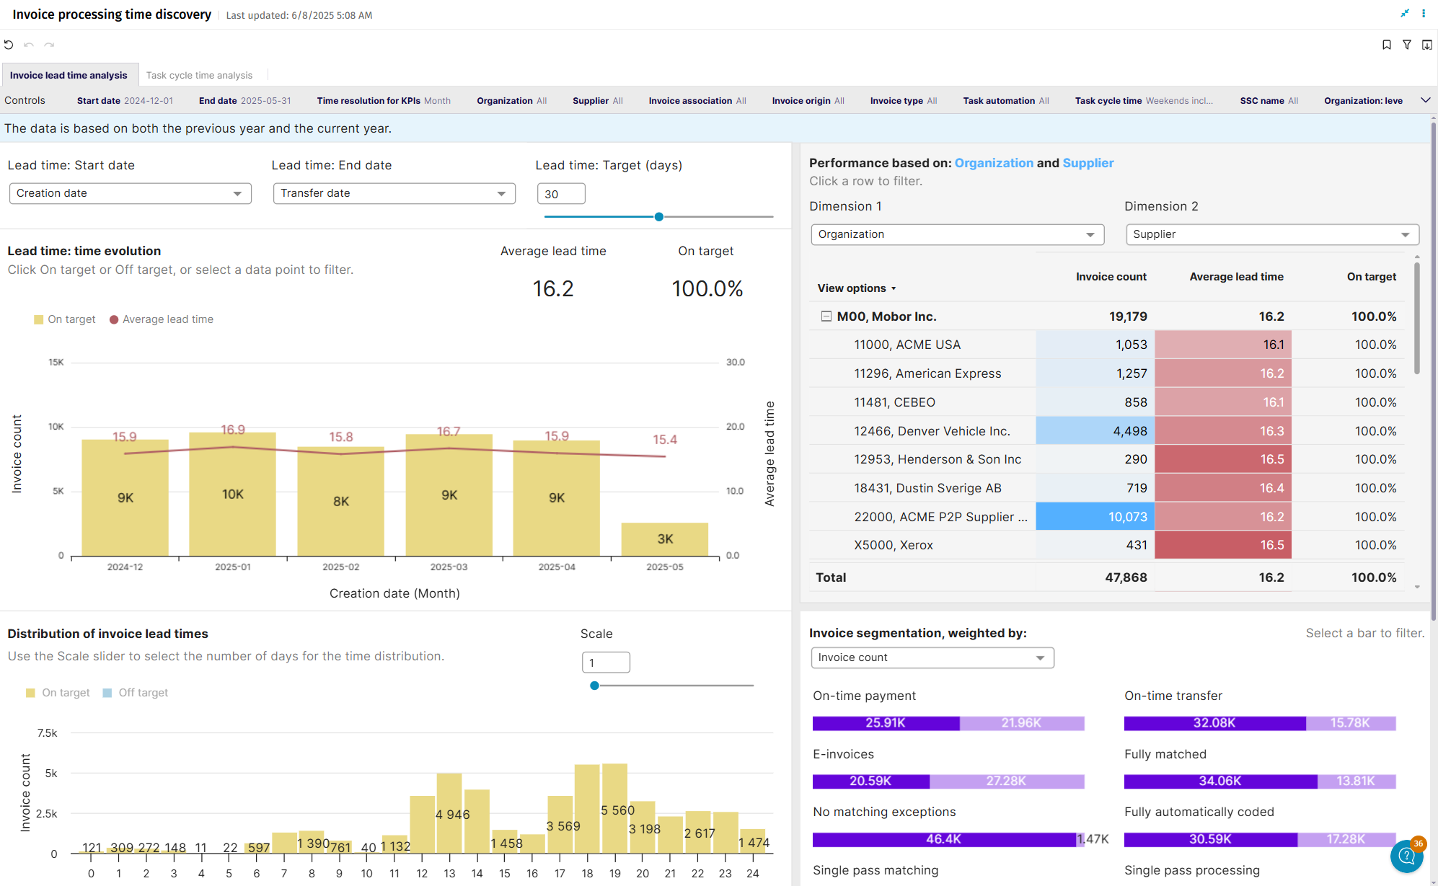
Invoice Processing Time Discovery

Slide 4
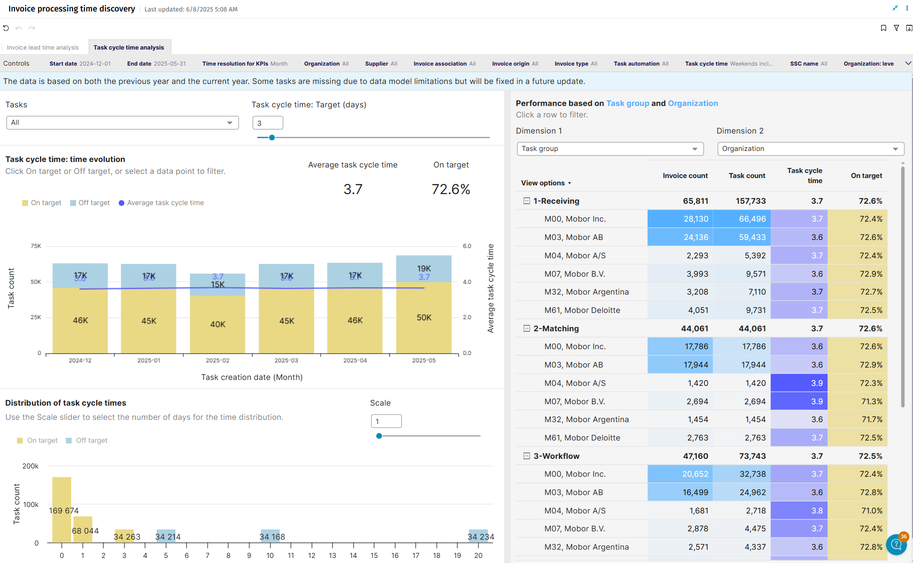
Invoice Processing Time Discovery

Slide 5
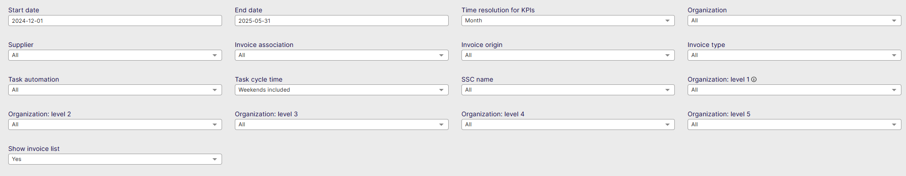
Invoice Processing Time Discovery - Controls
Start date: Select the beginning of the time interval. The selected date is included.
End date: Select the end of the time interval. The selected date is included
Time resolution for KPIs: Select how to group data over time. Options include per month, per quarter, or per year.
Organization: Filter data by your company organizations.
Supplier: Filter data by suppliers.
Invoice Association: Filter data based on whether the invoices are PO, Spend Plan or Non-PO invoices
Invoice Origin: Filter data by invoice origin
Invoice Type: Filter data by invoice type.
Task Automation: Select to show only manual or Automatic tasks
Task Cycle Time: Include or exclude weekends
SSC name: Filter per your defined Shared Service Center
Organization Level 1: Filter on the highest level of Organization in AP
Organization Level 2: Filter on the Second highest level of Organization in AP
Organization Level 3: Filter on the Third highest level of Organization in AP
Organization Level 4: Filter on the Fourth highest level of Organization in AP
Organization Level 5: Filter on the Fifth highest level of Organization in AP
Show Invoice List: Show the list of Invoices for the data selected in the dashboard

Slide 6
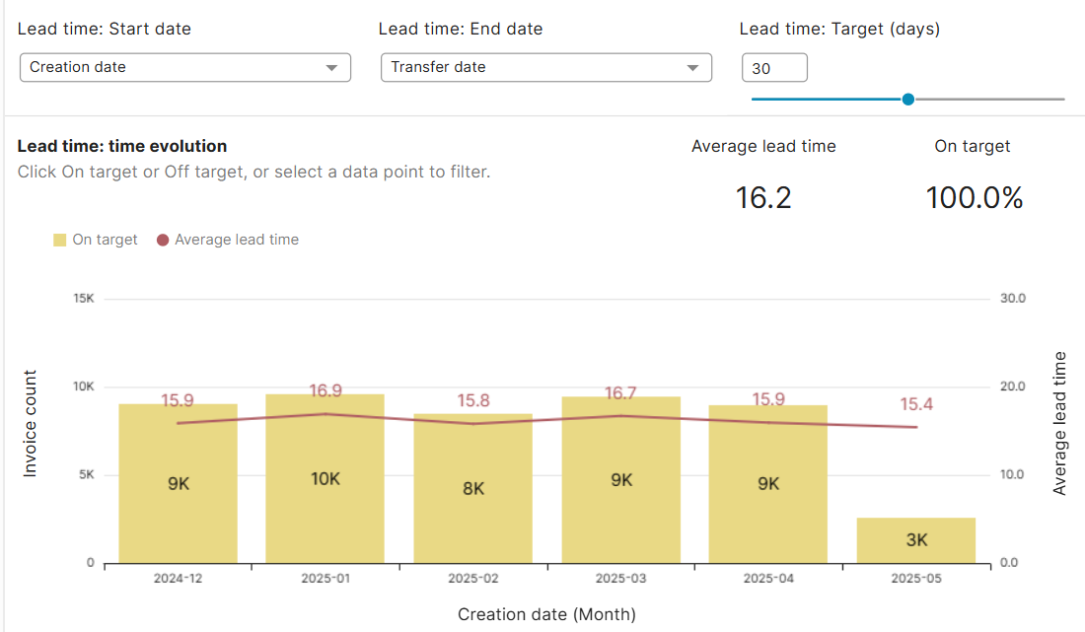
Invoice Processing Time Discovery -
Invoice Lead Time Analysis
Lead Time: Time Evolution
Lead Time: Start date - allows you to select when to start calculating the lead time
Lead Time: End date – allows you to select when the lead time calculation should end
For both, these are the options:
  Creation date (when the invoice enters the AP system)
  Invoice date (from the invoice)
  Voucher date (from the invoice – usually = invoice date)
  Transfer date (when transferred to ERP)
  Payment date (feedback from ERP)
  Due date (from the invoice)

Slide 7
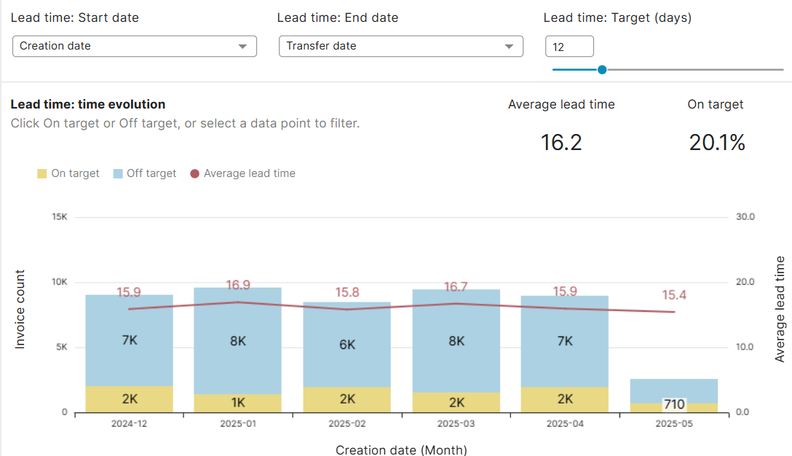
Invoice Processing Time Discovery -
Invoice Lead Time Analysis
Lead Time: Time Evolution
Lead Time: Target (days) allows you to set a target amount of days in which the invoice should move from the set Start Date to the set End date
The graph below will show you the lead times of all of the months (or other time resolution selected in controls)
The red line & numbers are the average lead times for the selected lead time.
The columns will change color and show you the amount of invoices within the set target within the bars
Example on the left:
  Yellow = number of invoices Inside the target
  Blue = Outside of the target

Slide 8
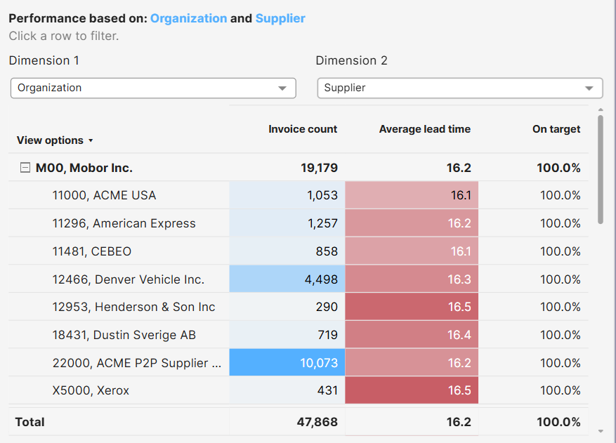
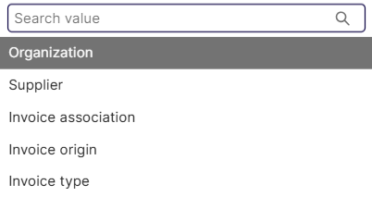
Invoice Processing Time Discovery
Invoice Lead Time Analysis
Performance Based on Dimensions
This dashboard shows ‘Invoice count’, ‘Average lead time’ & ‘% on target’
Select 2 dimensions in the dropdowns to change the first column, and pivot the data based on the following values:

Slide 9
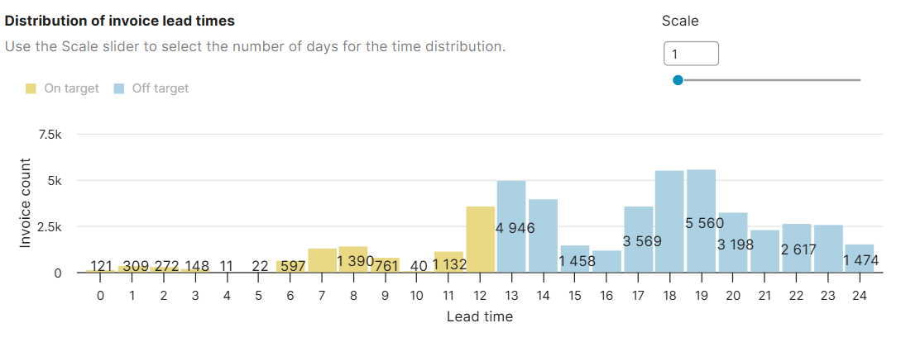
Invoice Processing Time Discovery
Invoice Lead Time Analysis
Distribution of Invoice Lead Times
This graph shows you the invoices per invoice lead time which is affected by the controls above
Yellow will show the on-target lead times, blue will show the off-target lead times
The scale will adjust the bottom axis, and set the intervals
  Example: This is useful if you want to see how many invoices have a lead time for instance +10 or +20 days

Slide 10
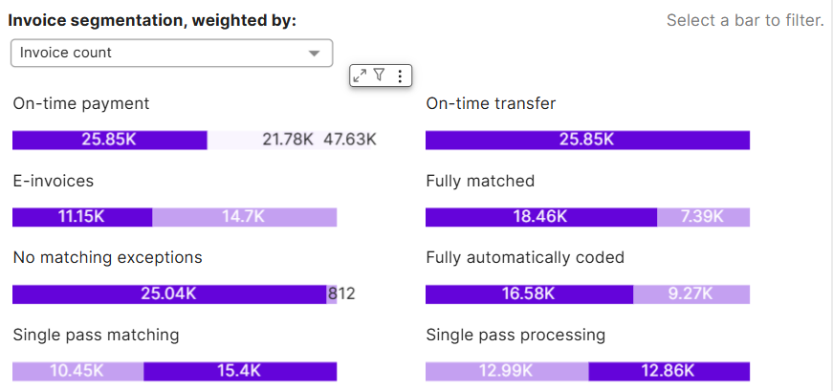
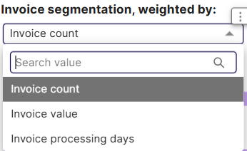
Invoice Processing Time Discovery
Invoice Lead Time Analysis
Invoice Segmentation
This graphic allows you to filter the entire dashboard based on the metrics of ‘On-time payment’, ‘On-time transfer’,’E-Invoices’, ‘Fully matched’, ‘No matching exceptions’, ‘Fully automatically coded’, ‘Single Pass matching’ & ‘Single Pass processing’
You can choose to see the segmentation weight by clicking the drop-down

Slide 11
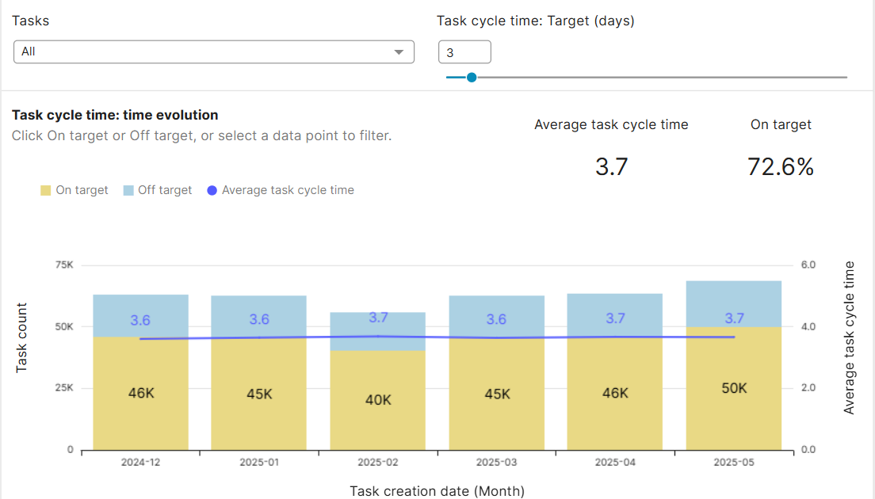
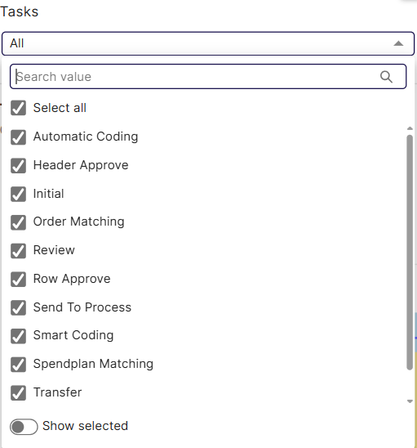
Invoice Processing Time Discovery
Invoice Cycle Time Analysis
Task Cycle Time
Shows the cycle time of invoices on task level
Allows you to set a target which the specific task needs to adhere to

Slide 12
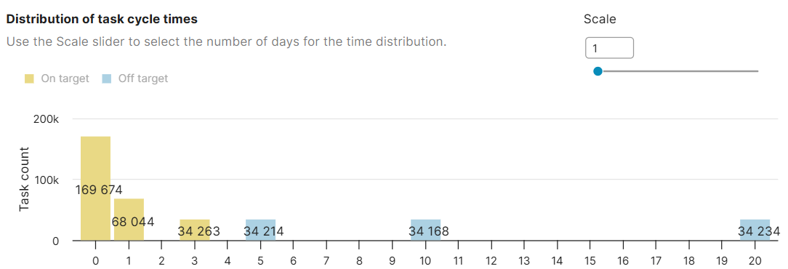
Invoice Processing Time Discovery
Invoice Cycle Time Analysis
Distribution of task Cycle Times
Shows the distribution of Cycle time across all of days for the selected tasks & on-target definition (on the top)
Yellow will show the on-target lead times, blue will show the off-target lead times
The scale will adjust the bottom axis, and set the intervals
  Example: This is useful if you want to see how many invoices have a lead time of for instance +10 or +20 days

Slide 13
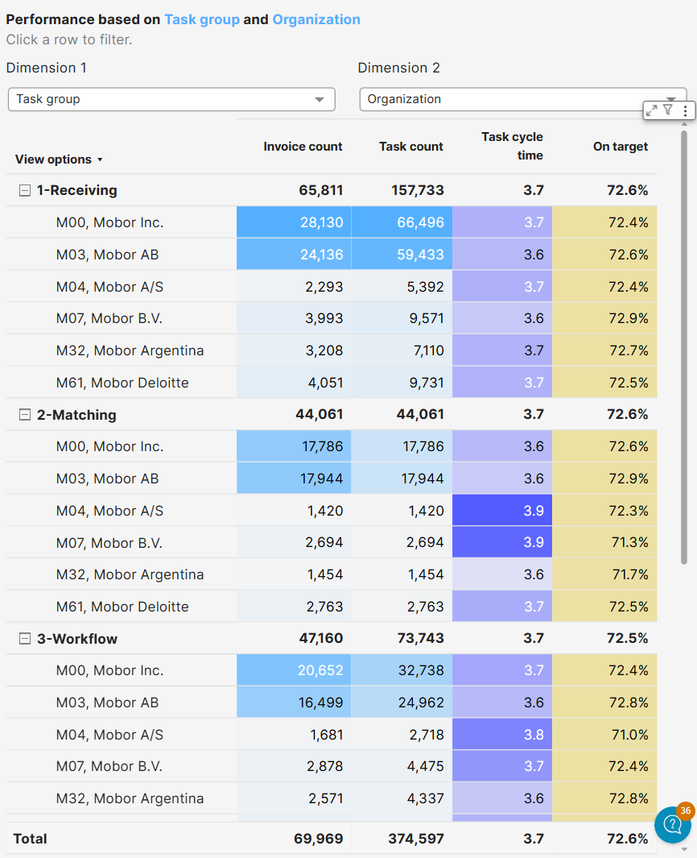
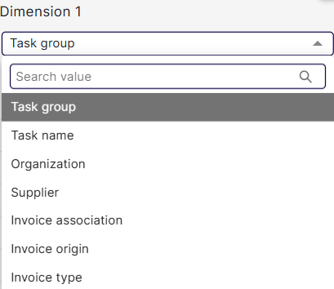
Invoice Processing Time Discovery
Invoice Cycle Time Analysis
Performance based on Dimensions
This dashboard shows ‘Invoice count’, ‘Task count’, ‘Task Cycle Time’ & ‘% on target’
Select 2 dimensions in the dropdowns to change the first column, and pivot the data based on the following values:

