Slide 1
Data & Spend Discovery
Insights Pro
Insights Essentials

Slide 2
Invoice & Spend Data Discovery
Invoice & Spend Data Discovery Summary
Summary of the Reporting:
These dashboards will provide a visual representation of all Invoice header data along with calculated KPIs.
It provides a solution for building invoice data reporting, invoice lists and makes them downloadable.
Features:
All Invoice header fields are available, even custom fields and enriched fields from the network and AP automation
All Invoice data for the last 3 years is available but by default the date filter will be applied for 1 year.
Any user is able to apply dimensions and date filters to the invoice data and view the result.
Any user can download the full data of any search result.
Invoice, supplier and value counts (even per currency) are available, as well as a bar chart to create high level reporting
These dashboards will end the need for building own custom dashboards to have access to intermittent reporting in older solutions, it gives the user free reign over all of the invoice data and will allow for quality data access and reporting

Slide 3
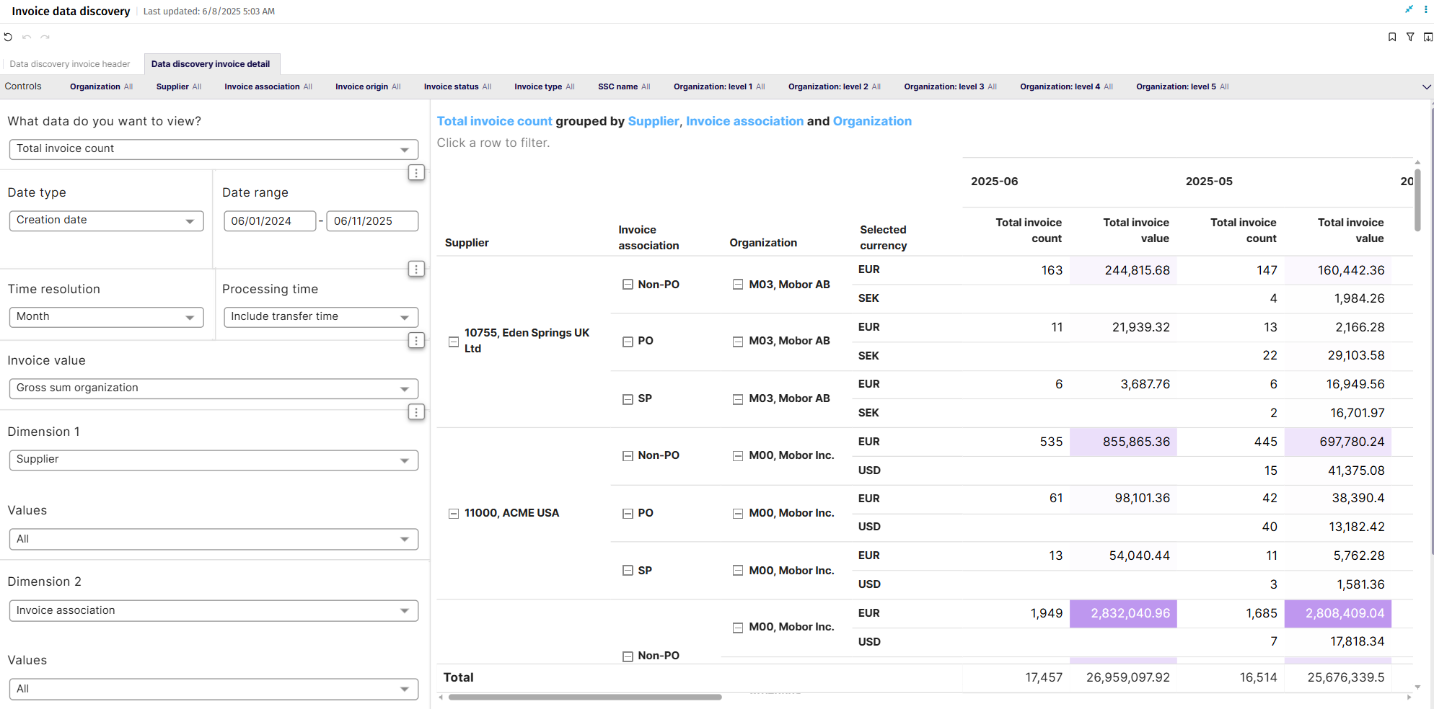
Invoice Data Discovery

Slide 4
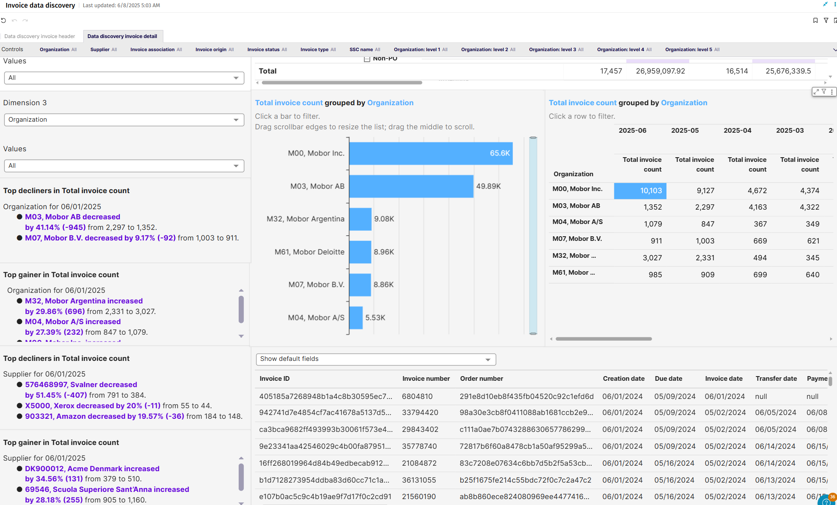
Invoice Data Discovery

Slide 5
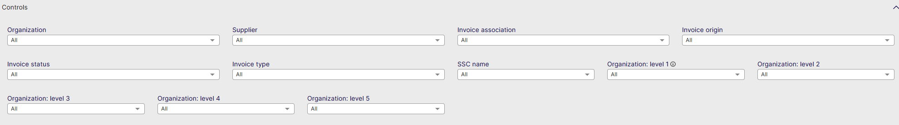
Invoice Data Discovery Controls
Organization: Filter data by your company organizations.
Supplier: Filter data by suppliers.
Invoice Association: Filter data based on whether the invoices are PO, Spend Plan or Non-PO invoices
Invoice Origin: Filter data by invoice origin
Invoice Status: Choose to see the invoices that are in a specific status (Cancelled, Closed, Completed, Matching...)
Invoice Type: Filter data by invoice type.
Invoice Value: Shows data based on Net Sum or Gross Sum but this time also per organization or for the company
Project: Filter Data by internal project
SSC name: Filter per your defined Shared Service Center
Organization Level 1: Filter on the highest level of Organization in AP
Organization Level 2: Filter on the Second highest level of Organization in AP
Organization Level 3: Filter on the Third highest level of Organization in AP
Organization Level 4: Filter on the Fourth highest level of Organization in AP
Organization Level 5: Filter on the Fifth highest level of Organization in AP
Show Invoice List: Show the list of Invoices for the data selected in the dashboard

Slide 6
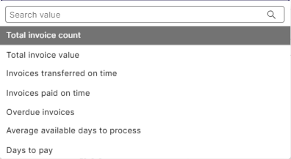
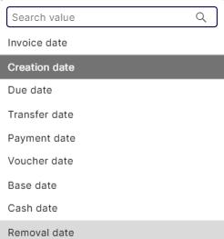
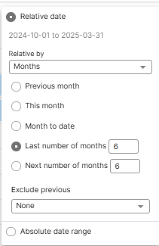
Invoice Data Discovery Header
Top controls for vizualisations

Slide 7
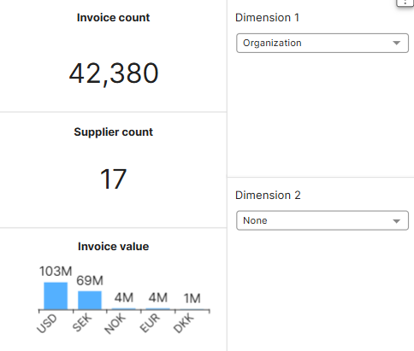
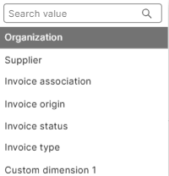
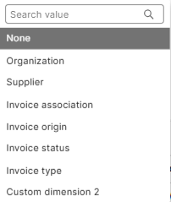
Invoice Data Discovery Header
Main KPI’s
Invoice count: Total number of Invoices
Supplier Count: Total number of suppliers
Invoice Value: Total invoice value per Currency
Dimension 1: Select the first dimension to represent the data in the column to the right
Dimension 2: Select the second dimension to represent the data in the column to the right

Slide 8
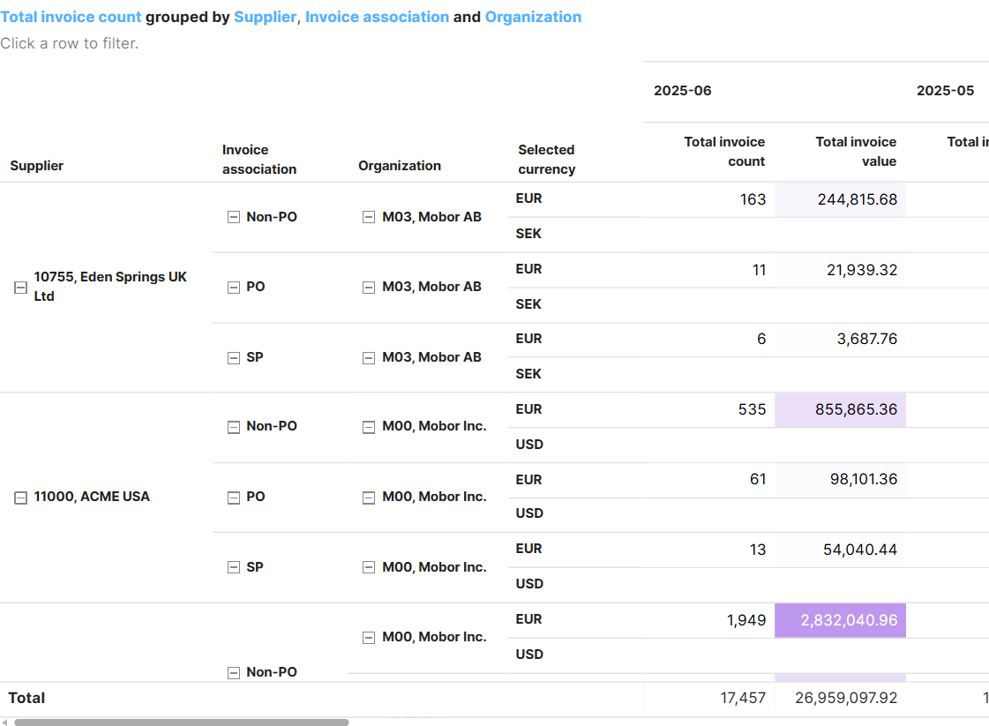
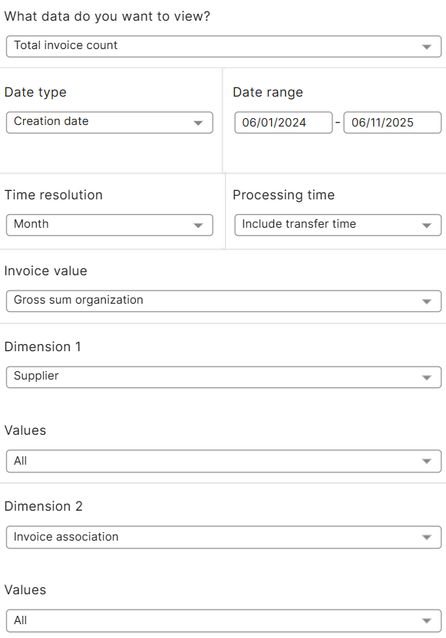
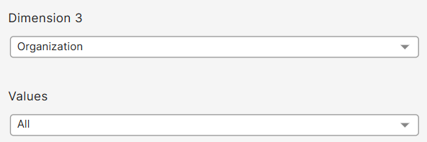
Invoice Data Discovery Details
Vizualization Controls
1
2
3
Use these dimension drop downs and filters to create the data report you want to see from the dashboards
The pivot table and Graphics below will adjust to all filters you set in these controls
All Basware standard fields are available for you to filter on in the main dashboards
All other fields will be available in the Invoice list drop down. All data can be downloaded.
1
3
2

Slide 9
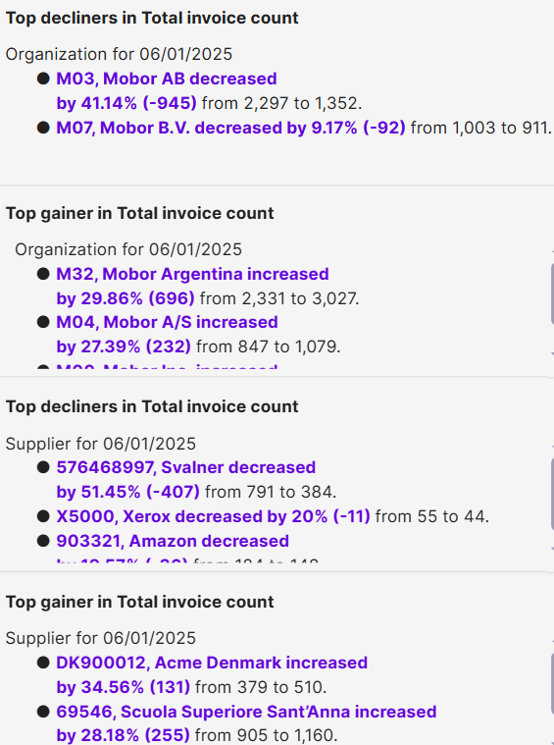
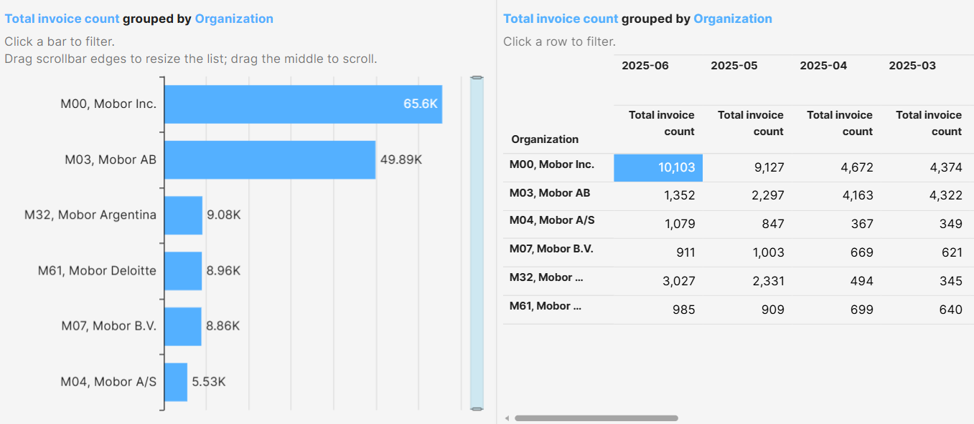
Invoice Data Discovery Details

Slide 10
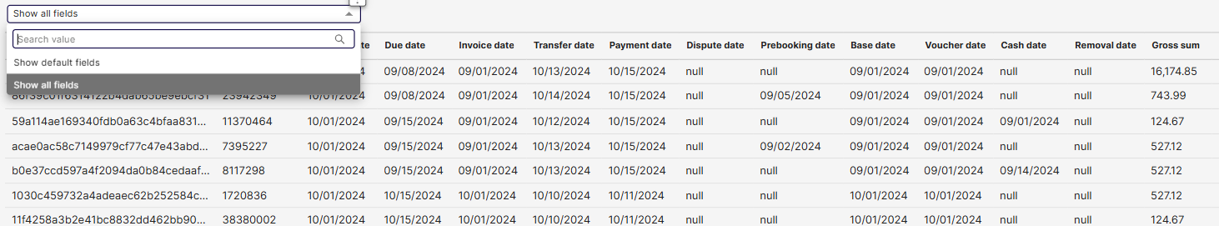
Invoice Data Discovery Details
Invoice List
You can choose to show only Basware’s Default fields, or show all fields, which will expand the data to show all custom fields configured in your AP automation solution
All of this data can be easily downloaded

Slide 11
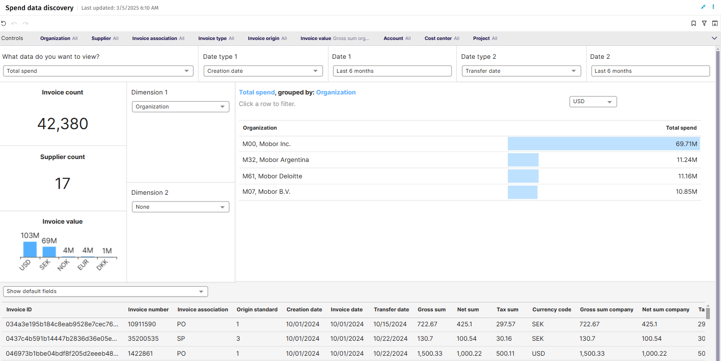
Spend Data Discovery

Slide 12
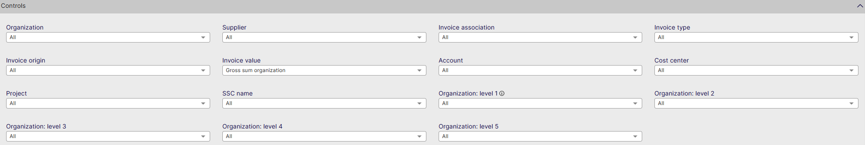
Spend Data Discovery Controls
Organization: Filter data by your company organizations.
Supplier: Filter data by suppliers.
Invoice Association: Filter data based on whether the invoices are PO, Spend Plan or Non-PO invoices
Invoice Type: Filter data by invoice type.
Invoice Origin: Filter data by invoice origin
Invoice Value: Shows data based on Net Sum or Gross Sum but this time also per organization or for the company
Account: Filter data by specific internal account
Cost Center: Filter Data by cost center
Project: Filter Data by internal project
SSC name: Filter per your defined Shared Service Center
Organization Level 1: Filter on the highest level of Organization in AP
Organization Level 2: Filter on the Second highest level of Organization in AP
Organization Level 3: Filter on the Third highest level of Organization in AP
Organization Level 4: Filter on the Fourth highest level of Organization in AP
Organization Level 5: Filter on the Fifth highest level of Organization in AP
Show Invoice List: Show the list of Invoices for the data selected in the dashboard

Slide 13
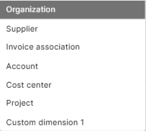
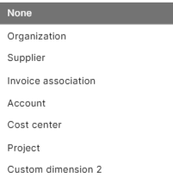
Spend Data Discovery
Main KPI
Invoice count: Total number of Invoices
Supplier Count: Total number of suppliers
Invoice Value: Total invoice value per Currency
Dimension 1: Select the first dimension to represent the data in the column to the right
Dimension 2: Select the second dimension to represent the data in the column to the right

Slide 14
Spend Data Discovery
Invoice List
You can choose to show only Basware’s Default fields, or show all fields, which will expand the data to show all custom fields configured in your AP automation solution

Slide 15
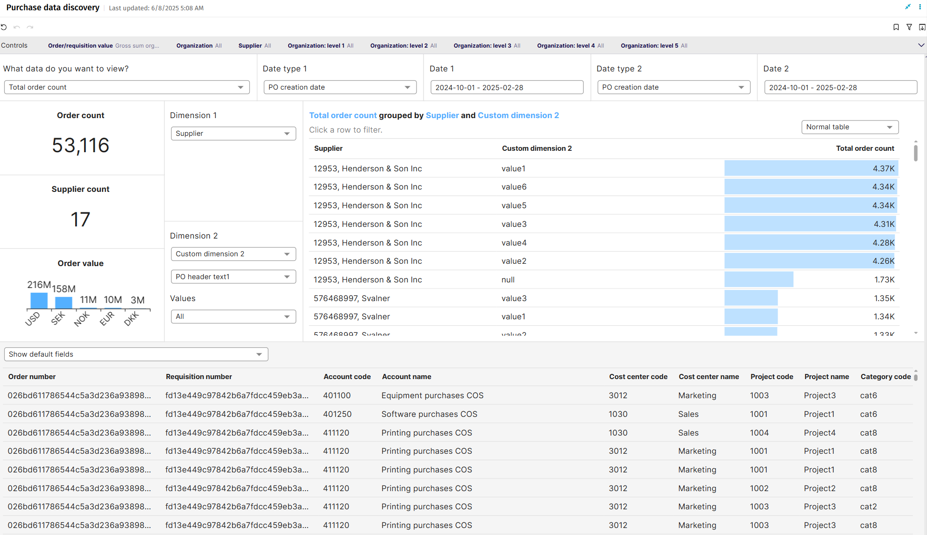
Purchase Data Discovery

Slide 16
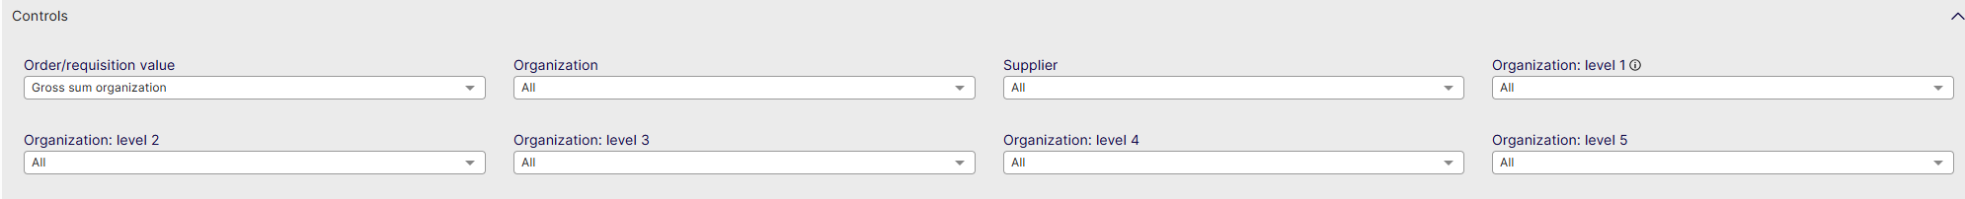
Purchase Data Discovery Controls
Order/Requisition value: Filter data on gross sum per organization/gross sum per company/net sum per company/net sum per organization
Organization: Filter data by Organization.
Supplier: Filter data on a specific Supplier.
Organization Level 1: Filter on the highest level of Organization in AP
Organization Level 2: Filter on the Second highest level of Organization in AP
Organization Level 3: Filter on the Third highest level of Organization in AP
Organization Level 4: Filter on the Fourth highest level of Organization in AP
Organization Level 5: Filter on the Fifth highest level of Organization in AP
Show Invoice List: Show the list of Invoices for the data selected in the dashboard

Slide 17
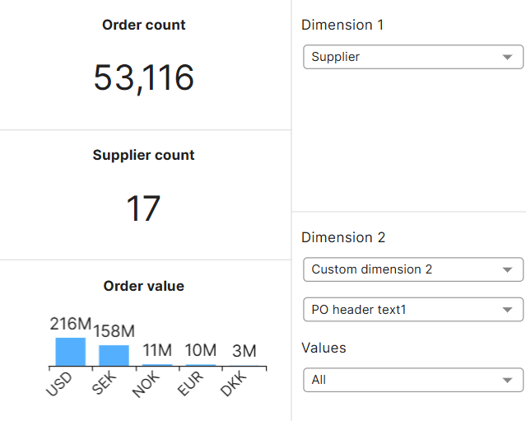
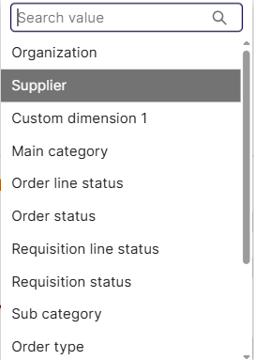
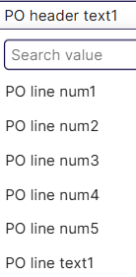
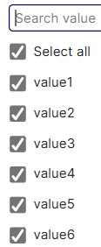
Purchase Data Discovery
Main KPI
Order count: Total number of Orders
Supplier Count: Total number of suppliers
Invoice Value: Total order value per Currency
Dimension 1: Select the first dimension to represent the data in the column to the right
Dimension 2: Select the second dimension to represent the data in the column to the right
PO header text: Line numbers

Slide 18
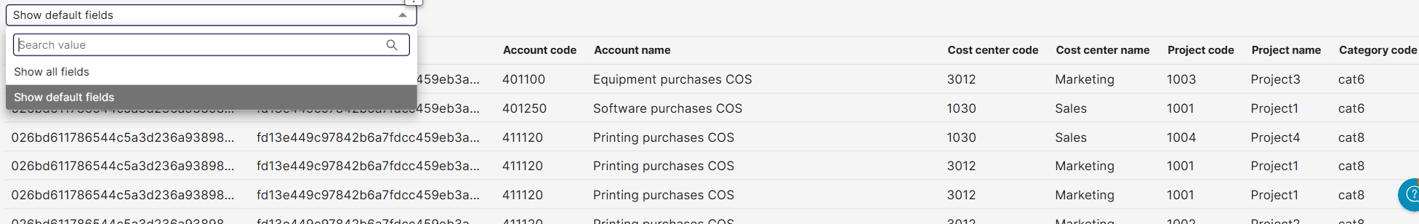
Purchase Data Discovery
Invoice List
You can choose to show only Basware’s Default fields, or show all fields, which will expand the data to show all custom fields configured in your Procurement/ AP automation solution

