Slide 1
Ask & Analyse
Insights Pro

Slide 2
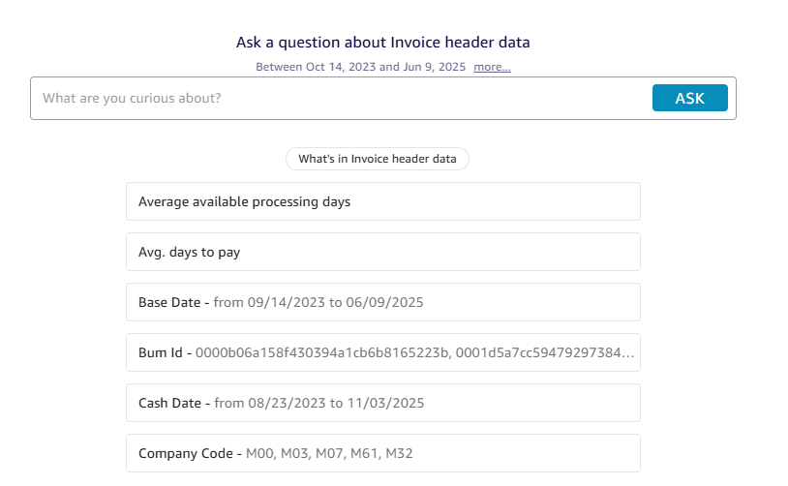
Ask & Analyse
Ask & Analyse
AI driven results based on Invoice Header data (The AI is not trained on line level information yet)
Type in your Question in the text box and press the ‘ask’ button
The system will interpret your question based on it’s learnings and the information it has available.
For the best results, please be as detailed as possible in phrasing your question

Slide 3
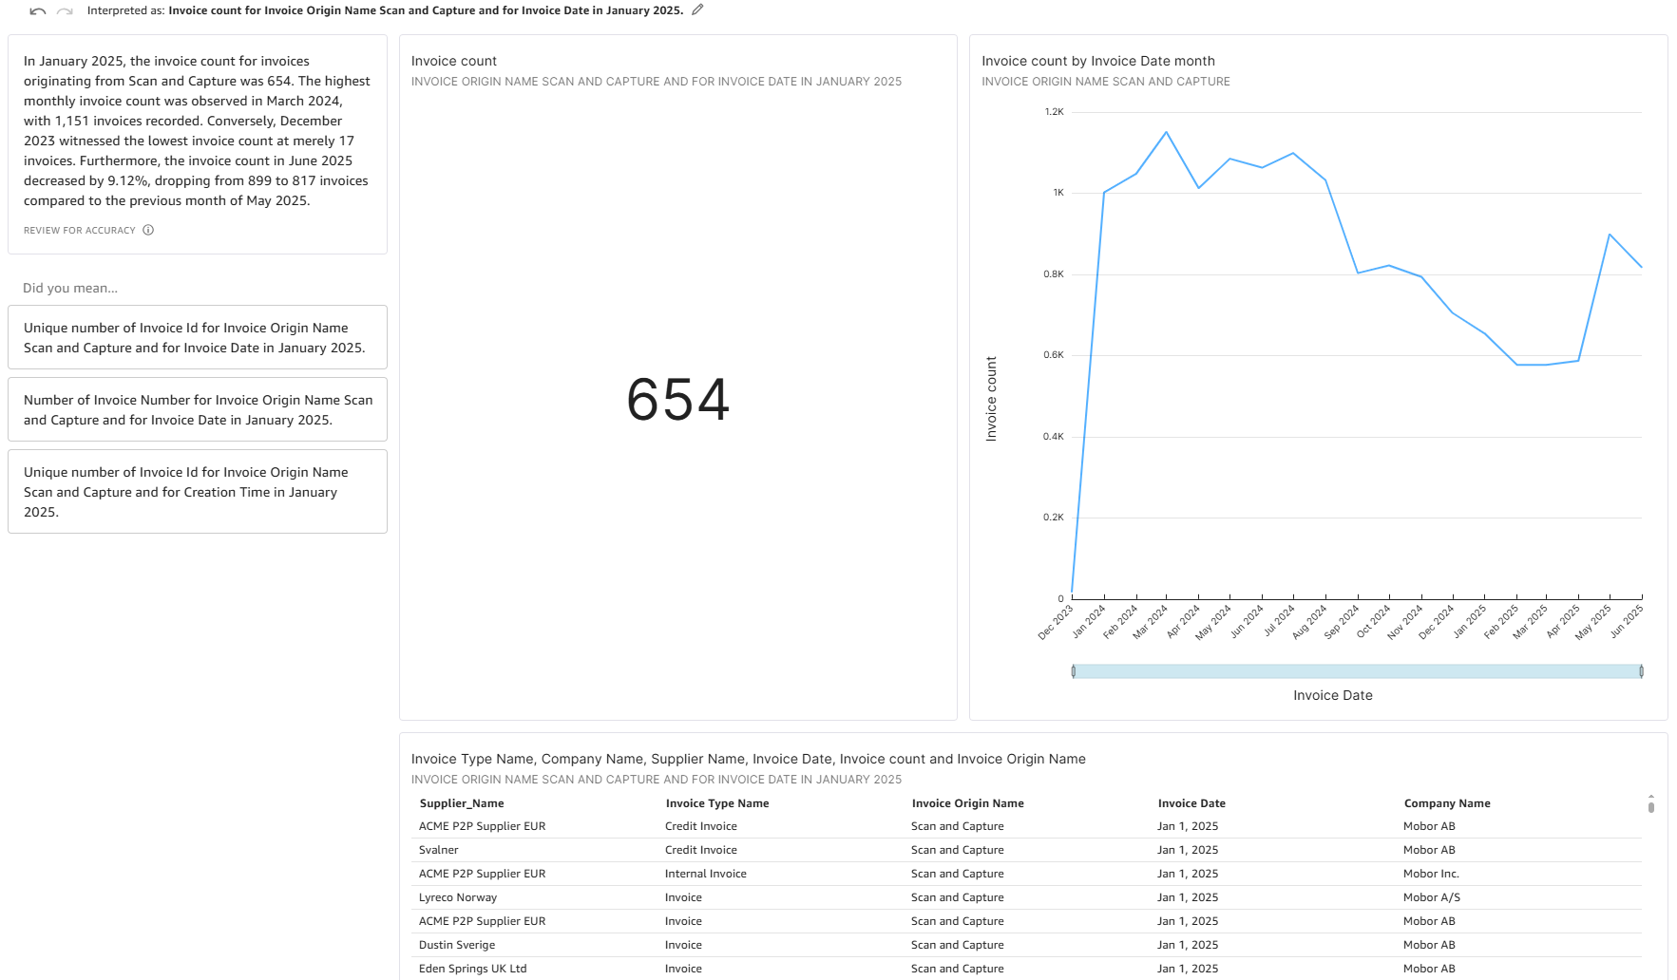
Ask & Analyse
Example 1 :

Slide 4
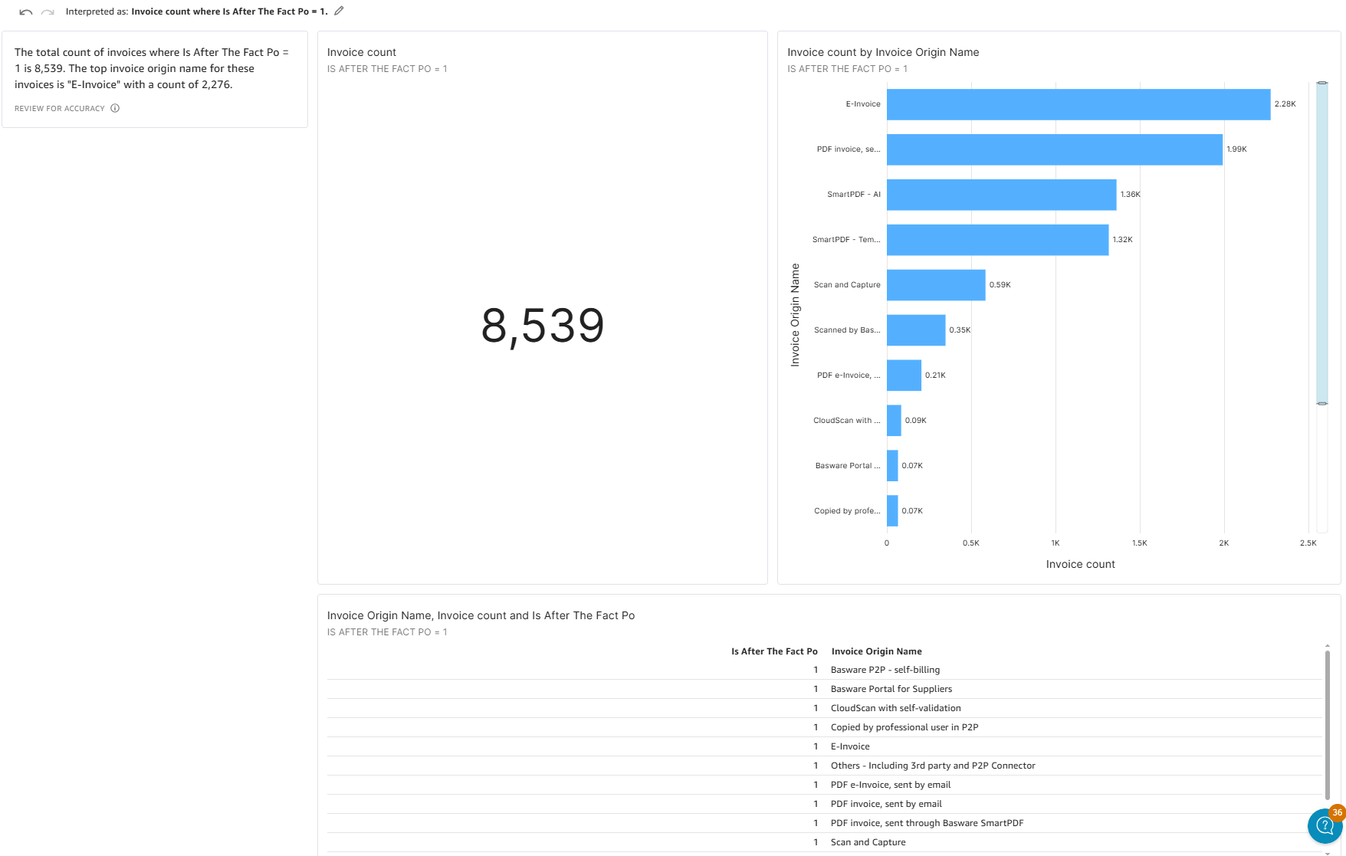
Ask & Analyse
Example 2 :

